Slide 1


Characterizing Applications
Runtime Behavior from
System Logs and Metrics
Raghul Gunasekaran, David Dillow, Galen Shipman
Oak Ridge National Laboratory
Richard Vuduc, Edmond Chow
Georgia Institute of Technology

Slide 2
Introduction
Compute Environment
  Dedicated resources
    Compute (processors)
    Memory
  Shared resources
    Network
    I/O (filesystem)
Applications libraries are optimized to attain the best performance on dedicated resources.
Shared resource contention
  Longer and variable runtime
  Degraded application performance
  Adversely affects scientific productivity

Slide 3
Introduction
“Runtime Characteristics”
Specifically model applications shared resource needs
“User-Application” Characteristics
  Varies from user to user, based on science needs.
  #nodes, dimensions of compute grid
  I/O usage (frequency of checkpointing)
A distribution of the number of applications running concurrently on Jaguar XT5

Slide 4
Introduction
Need to Characterize individual “user-applications”
Solution Requirements
  Zero or negligible overhead
  No impact on system/application performance
  Monitor continuously in real-time
Current tools
  Fine grained details of application behavior
  High overhead (at least 4-10%)
    Compute cycles
    Bandwidth for writing trace
  Restricted usage on production systems

Slide 5
Application Runtime Characteristics
Our Approach
  System logs and metrics
  Estimate shared resource needs of user-applications
  Build a profile for individual user-application
Present preliminary findings
  Identifying logs events and metrics that can be used for characterizing application
  Benefits of application profiling
    Anomaly Detection
    Context-aware Scheduling
    Observed shared resource conflicts on Jaguar XT5

Slide 6
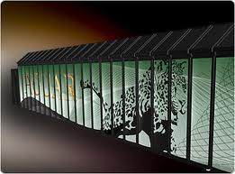
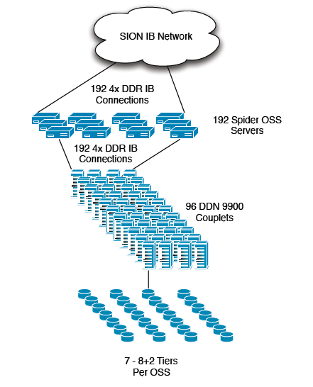
Compute Platform
Jaguar Cray XT5
18688 compute nodes
Compute Node
  Two 2.4GHz hex-core AMD Opteron's
  16GB memory
SeaStar interconnect
  Peak bidirectional BW 9.6 GB/s
  Sustained BW of over 6GB/s
Connects to storage via 192 I/0 nodes
Spider center-wide Lustre Filesystem
Peak bandwidth 240 GB/s
192 OSS → 96 RAID controller → 13440 1TB drives
Analyzed
4 months of system logs and metrics.
10 most frequent applications
Spider – Center wide Lustre File system

Slide 7
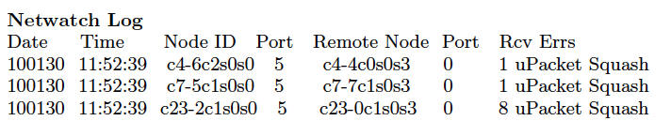
Application Runtime Characteristics
Netwatch(RAS) log
  3D Interconnect link status
  Sampled periodically at the SeaStar interconnect
  uPacket squash error
    Link-layer message
    Indicative of number of retransmissions on a link
    Reported for data loss, data corruption
    Bad Link (Hardware error)
      Links reporting errors over long periods are replaced
Sample netwatch log entries

Slide 8
Application Runtime Characteristics
Netwatch(RAS) log
  Strong correlation between packet squash and applications
  Observation from 3 different applications
    App-1 – I/O intensive
    App-3 – MPI
    App-4 – Global Arrays
    (App-3 and App-4 heavy inter-process communication)
  Conclusion: Able to observe know application behavior from error logs
Netwatch log stats for 3 different applications

Slide 9
Application Runtime Characteristics
File System Utilization
Usage stats from RAID controller
Zero overhead
  Stats captured over the system’s management network (ethernet)
CDF of I/O utilization of a specific user
Typical file system write bandwidth utilization in a day

Slide 10
Application Runtime Characteristics
File System Utilization
  Interested in applications with peak usage over 5 GB/s
  For short jobs (few minutes), directly capturing the CDF over multiple runs
    Avoid runs with large variance
  For long jobs (checkpointing)
    Autocorrelation function, capturing the periodicity
Write Bandwidth Utilization by three different applications

Slide 11
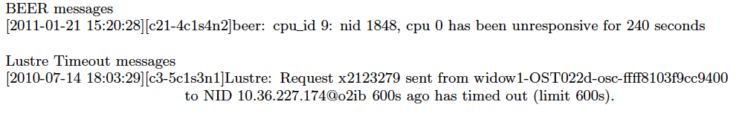
Application Runtime Characteristics
Other log messages/events
  Indicative of the progress of the application
Sample console log messages
BEER (Basic End-to-End Reliability) protocol
- reliable communication between pair of NIDs
- observed for MPI jobs
File System Timeout Messages
- indicates node did not get a response from the storage system
- retransmits request after a timeout period

Slide 12
Application Profiling
Profile individual applications
  Runtime characteristics
  Shared Resource needs
    Network utilization
    I/O bandwidth usage
  From our observations on Jaguar, most scientific users have one or more fixed job allocation models
  Model ‘typical’ run of application
    From observation made over multiple runs
  The model serves as an acceptable or expected behavior of an application in a shared resource environment

Slide 13
Benefits of Application Profiling
Anomaly Detection
  Deviation from expected behavior of application
  Cause or victim
    The application might be at fault
    The application may have been affected by other applications sharing the compute platform
  Example Observations:
  Application profiled not to be communication intensive
    Observed heavy packet squash, user fault
  Multiple I/O intensive jobs run concurrently
    Observed peak-utilization of file system
    Longer application runtime

Slide 14
Benefits of Application Profiling
Identifying Inter-job interference
Observed Example 1:
  App1 – MPI intensive
    Heavy inter-process communication, observed upacket squashes
  App2 – I/O intensive
    File system usage observed
    File system timeout messages → increased application runtime
App2 was affected by App1 has both MPI and I/O heavily rely on the 3D Torus interconnect
Observed Example 2:
- Non-contiguous node assignment affects MPI jobs
  - Jobs allocations based on node availability, not resource availability
Better Scheduler Design
  Understanding application’s resource needs

Slide 15
Conclusions & Future Work
Exascale System
  Heterogeneous compute nodes 15-18k
  Limited shared resources – Interconnect and I/O
  More number of applications share the compute platform
Demands
  Characterization of applications and performance impacts based on shared resource needs
  Continuous monitoring and learning framework profiling application runtime characteristics
Continue our work profiling application runtime characteristics and resource needs, leveraging machine learning techniques.
Design of Context-Aware Scheduler.

Slide 16
Thank You
Questions ?
This research used resources of the Oak Ridge Leadership Computing Facility, located in the National Center for Computational Sciences at Oak Ridge National Laboratory, which is supported by the Office of Science of the Department
of Energy under Contract DE-AC05-00OR22725.

