Slide 1
Implementing Large Scale FFTs on Heterogeneous Multicore Systems
Yan Li¹, Jeff Diamond², Haibo Lin¹,
Yudong Yang³, Zhenxing Han³
June 4th, 2011
¹IBM China Research Lab, ²University of Texas at Austin, ³IBM Systems Technology Group

Slide 2
Current FFT Libraries
2nd most important HPC application
after dense matrix multiply
Post-PC emerging applications
Power efficiency
custom VLSI / augmented DSPs
Increasing interest in heterogeneous MC
Target original HMC - IBM Cell B. E.
Notes:
This work was done in 2008

Slide 3
FFT on Cell Broadband Engine
Best implementations not general
FFT must reside on single accelerator (SPE)
Not “large scale”
Only certain FFT sizes supported
Not “end to end” performance
First high performance general solution
Any size FFT spanning all cores on two chips
Extensible to any size
Performance 50% greater
Notes:
Just focused on throughput speed of inner kernel

Slide 4
Paper Contributions
First high performance, general FFT library on HMC
67% faster than FFTW 3.1.2 “end to end”
36 FFT Gflops for SP 1-D complex FFT
Explore FFT design space on HMC
Quantitative performance comparisons
Nontraditional FFT solutions superior
Novel factorization and buffer strategies
Extrapolate lessons to general HMC
Notes:
High performance
Explain that FFTW 3.1.2 is version super optimized for Cell.

Slide 5
Talk Outline
Introduction
Background
Fourier Transform
Cell Broadband Engine
FFT Implementation
Results
Conclusion
Notes:
That was the introduction
What’s hard? What’s end to end?
How does it compare to GPUs and emerging HMC, what features help with FFT?

Slide 6
Fourier Transform is a Change of Basis
iY
P•(cos θ, i sin θ) = Pe^{iθ}
P(x,y)
θ
X
Complex Unit Circle
Notes:
What to convert a quantity like time and amplitude into another quantity like frequency and amplitude…
How do you find the component of a vector in a given direction? Dot product.
Dot product works for a static vector, it also works for continuous and discrete functi on. Here we get a single point mapped onto a single angle…
We can express frequencies as the coordinates of an imaginary unit circle and express it compactly as an imaginary exponent

Slide 7
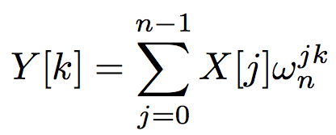
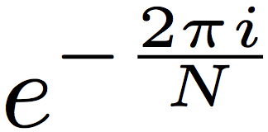
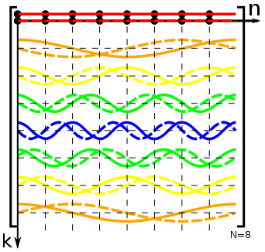
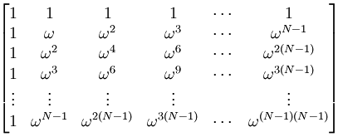
Discrete Fourier Transform
ω_{N} =
Y[k] =
•X[j]
Cost is Order(N²)
* Graphs from Wikipedia entry “DT-matrix”
Notes:
There’s a normalization factor we’re not showing…
Look at the k factor

Slide 8
Fast Fourier Transform
J. Cooley and J Tukey, 1965
n = n1 * n2
Can do this recursively, factoring n1 and n2 further…
For prime sizes, can use Rader’s algorithm:
Increase FFT size to next power of 2
Perform two FFTs and one inverse FFT to get answer
Notes:
J. Cooley and J. Tukey. An algorithm for the machine computation of the complex fourier series. Mathematics of Computation, 19:297–301, 1965. Can show with basic algebra.
Note that you’re doing this for each Y point as a function of k1 and k2. Y is frequency domain.
Inner parenthesis is an ordinary DFT of size n1. Note the strided acess.
Outer edges are just a normal DFT of size n2 using the results of the earlier fourier transform. Note that each of the outer DFTs start in consecutive locations in memory (j2)
One term doesn’t fit – unity factors based on the original n. These are called twiddle factors. (Fudge factors.)
Note strided and sequential access -> we can view strided access as across the rows of a matrix.
Note how the inside and far right term looks just like another FFT of size n2, but there was one extra term over all n called the twiddle.
We can express this kind of strided access in the form of a 2-D matrix.

Slide 9
Cooley-Tukey Example
Highest level is simple factorization
Example: N = 35, row major
0 | 1 | 2 | 3 | 4 | 5 | 6
7 | 8 | 9 | 10 | 11 | 12 | 13
14 | 15 | 16 | 17 | 18 | 19 | 20
21 | 22 | 23 | 24 | 25 | 26 | 27
28 | 29 | 30 | 31 | 32 | 33 | 34
Notes:
Viewing a 1D set of points as a 2D matrix of dimensions n1 and n2, which are 5 and 7. Imagine them laid out in row major order sequentially in memory,

Slide 10
Cooley-Tukey Example
Step 1: strided 1-D FFT across columns
0 | 1 | 2 | 3 | 4 | 5 | 6
7 | 8 | 9 | 10 | 11 | 12 | 13
14 | 15 | 16 | 17 | 18 | 19 | 20
21 | 22 | 23 | 24 | 25 | 26 | 27
28 | 29 | 30 | 31 | 32 | 33 | 34
Replaces columns with all new values
Notes:
Need to do a gather for each column, then do an FFT on it. This now leaves these columns sequential in local memory.

Slide 11
Cooley-Tukey Example
Step 2: multiply by twiddle factors
1 | 1 | 1 | 1 | 1 | 1 | 1
1 | W | W² | W³ | W⁴ | W⁵ | W⁶
1 | W² | W⁴ | W⁶ | W⁸ | W¹⁰ | W¹²
1 | W³ | W⁶ | W⁹ | W¹² | W¹⁵ | W¹⁸
1 | W⁴ | W⁸ | W¹² | W¹⁶ | W²⁰ | W²⁵
(Ws are base N=35)
Exponents are product of coordinates
Notes:
Multiply with global twiddle factors, the extra term.
Looks like the original unfactorized DFT.

Slide 12
Cooley-Tukey Example
Step 3: 1-D FFT across rows
0 | 1 | 2 | 3 | 4 | 5 | 6
7 | 8 | 9 | 10 | 11 | 12 | 13
14 | 15 | 16 | 17 | 18 | 19 | 20
21 | 22 | 23 | 24 | 25 | 26 | 27
28 | 29 | 30 | 31 | 32 | 33 | 34
Replaces rows with all new values
This gather is all-to-all communication
Notes:
Unfortunately, this now requires another blocking transpose, because you had just gathered up the columns.
This is the all-to-all communication step in a parallel FFT.

Slide 13
Cooley-Tukey Example
Frequencies are in the wrong places.
0 | 5 | 10 | 15 | 20 | 25 | 30
1 | 6 | 11 | 16 | 21 | 26 | 31
2 | 7 | 12 | 17 | 22 | 27 | 32
3 | 8 | 13 | 18 | 23 | 28 | 33
4 | 9 | 14 | 19 | 24 | 29 | 34
Step 4: do final logical transpose
Really a scatter
Notes:
Because in initial equation, the answer was in reverse stride
Why 4 instead of 6 steps? Because in parallel version two synchronizations must be done to make sure data has arrived before next FFTs can begin.

Slide 14
Talk Outline
Introduction
Background
FourierTransform
Cell Broadband Engine
FFT Implementation
Results
Conclusion
Notes:
What’s hard? What’s end to end?
How does it compare to GPUs and emerging HMC, what features help with FFT?

Slide 15
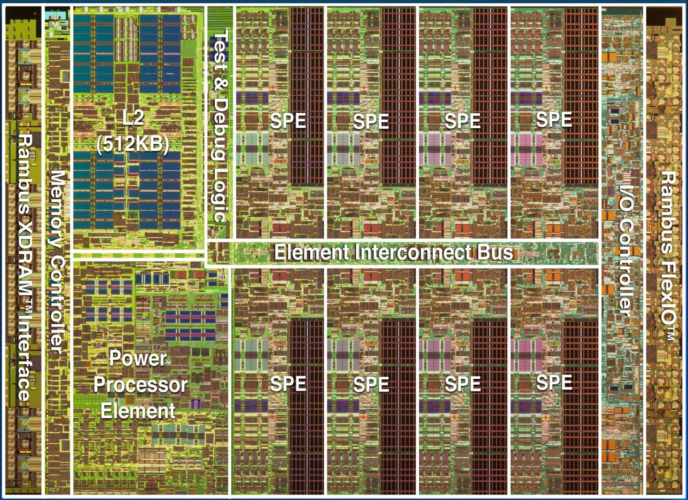
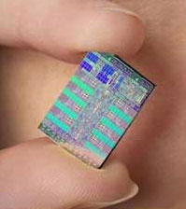
First Heterogeneous Multicore
Cell 2006 – 90nm, 3.2 GHz – a Low Latency Throughput Architecture
234MT, 235mm^2, 204 SP GFLOPS
25.6 GB/sec bidirectional ring bus, 1 cycle hop
256KB scratchpad per SPE, 6-cycle latency
4-wide, dual issue 128-bit SIMD, 128 registers
SPE DMA control with true scatter/gather via address list
8 vector processors
64-bit PowerPC
Notes:
Well ahead of time. Mention use in RoadRunner. Point about Cell2 cancellation in 2008, cmp with GeForce 7800
Compare with GPU -> emphasize this is a high frequency, low latency throughput architecture, needs just 6 threads to cover latency, use explicit ILP, more powerful ISA, much more efficient than GPU
Need less threads, more resources per thread.

Slide 16
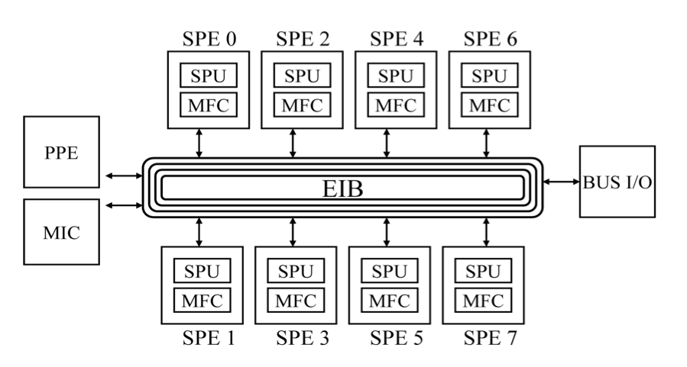
IBM BladeCenter Blade
Dual 3.2 Gz PowerXCell 8i
8GB DDR2 DRAM over XDR interface
Notes:
Same blade used in RoadRunner Supercomputer
Double precision enhanced
Show ring bus is logically extended over a direct link to create 16 SPUs.

Slide 17
Talk Outline
Introduction
Background
Fourier Transform
Cell Broadband Engine
FFT Implementation
Results
Conclusion
Notes:
What’s hard? What’s end to end?
How does it compare to GPUs and emerging HMC, what features help with FFT?

Slide 18
Key Implementation Issues*
Communication Topology
Centralized (classic accelerator)
Peer to peer
FFT factorization
Scratchpad allocation
Twiddle computation
* For additional implementation details, see IPDPS 2009 paper
Notes:
Briefly highlight three issues
Continually found that winning design points were very different from classic architectures
Note prior publication in IPDPS 2009: “A performance model for fast fourier transform.”

Slide 19
1. Communication Topology
Notes:
Accelerator paradigm of having fat core give out work to accelerators and collect results was inferior
Peer to peer strategy about 11% faster… example where it’s good to have autonomous thin cores
Going with P2P leads us to a novel factorization strategy…
Next issue – Factorization strategy

Slide 20
2. Factorization Strategy (N1xN2)
Extreme aspect ratio – nearly 1-D
Choose N1 = 4 x number of SPEs
Each SPU has exactly 4 rows
Each row starts on consecutive addresses
Exact match for 4-wide SIMD
Exact match for 128-bit random access and DMA
Use DMA for scatters and gathers
All-to-all exchange, initial gather, final scatter
Need to store large DMA list of destinations
Notes:
Nominally just 1 row per SPU, but we use SIMD to 4 rows at same time starting at consecutive addresses

Slide 21
Less SPEs Improves Throughput
Notes:
We often wish to do many FFTs at the same time.

Slide 22
3. Allocating Scratchpad Memory
Need to store EVERYTHING in 256KB
Code, stack, DMA address lists, buffers…
64KB for 8,192 complex points
64KB for output (FFT result) buffer
64KB to overlap communication
Only 64KB left to fit…
120KB for kernel code
64KB for twiddle factor storage
Notes:
Situation worse than conventional case with separate instruction cache
How do we fit the remaining 184KB into less than 64KB?

Slide 23
Multimode Twiddle Buffers
Allocate 16KB in each SPU
Supports local FFTs up to 2,048 points
Three Kernel Modes
< 2KP, use twiddle factors directly
2KP-4KP, store half and compute rest
4KP-8KP, store ¼ and compute rest
Only 0.5% performance drop
Leaves 30KB for code
Dynamic code overlays

Slide 24
Talk Outline
Introduction
Background
Fourier Transform
Cell Broadband Engine
FFT Implementation
Results
Conclusion
Notes:
What’s hard? What’s end to end?
How does it compare to GPUs and emerging HMC, what features help with FFT?

Slide 25
FFT Is Memory Bound!
Transfer takes 42-400% longer than entire FFT
Notes:
On average, xfer takes 42% more time. Off-chip transfer is 5x slower if user didn’t initialize his output array. (Get TLB initialization page misses)
Another example where implementation differs from traditional. Certainly didn’t need to optimize kernel further…)
Point about the most important part of the operation occurring outside of your library

Slide 26
67% faster than state of the art
Excellent power of two performance
Notes:
“end to end performance” -> POINT OUT POWER OF 2 speeds extra high compared with cache based systems like Power7
Avg performance FFT GFLOPS 28.87 9.01 18.63, avg speedup was 220.33% 55.01%
Comparing with version of FFTW specially optimized to exploit the features of the Cell. 3.1.1 was half the speed!

Slide 27
Conclusion
Best in class general purpose FFT library
67% faster than FFTW 3.2.2
Heterogeneous MC effective platform
Different implementation strategies
Peer-to-peer communication superior
Case for autonomous, low latency accelerators
Notes:
In future must focus on off chip memory bottleneck by reducing latencies throughout chip to reduce thread count and add on-chip memory.

Slide 28
Thank You
Any Questions?

