Slide 1
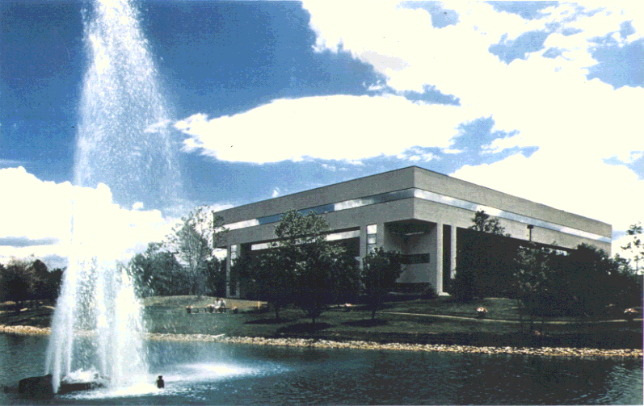
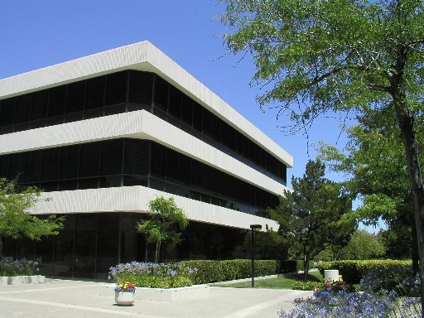
OpenFOAM on a GPU-based Heterogeneous Cluster
Rajat Phull,
Srihari Cadambi, Nishkam Ravi and Srimat Chakradhar
NEC Laboratories America
Princeton, New Jersey, USA.
www.nec-labs.com

Slide 2
OpenFOAM Overview
OpenFOAM stands for:
‘Open Field Operations And Manipulation’
Consists of a library of efficient CFD related C++ modules
These can be combined together to create
solvers
utilities (for example pre/post-processing, mesh checking, manipulation, conversion, etc)

Slide 3
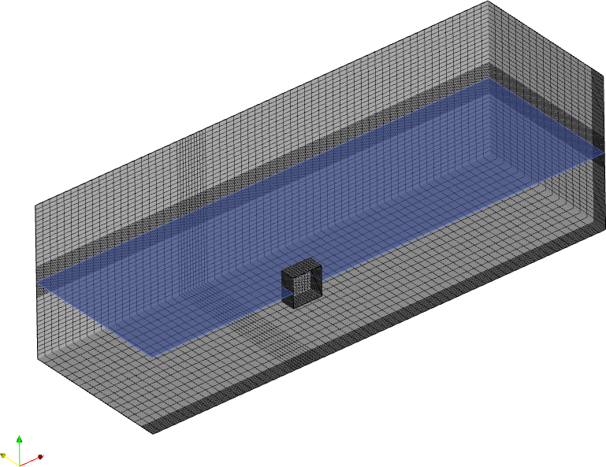
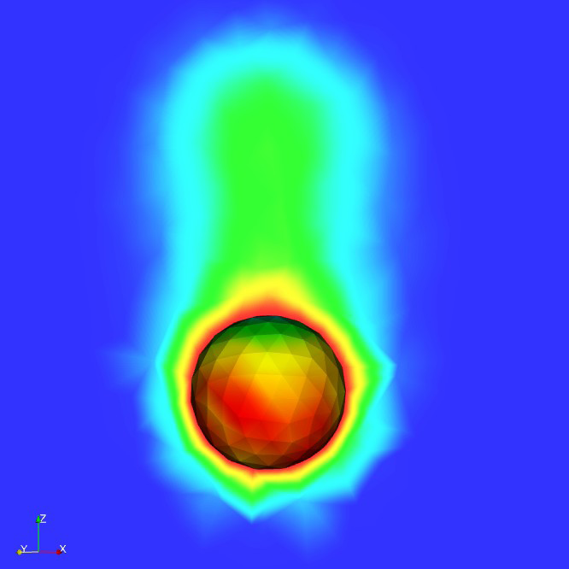
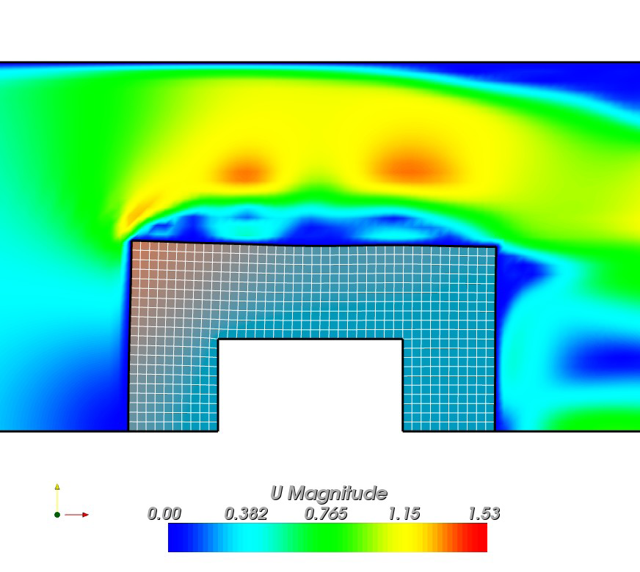
OpenFOAM Application Domain: Examples
Buoyancy driven flow:
Temperature flow
Fluid Structure Interaction
Modeling capabilities used by aerospace, automotive, biomedical, energy and processing industries.

Slide 4
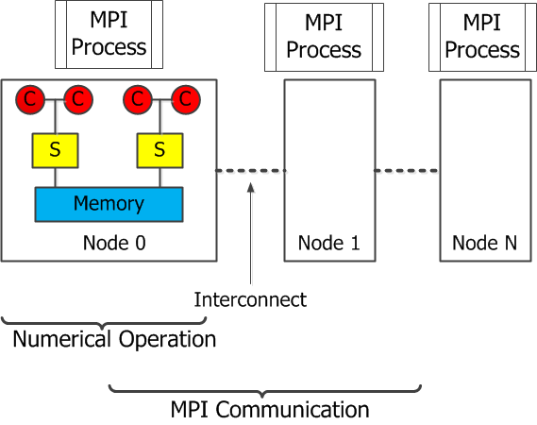
OpenFOAM on a CPU clustered version
Domain decomposition: Mesh and associated fields are decomposed.
Scotch Practitioner

Slide 5
Motivation for GPU based cluster
OpenFOAM solver on a CPU based cluster
Each node: Quad-core 2.4GHz processor and 48GB RAM
Performance degradation with increasing data size

Slide 6
This Paper
Ported a key OpenFOAM solver to CUDA.
Compared performance of OpenFOAM solvers on CPU and GPU based clusters
Around 4 times faster on GPU based cluster
Solved the imbalance due to different GPU generations in the cluster.
A run-time analyzer to dynamically load balance the computation by repartitioning the input data.

Slide 7
How We Went About Designing the Framework
Profiled representative workloads
Computational Bottlenecks
CUDA implementation for clustered application
Imbalance due to different generation of GPUs or nodes without GPU
Load balance the computations by repartitioning the input data

Slide 8
InterFOAM Application Profiling
Straightaway porting on GPU → Additional data transfer per iteration.
Avoid data transfer each iteration→Higher granularity to port entire solver on the GPU
Computational Bottleneck

Slide 9
PCG Solver
Iterative algorithm for solving linear systems
Solves Ax=b
Each iteration computes vector x and r, the residual r is checked for convergence.

Slide 10
InterFOAM on a GPU-based cluster
Convert Input matrix A from LDU to CSR
Transfer A, x0 and b to GPU memory
Kernel for Diagonal preconditioning
CUBLAS APIs for linear algebra operations. CUSPASE for matrix vector multiplication
No
Communication requires intermediate vectors in host memory. Scatter and Gather kernels reduces data transfer.
Converged?
Yes
Transfer vector x to host memory

Slide 11
Cluster with Identical GPUs : Experimental Results (I)
Problem Size | Time(s)
 | 1 Node (4-cores) | 2 Nodes (8-cores) | 3 Node (12-cores) | 1 Node (2 CPU cores + 2-GPUs) | 2 Nodes (4 CPU cores + 4-GPUs) | 3 Nodes (6 CPU cores + 6-GPUs)
159500 | 46 | 36 | 32 | 88 | 87 | 106
318500 | 153 | 85 | 70 | 146 | 142 | 165
637000 | 527 | 337 | 222 | 368 | 268 | 320
955000 | 1432 | 729 | 498 | 680 | 555 | 489
2852160 | 20319 | 11362 | 5890 | 4700 | 3192 | 2900
4074560 | 39198 | 19339 | 12773 | 7388 | 4407 | 4100
Node: A quad-core Xeon, 2.4GHz, 48GB RAM + 2x NVIDIA Fermi C2050 GPU with 3GB RAM each.

Slide 12
Cluster with Identical GPUs : Experimental Results (II)
Performance: 3-node CPU cluster vs. 2 GPUs
Performance: 4-GPU cluster is optimal

Slide 13
Cluster with Different GPUs
OpenFOAM employs task parallelism, where the input data is partitioned and assigned to different MPI processes
Nodes do not have GPUs or the GPUs have different compute capabilities
Iterative algorithms: Uniform domain decomposition can lead to imbalance and suboptimal performance

Slide 14
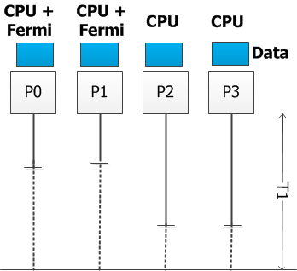
Heterogeneous cluster : Case for suboptimal performance for Iterative methods
Iterative convergence algorithms: Creates parallel tasks that communicate with each other
P0 and P1 : Higher compute capability when compared to P2 and P3
Suboptimal performance when data equally partitioned: P0 and P2 complete the computations and wait for P2 and P3 to finish

Slide 15
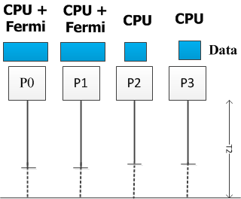
Case for Dynamic data partitioning on Heterogeneous clusters
Runtime analysis +
Repartitioning

Slide 16
Why not static partitioning based on compute power of nodes?
Inaccurate prediction of optimal data partitioning, especially when GPUs with different memory bandwidths, cache levels and processing elements
Multi-tenancy makes the prediction even harder.
Data-aware scheduling scheme (selection of computation to be offloaded to the GPU is done at runtime) makes it even more complex.

Slide 17
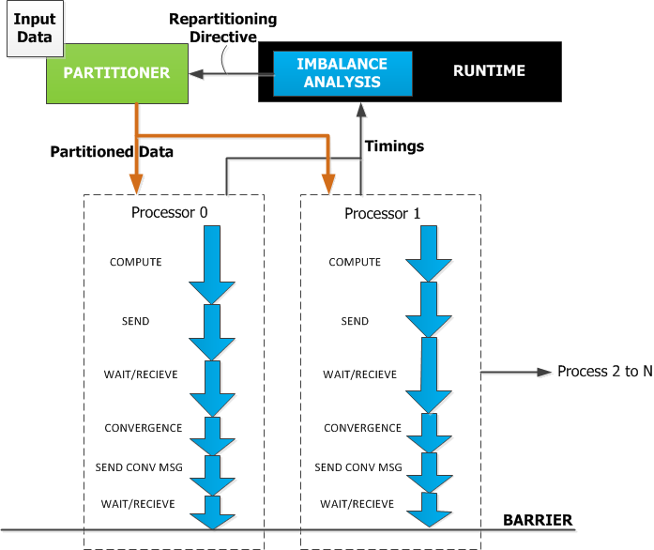
How Data repartitioning system works?

Slide 18
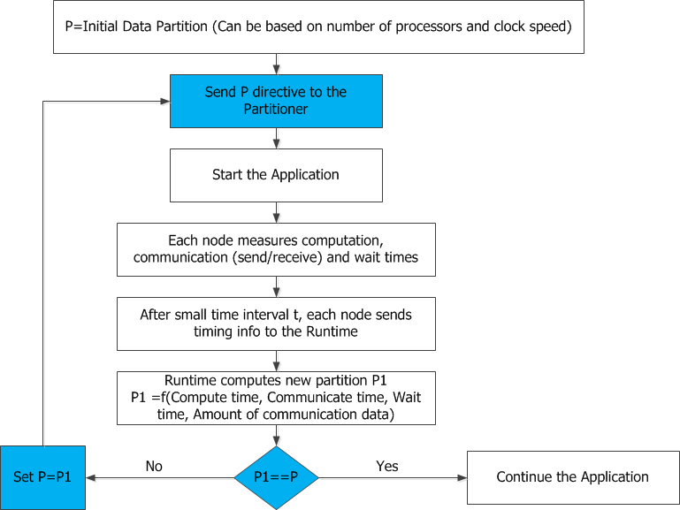
How Data repartitioning system works?

Slide 19
Model for Imbalance Analysis : In context of OpenFOAM
Processes | P[0] | P[1] | P[2] | P[3]
Data Ratio | x[0] | x[1] | x[2] | x[3]
Compute Time | T[0] | T[1] | T[2] | T[3]
Low communication overhead
With Unequal partitions: No significant comm^{n} overhead
Weighted mean (t^{w}) = ∑ (T[node] * x[node]) / ∑ (x[node])
If T[node] < t^{w}
Increase the partitioning ratio on P[node]
else
Decrease the partitioning ratio on P[node]

Slide 20
Data Repartitioning: Experimental Results
Problem Size | Average Time per Iteration(MS)
 | Work load equally balanced | Static partitioning | Dynamic repartitioning
159500 | 1.9 | 1.9 | 1.9
318500 | 2.4 | 2.2 | 2.2
637000 | 2.85 | 2.7 | 2.35
955000 | 5.9 | 3.15 | 2.75
2852160 | 13.05 | 6.1 | 5.8
4074560 | 25.5 | 8.2 | 7.2
Node 1 contains 2 CPU cores + 2 C2050 Fermi
Node 2 contains 4 CPU cores
Node 3 contains 2 CPU cores + 2 Tesla C1060

Slide 21
Summary
OpenFOAM solver to a GPU-based heterogeneous cluster. Learning can be extended to other solvers with similar characteristics (domain decomposition, Iterative, sparse computations)
For a large problem size, speedup of around 4x on a GPU based cluster
Imbalance in GPU clusters caused by fast evolution of GPUs, and propose a run-time analyzer to dynamically load balance the computation by repartitioning the input data.

Slide 22
Future Work
Scale up to a larger cluster and perform experiments with multi-tenancy in the cluster
Extend this work to incremental data repartitioning without restarting the application
Introduce a sophisticated model for imbalance analysis to support large sub-set of applications.

Slide 23
Thank You!

