Slide 1
Scalable Fast Multipole Accelerated Vortex Methods
Qi Hu ª
Nail A. Gumerov ª
Rio Yokota ^{b}
Lorena Barba ^{c}
Ramani Duraiswami ª
ª Department of Computer Science, University of Maryland, College Park
^{b} King Abdullah University of Science and Technology
^{c} Mechanical and Aerospace Engineering, George Washington University
1 of 23
Notes:
Good morning, everyone.
Welcome to my dissertation defense. This presentation is a summary of the research we have done in the past several years on fast multipole method algorithms for heterogeneous architectures. All these work are collaborated with my supervisors prof. Duraiswami, Gumerov.

Slide 2
Motivation: N-body Problems in Brownout
Complicated phenomena involving interaction between rotorcraft wake, ground, and dust particles
Causes accidents due to poor visibility and damage to helicopters
Understanding can lead to mitigation strategies
Fast evaluation of the fields at particle locations
Need for fast evaluation of all pairwise N-body interactions
Image courtesy of Professor Leishman
2 of 23
Notes:
The motivation of our research is from the brownout problem, in which we collaborate with the leading group from aero mechanics engineer dept.
Basically, we want to simulate the dust dynamics when a rotorcraft is landing on a dust land. These three pics show the different dust cloud caused by different rotorcrafts.
Such problem involves complicated interactions between rotorcraft wake, ground and dust particles and the core computation module is the so called N-body interactions.
To achieve high fidelity simulation, we have to use a large number of particles and vortex elements. However, the quadratic computation cost of n-body problems is too expensive for us and will make the processing on modern computing hardware practical. Hence we have to find alternative method to solve n-body problems.

Slide 3
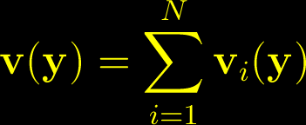
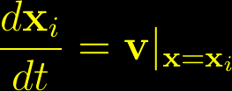
Motivation: Equations to Solve
3 of 23
Notes:
Here are the equations we try to solve.
The velocity field is determined by the Biot-Savart law. This second equation is often modified by using a smoothing kernel as we have already show in previous slides. Here we do incorporate the Gaussian smoothing which corresponds to vortex blobs. Note that implementing this Gaussian kernel involves several very expensive transcendental functions.
The displacement of the particles or vortex elements are updated according to velocity and also the stretching terms are updated by take the gradient of the velocity.

Slide 4
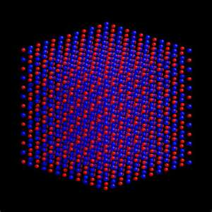
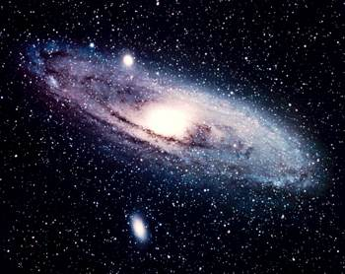
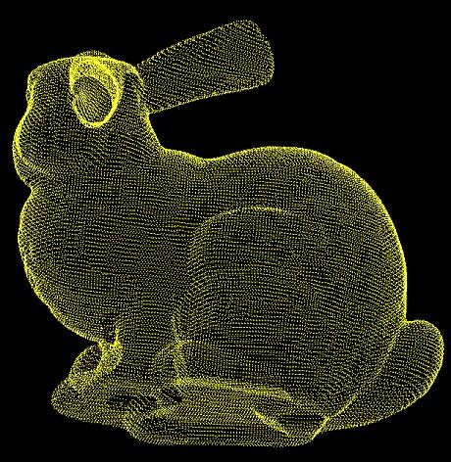
Motivation
Many other applications require fast evaluation of pairwise interactions with 3D Laplacian kernel and its derivatives
Astrophysics
(gravity potential
and forces)
Molecular Dynamics
(Coulomb potential
and forces)
wissrech.ins.uni-bonn.de
Micro and Nanofluidics
(complex channel Stokes flows)
Imaging and Graphics (high quality RBF interpolation)
Much More!
4 of 23
Notes:
The nbody problems actually appears in many other fields, such as astrophysics, molecular dynamics or computer graphics. We fell that effectively solving this problem will make a big impact.

Slide 5
Previous Work
FMM on distributed systems
Greengard & Gropp 1990 discussed parallelizing FMM
Ying, et al. 2003: the parallel version of kernel independent FMM
FMM on GPUs
Gumerov & Duraiswami 2008 explored the FMM algorithm for GPU
Yokota, et al. 2009, 2012 presented FMM on the GPU cluster
Qi, et al. 2011, 2012 developed heterogenous FMM algorithm
Other impressive results use the benefits of architecture tuning on the networks of multi-core processors or GPUs
Hamada, et al. 2009, 2010: the Golden Bell Prize SC’09
Lashuk, et al. 2009 presented kernel independent adaptive FMM on heterogeneous architectures
Chandramowlishwaran, et al. 2010: optimizations for multi-core clusters
Cruz, et al. 2010: the PetFMM library
5 of 23
Notes:
Approximation algorithms are often used to solve large scale nbody problems. Treecode and Fast multipole mothods are two primary approaches. We prefer FMM because it can achieve arbitrary accuracy up to machine precision.
The previous includes FMM parallel algorithm on distributed architectures. Recently, many research works are on the FMM GPU implementations.
There are also other impressive works on the different FMM algorithms with different optimization or tuning strategies, for different hardware platforms.

Slide 6
Previous Work
Treecode-based vortex method
Modeling rotor wakes hybrid overflow-vortex method on a GPU cluster (Stock & Stone 2010)
Isotropic turbulence simulation (Hamada, et al. 2009)
FMM-based vortex method
Validate soundness of FMM-based VEM using GPUs by Yokota & Barba group in a series of publications
6 of 23
Notes:
In literature, vortex method often used treecode to solve n-body problems. There are many papers published on this topic for example, by stock 2010 and Hamada 2009.
Recently, Yokota and Barba group have a series of publications to develop FMM-based vortex method and successfully scale to very large problem size. In 2012 they reported a isotropic turbulence simulations for 8 billion parciles by using 4096 GPUs.
Compared with those excellent work, based on the recent theoretical advances and our distributed heterogeneous FMM, we still think there is room to improve. In this section, I will briefly show our results.

Slide 7
Contributions
Highly optimized heterogeneous FMM algorithms for dynamic problems
Lamb-Helmholtz Decomposition
Gaussian blob approximation
7 of 23

Slide 8
N-body Problem
Source points:
Receiver points:
The matrix-vector product:
Complexity of direct method:
8 of 23
Notes:
Phi is the kernel function. In this dissertation, we focus on laplacian kernels. But there are also corresponding theory and algorithms for other kind of kernels.

Slide 9
Introduction of FMM
FMM introduced by Rokhlin and Greengard (1987)
Achieves dense NxM matrix-vector multiplication for special kernels in O(N+M) time and memory cost
Based on the idea that the far field of a group of singularities (vortices) can be represented compactly via multipole expansions
9 of 23
Notes:
What is the key idea of FMM in short?
In nbody problems, it is known the influence of the group of far field objects can be approximately replaced by a single object. FMM puts this idea in a rigorous mathematical framework can achieve machine precision or other required precisions.
we divide it into two terms: the first is for far field interaction, and the second term is for near field interaction. This far field approximation is realized by the hierarchical data structure and multipole and local expansions. In the next slide, we will explain how this approximation can reduce the overall complexity.
Using Fast multipole methods, we can reduce this matrix-vector-product computation cost to linear. The key is the hierarchical data structure.

Slide 10
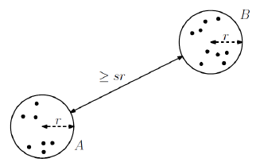
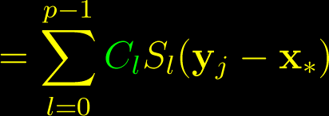
Factorization and well separate pair
Factorization of the far-field interaction:
Well separate pairs via hierarchical data structures
Image courtesy of Professor Mount
10 of 23
Notes:
The trick of reducing complexity is due to factorization which can separate x and y. Lets consider only one receiver. Recall we divide the sum of all interactions to near and far fields. Here this equation show the accumulated interactions outside the neighbor domain.
Expand the kernel function at x* by using multipole expansions. After we rearrange the sums, we can separate the x_i and y_j, such that C_l is independent of y_j. If we compute all C_l and all S_l, it only require M+N operations to get all receivers’ far field interactions.
However, such factorizations over x_* is only valid for certain regions but not for global space, so we need to group receivers in space accordingly such that we can perform valid factorizations and use this trick to save our computation.
To guarantee the accuracy of factorization, we have to separate these groups as the so called well separate pairs:
Definitions: given a parameter s, A and B are well separated if there are two spheres with radius r (circles in 2d, hyper sphere in higher dimension) such that the nearest distance is larger than sr.
In FMM, these well separate pairs are realized by spacial boxes in quadtree (2D) /octree (3D).

Slide 11
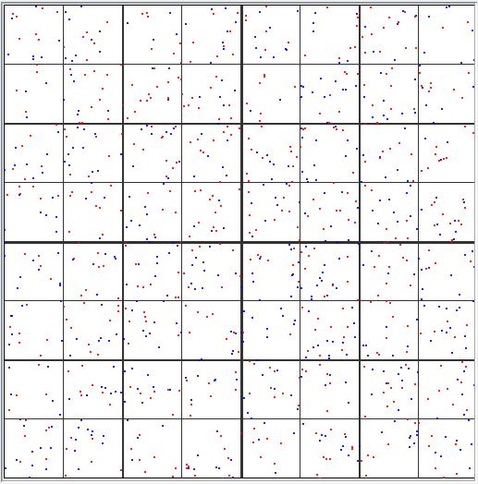
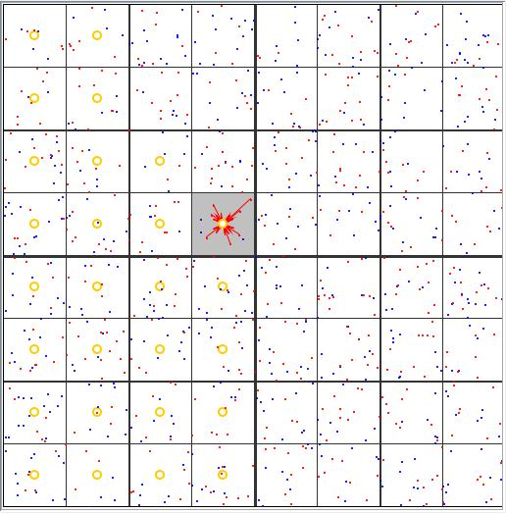
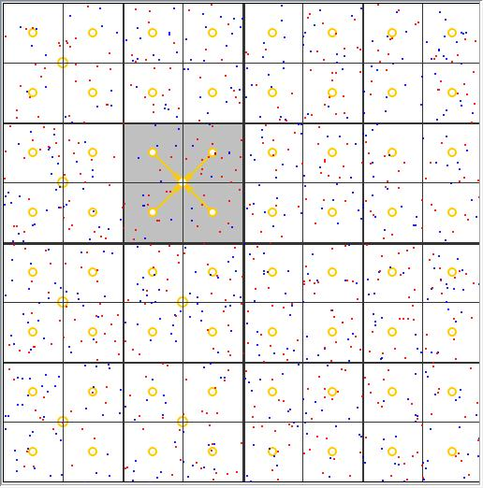
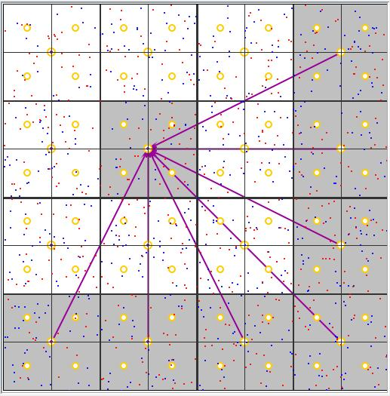
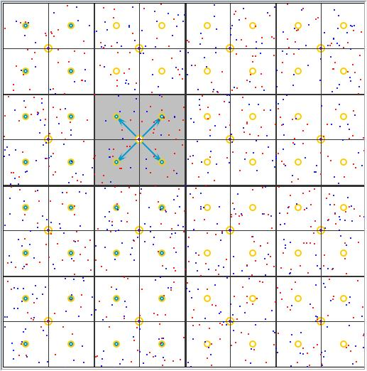
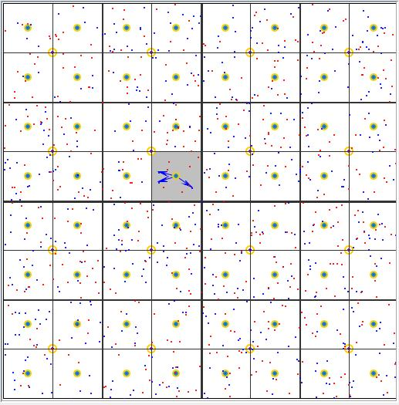
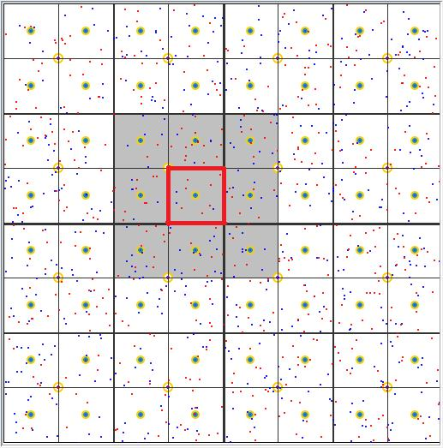
FMM Flow Chart
Build data structures
Initial expansions
Upward translations
Downward translations
Local expansions
Near-field direct sum and final summation
From Java animation of FMM by Y. Wang M.S. Thesis, UMD 2005
11 of 23
Notes:
The steps are summarized as follow:

Slide 12
Heterogeneous Architecture
openMP
GPU
GPU
CPU
core
CPU
core
CPU
core
CPU
core
PCI-e
MPI
openMP
GPU
GPU
CPU
core
CPU
core
CPU
core
CPU
core
PCI-e
InfiniBand
12 of 23
Notes:
Here is the typical architecture of a heterogeneous computing node

Slide 13
Single Node Heterogeneous Algorithm
ODE
solver:
source
receiver
update
particle positions, source strength
data structure (octree and neighbors)
source M-expansions
translation stencils
local direct sum
upward M|M
downward M|L L|L
receiver L-expansions
time
loop
final sum of far-field and near-field interactions
GPU work
CPU work
13 of 23
Notes:
In this slide, we will show our single node heterogeneous algorithm.
Boxes of blue color represents GPU work while red boxes are for CPU work.
Lets assume that we have an ODE solver which use our FMM algorithm to update each time step’s source and receiver data, which shown in the purple color.
Firstly, this outside FMM solver pass the particle positions and source strength to our single node algorithm. Next, we compute all needed data structures, such as data point sorting and neighbor construction, in parallel on GPU as described in previous section. After that, we will divide the work to two parts and process them in parallel.
Firstly, GPU computes the source s-expansions. CPU compute the translation stencils. After all of them are done, we let GPU first copy all these S-coefficients from device, GPU’s global memory to the host CPU’s main memory. Then, GPU continue its work to process the local direct sum while CPU takes the S-coefficients and translation stencils to compute the upward SS translation, then downward SR and RR translations. This step is the most time consuming part among all the algorithm. We also want to find a optimal level, such that, these two big computation, i.e. local direct sum and translations workload can be balanced. We call these overlapped region here as the parallel region.
After we finish the parallel region, the CPU will copy all the translated R-coefficients to the GPU’s global memory. The GPU further take these receiver’s position and strength to compute the R-expansions and consolidate with the corresponding translated coefficients. Finally, it sums up the local direct sum and far field approximated sum. In the very end, it resort all these sums to the original input order and copy to CPU’s main memory. Note that, this reorder doesn’t take extra time since we stored an inverse map when we sort all the receivers. Reorder here is just like copy data to different addresses.

Slide 14
Advantages
CPU and GPU are tasked with the most efficient jobs
Faster translations: CPU code can be better optimized which requires complex translation stencil data structures
Faster local direct sum: many cores on GPU; same kernel evaluation but on multiple data (SIMD)
The CPU is not idle during the GPU-based computations
High accuracy translation without much cost penalty on CPU
Easy visualization: all data reside in GPU RAM
14 of 23
Notes:
Compare to non-heterogeneous algorithms, our new solution has several advantages.
Firstly… the translation stencils require complex data structure. Different box needs different translation coefficients and operations. For more advanced translation schemes, such as the one reduce the 189 S|R translation to 119, they require much more complicated data structures. In this case, it is the memory access but not the computation power to determine overall cost. Hence, we’d better to use CPU with large cache and multithreading to speedup the translation.
In contrast, the local sum does not require complex data structure. It just needs arrays to address the data then evaluate the kernel, which is quite similar to the single instruction on multiple data model. So the more computation cores we have, the shorter the computation time we have.
Hence, we keep both CPU and GPU running during the evaluation stage, which makes the whole system be the best used.
Since we use CPU to process the translation, we could use double precision without much cost penalty. High accuracy translations will make our final sum more accurate. However, to achieve the same thing, using GPU will take substantial extra time.
Because all the data are on GPU’s global memory, it is easy to dump all of them to the rendering pipelines and show their visualization directly on the screen.

Slide 15
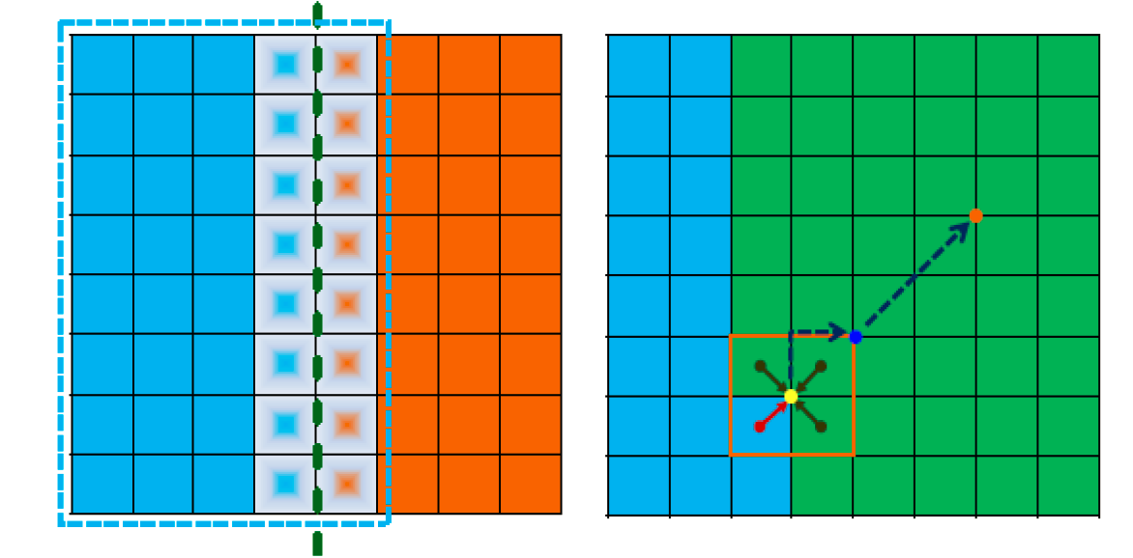
Issues with Distributed Algorithms
Halo regions
Incomplete translations
15 of 23
Notes:
Now lets look at how to design the distributed algorithm.
First of all, we have to consider some technique issues when the problem domain or data is distributed among different computing nodes.
The first one is Halo regions.
The second one is incomplete far-field translation due to data partition.
The third how to balance workload

Slide 16
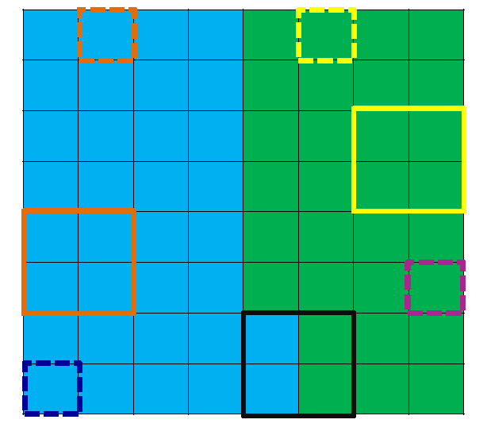
Box Types to Manage Halo Regions
Five types: root, import, export, domestic, other
Each node computes its box types on GPUs with other FMM data structures
Very small overhead
A 2D example
16 of 23
Notes:
The five box types are:….
Here our intention of this slides is to show those concepts and help to visualize this task

Slide 17
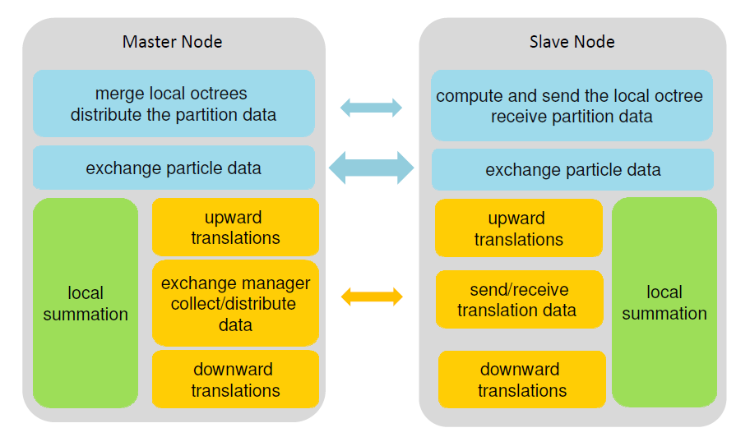
The Fully Distributed Heterogeneous Algorithm
17 of 23
Notes:
In this figure, we show how each node communicates with others and how we map each component on to the heterogeneous architecture. Note that this one does not provide all details of algorithm components for example the data structure parts are skipped.
Those blue regions are for the preprocessing. It also used GPU as much as possible to reduce the processing time. There are two communications one is for the particle statistics which is small while the other one is for raw data which is large.
Green part are performed on GPU while yellow part are performed on CPU. After performing the upward translation, we have a global communication to exchange halo region data.
The most important thing here is that, GPU process the most time consuming computation without any interrupts! In the mean time, CPU can perform translation, communications or other stuffs. Hence, this halo region communication wont effect the overall performance if the local summation dominates the concurrent region.

Slide 18
Lamb-Helmholtz Decomposition
Mathematically reformulation (Gumerov & Duraiswami 2013)
Velocity field can be described by only two harmonic scalar potentials
Perform the FMM translations for “velocity+streching” calculation at the cost of two Laplace potential kernels instead of six
18 of 23
Notes:
Last year, professor Gumerov and Duraiswami introduced a new formulation to solve the previous equations. This new formulation is called lamb-helmhotz decomposition, which said that given the divergence constraints the velocity field can be described by two scalar potentials.
Therefore, based on this decomposition, we can obtain the velocity and stretching terms on the cost corresponding to two baseline FMM on scalar kernel. Note that, by counting the number of operations for direct evaluate the velocity and stretching, this cost is about six times of a scalar kernel. Hence, this new formulation provides good algorithmic speedup.

Slide 19
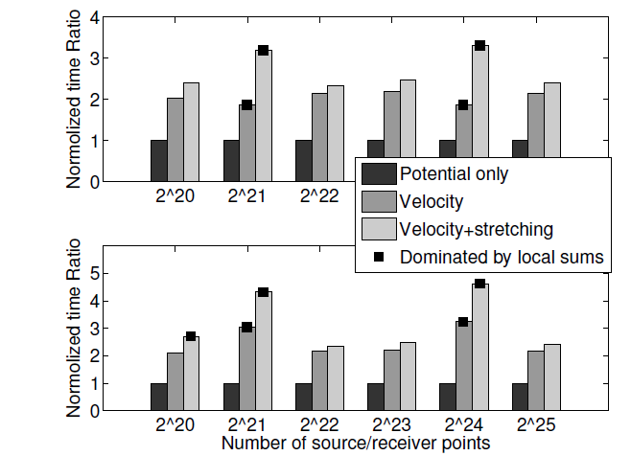
FMM for Vortex Element Methods
Gaussian smoothing kernels evaluated on GPU
Fast approximations with guaranteed accuracy
No
smoothing
It combines
Algorithmic speedup
Fast data structure constructions
Highly optimized CUDA, OpenMP and MPI implementations
Has smoothing
19 of 23
Notes:
The gaussian smoothing has no effect on far field interaction since it decays very fast. But it will introduce the erf() and exponential functions into the local summations. Recall the fact that we perform the local summation on GPU, those transcendental functions will substantially decease our performance due to the GPU hardware implementation. So we have to use some good algebraic approximations to replace erf(). We did rigorous comparisons to study the treat-off between the speed and accuracy and conclude a good approximation with guaranteed accuracy. The details of those analysis can be found in my thesis.
To validate our claim on the performance improvement on this new algorithm, we use this figure: On the top it shows the results without smoothing while on the bottom it shows results with smoothing.
Bar with a solid square on the top means that time is dominated by the local summation. For this, we will not see any algorithmic improvement because the local sum is direct evaluation of the kernel. When the velocity should be around 3 time costy than the scalar while the stretching is about 6 times. You could see here our implementations actually provide better performance since the timing is less than the theoretical costs.
When the translation dominates the overall timing, our performance agreed with the theoretical speedup. All the stretching+velocity is about 2 and less than 2.5 times than the scalar kernel.

Slide 20
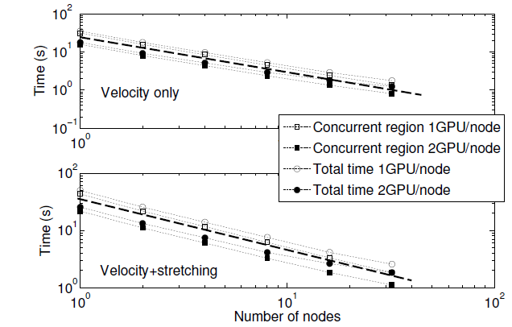
Strong Scalability
20 of 23

Slide 21
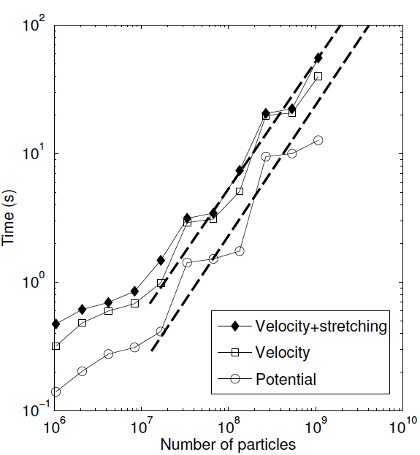
The Billion Size Test Case
Truncation number p=12
2³⁰ ~1.07 billion particles
32 computing nodes
Streching+velocity: 55.9s
49.12Tflops/s with 64 C1060 GPUs (933 Gflop/s peak performance for each GPU reported by NVIDIA)
Equivalent to 82% efficiency
Velocity: 39.9s
Each node: dual quad-core Intel Nehalem 5560 2.8 GHz CPU, 24 GB of RAM; two Tesla C1060 GPU
21 of 23
Notes:
Still we show the overall performance by running the problem size as large as possible on our 32 nodes cluster. When we achieve the billion size, we could finish the stretching + velocity within 1 min and the parallel efficiency for this case is 82%. Note that, the velocity takes longer time compared with our previous results because we have larger truncation number here.

Slide 22
Conclusions
Developed scalable vortex methods using FMM
Algorithmic acceleration on the translations via Lamb-Helmholtz decomposition
Incorporate our distributed heterogeneous FMM algorithm
Analyzed the treat-off between accuracy and speed of the expensive vortex core evaluations
Valid the acceptable accuracy of FMM based Vortex Method
The FMM algorithms developed can be used in solvers for many large scale problems in aeromechanics, astrophysics, molecular dynamics, etc.
22 of 23

Slide 23
Future Work
Fast data structures without using histograms
Distributed communication management
Automatic GPU/CPU work balance algorithms
Partition methods and dynamic data structure updates
23 of 23

