Slide 1
Open Source Software Support for the OpenMP Runtime API for Profiling
Oscar Hernandez, Ramachandra Nanjegowda, Van Bui, Richard Krufin and Barbara Chapman
High Performance Computing and Tools Group (HPCTools)
Computer Science Department
University of Houston, Texas
Notes:
1
1
1
1

Slide 2
Agenda
Introduction to collector API.
The basic collector interface and usage.
Simple tools.
Advanced tools.
Implementation of collector API support.
Future work, conclusion and questions.
Notes:
2
2
2
2

Slide 3
Objective of collector interface
Designed to provide portable means for tools to collect information about an OpenMP application during runtime in transparent and scalable and independent manner.

Slide 4
Features of collector api
Collector interface or collector API was proposed by SUN as a white paper for tools committee of OpenMP ARB.
Bi-directional: Communication between the OpenMP runtime library and performance tools.
Scalable: Minimal overhead as Is a query and event notification based interface.
Transparent: No need for application change, recompilation, instrumentation. and supports dynamic binding
Independent: The tool and the runtime evolve independently
Extensible: Adding more events and requests.

Slide 5
Related work
POMP
Source code instrumentation using Opari.
GASP
Profiling interface for global address space programming models (UPC, CAF).
PMPI
A set of wrappers for each MPI call, with instrumentation calls before and after MPI calls.
PERUSE
Complements PMPI, extends MPI to give more information about internal states.

Slide 6
The basic interface
The single routine, int __omp_collector_api(void *msg) used by tools to communicate with runtime.
One call, many requests.
Designed to support events/states needed for statistical profiling and tracing tools.
OpenMP Program
(object code)
OpenMP Runtime Library
Collector API
Executable
request
events
Performance Tool

Slide 7
Request and events and response
“__omp_collector_api(void *msg)”
msg
SZ
R#
EC
RSZ
MEM
SZ
R#
EC
RSZ
MEM
0
Request1
Request2
Request Examples
OMP_REQ_START
OMP_REQ_REGISTER
Events Examples
OMP_EVENT_FORK
OMP_EVENT_JOIN
Response
PRID and PRFP.
Embedded in the MEM passed in REQ

Slide 8
Typical usage
Export LD_PRELOAD to point to tool.
The tool exports the initialization and finalization routines using __atribute__ GCC extension.
Tools checks if collector is present
Tools request collector for initialization.
Tools register thread events with callbacks to the OpenMP RTL.
Performance Tool
OpenMP Application
with Collector API.
Is there a collector API?
Yes/No
Initialize
collector API
Success/Ready
Register Event(s)/
Callback(s)
Event Notification
/Callback

Slide 9
Simple tools
Collecting OpenMP metrics and thread states.
Collecting user call stack

Slide 10
OpenMP states and metrics
Example:
#pragma omp parallel for reduction (+:sum)
for(i=0; i <N ; i++)
sum += a[i];
Master Thread
Serial State
Fork
Overhead State (Prepare for Fork)
Begin idle Event
Fork Event
Idle State
Overhead State
(Scheduler)
End idle
Event
Work State
sum += a[i];
Begin Barrier
Reduction State
Begin
idle Event
End Barrier
Implicit Barrier State
Join Event
Idle State
(end parallel region)
Serial State
Slave
Thread
Slave
Thread
Slave
Threads

Slide 11
Advanced usage
Collector API with TAU.
Selective instrumentation using dynamic optimizer
Integration of Collector API with PIN.

Slide 12
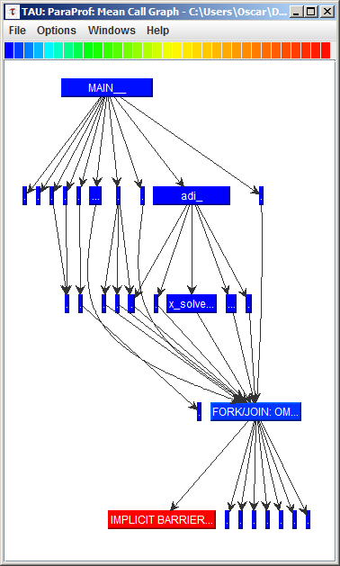
OpenMP Collector API with TAU
Enabling Fork and Join
Events.
Begin/End Implicit Barriers
Procedures
were Instrumented with the compiler
Parallel Region(s)

Slide 13
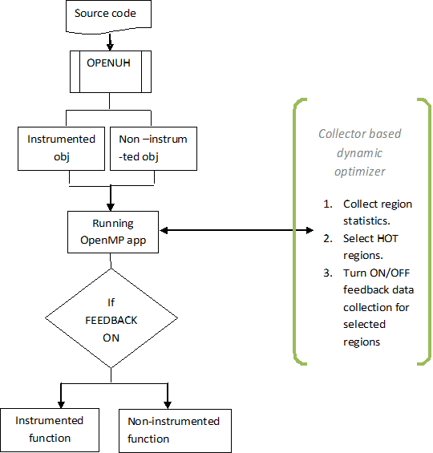
Dynamic instrumentation using collector API
Dynamic optimizer will turn off/on the feedback data collection.
This minimizes code generation of instrumentation at runtime
Generate conditionals and function pointers to support code patching
double x_solve(… )
{
if(feedback_on) {
return x_solve_inst(….)
}
….
}

Slide 14
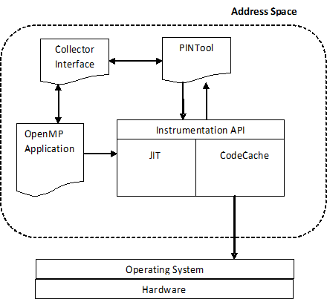
Integration with PIN
PIN, an dynamic instrumentation tool.
Enables to analyze the application at instruction level.
Leverage collector api to collect more highlevel statistics.
Better understanding of the program behavior with low level instrumentation and high level statistics.

Slide 15
Implementation of collector interface in OpenUH
inline void __ompc_barrier(void) {
__ompc_set_state(THR_IBAR_STATE); __ompc_event_callback(OMP_EVENT_THR_BEGIN_IBAR);
__ompc_barrier_wait(&__omp_level_1_team_manager);
__ompc_event_callback(OMP_EVENT_THR_END_IBAR); __ompc_set_state(THR_WORK_STATE);
return;
}
2 functions inserted at different points in RTL
__ompc_event_callback(event_name)
__ompc_set_state(state_name)

Slide 16
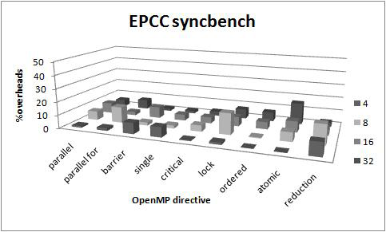
Overhead and scalability
A tool with callback for each event, and call stack display for unique regions.
Most cases overhead is less than 5% relative to the execution time.

Slide 17
Conclusion and future work
Collector interface for both tool users and tool developers.
Make the basic and advanced tools available.
Integrate with other tools like TAU, PIN and many more.
Integrate with dynamic compiler framework.

Slide 18
References
Formal definition http://www.compunity.org/futures/omp_collector_api.h
White paper at http://www.compunity.org/futures/omp-api.html
Providing Observability for OpenMP 3.0 Applications Yuan Lin, Oleg Mazurov

Slide 19
Questions?
Notes:
19
19
19
19

Slide 20
Backup slides

Slide 21
Collecting user callstack
Libpsx extension to Perfsuite library.
Callstack retrieval using libunwind.
Mapping of callstack values to source code location using Binary File descriptor API (libbfd).
Removing the RTL frames in the trace.
1. Request current PRID and PRFP
2. Determine unique region using Frame pointer.
OMP_JOIN_EVENT Callback
IsUniqueRegion ?
1. Provides the instruction pointer values for each stack frame.
Collect call stack psx_rtc_cs()
psx_bfd_map()
1. Map the instruction pointer values with source code locations

Slide 22
Implementation of collector interface in OpenUH
OpenMP Runtime
Collector API
Collector Tool
REQ_START
Init queue, callback tables, keep track of PRID’s
OMP_REQ_START
Begin tracking of states, PRID’s
OMP_REQ_EVENT
REQ_EVENT
Store the callback functions in callback table.
Activate monitoring of event A
OMP_REQ_PRID
REQ_PRID
PRID and PRFP in the response
Query Current state

Slide 23
Hardware counters and Collector interface
Collector Tool
OpenMP Application
PAPI_Init
PAPI_Add_Event
PAPI_Overflow
Register Fork and Join
Invoke callback
Callback()
if(FORK)
PAPI_START
if(JOIN)
PAPI_STOP
Fork/Join
Invoke Handler
Counter Oveflow
Handler()
Mechanism to map to source line

