Slide 1
A Micro-benchmark Suite for AMD GPUs
Ryan Taylor
Xiaoming Li

Slide 2
Motivation
To understand behavior of major kernel characteristics
  ALU:Fetch Ratio
  Read Latency
  Write Latency
  Register Usage
  Domain Size
  Cache Effect
Use micro-benchmarks as guidelines for general optimizations
Little to no useful micro-benchmarks exist for AMD GPUs
Look at multiple generations of AMD GPU (RV670, RV770, RV870)

Slide 3
Hardware Background
Current AMD GPU:
  Scalable SIMD (Compute) Engines:
    Thread processors per SIMD engine
      RV770 and RV870 => 16 TPs/SIMD engine
      5-wide VLIW processors (compute cores)
  Threads run in Wavefronts
    Multiple threads per Wavefront depending on architecture
      RV770 and RV870 => 64 Threads/Wavefront
    Threads organized into quads per thread processor
    Two Wavefront slots/SIMD engine (odd and even)

Slide 4
AMD GPU Arch. Overview
Hardware Overview
Thread Organization

Slide 5
Software Overview
00 TEX: ADDR(128) CNT(8) VALID_PIX
0 SAMPLE R1, R0.xyxx, t0, s0 UNNORM(XYZW)
1 SAMPLE R2, R0.xyxx, t1, s0 UNNORM(XYZW)
2 SAMPLE R3, R0.xyxx, t2, s0 UNNORM(XYZW)
01 ALU: ADDR(32) CNT(88)
8 x: ADD ____, R1.w, R2.w
y: ADD ____, R1.z, R2.z
z: ADD ____, R1.y, R2.y
w: ADD ____, R1.x, R2.x
9 x: ADD ____, R3.w, PV1.x
y: ADD ____, R3.z, PV1.y
z: ADD ____, R3.y, PV1.z
w: ADD ____, R3.x, PV1.w
14 x: ADD T1.x, T0.w, PV2.x
y: ADD T1.y, T0.z, PV2.y
z: ADD T1.z, T0.y, PV2.z
w: ADD T1.w, T0.x, PV2.w
02 EXP_DONE: PIX0, R0
END_OF_PROGRAM
Fetch Clause
ALU Clause

Slide 6
Code Generation
Use CAL/IL (Compute Abstraction Layer/Intermediate Language)
  CAL: API interface to GPU
  IL: Intermediate Language
    Virtual registers
  Low level programmable GPGPU solution for AMD GPUs
  Greater control of CAL compiler produced ISA
  Greater control of register usage
Each benchmark uses the same pattern of operations (register usage differs slightly)

Slide 7
Code Generation - Generic
Reg0 = Input0 + Input1
While (INPUTS)
Reg[] = Reg[-1] + Input[]
While (ALU_OPS)
Reg[] = Reg[-1] + Reg[-2]
Output =Reg[];
R1 = Input1 + Input2;
R2 = R1 + Input3;
R3 = R2 + Input4;
R4 = R3 + R2;
R5 = R4 + R5;
…………..
…………..
…………..
R15 = R14 + R13;
Output1 = R15 + R14;

Slide 8
Clause Generation – Register Usage
Sample(32)
ALU_OPs Clause (use first 32 sampled)
Sample(8)
ALU_OPs Clause (use 8 sampled here)
Sample(8)
ALU_OPs Clause (use 8 sampled here)
Sample(8)
ALU_OPs Clause (use 8 sampled here)
Sample(8)
ALU_OPs Clause (use 8 sampled here)
Output
Sample(64)
ALU_OPs Clause (use first 32 sampled)
ALU_OPs Clause (use next 8)
ALU_OPs Clause (use next 8)
ALU_OPs Clause (use next 8)
ALU_OPs Clause (use next 8)
Output
Register Usage Layout
Clause Layout

Slide 9
ALU:Fetch Ratio
“Ideal” ALU:Fetch Ratio is 1.00
  1.00 means perfect balance of ALU and Fetch Units
    Ideal GPU utilization includes full use of BOTH the ALU units and the Memory (Fetch) units
  Reported ALU:Fetch ratio of 1.0 is not always optimal utilization
    Depends on memory access types and patterns, cache hit ratio, register usage, latency hiding... among other things

Slide 10
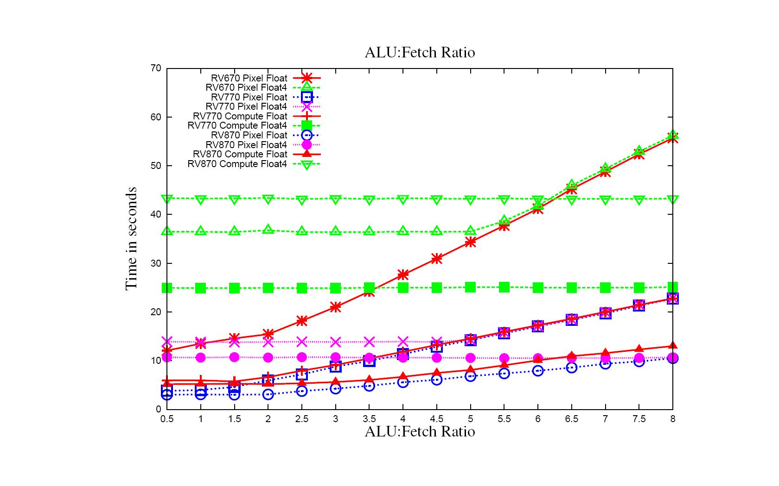
ALU:Fetch 16 Inputs 64x1 Block Size – Samplers
Lower Cache Hit Ratio

Slide 11
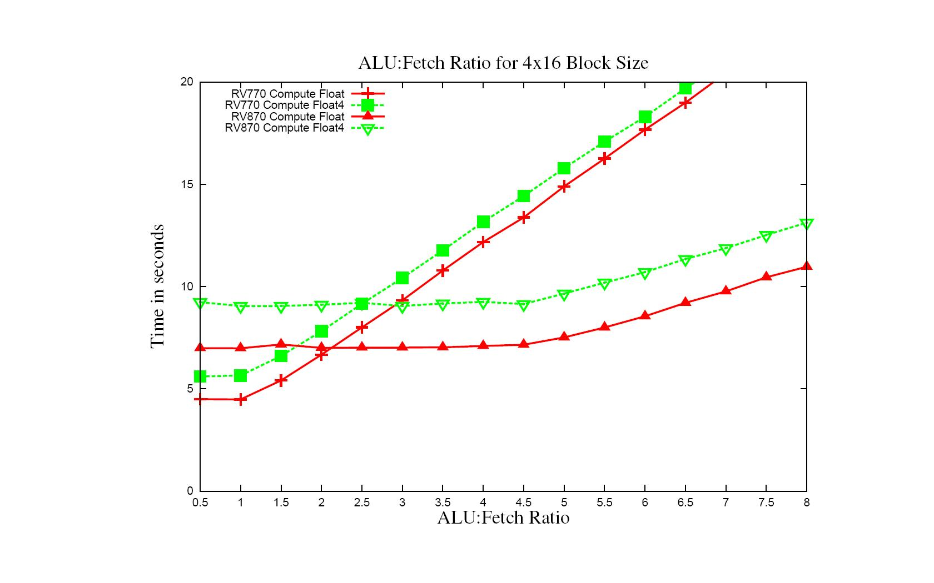
ALU:Fetch 16 Inputs 4x16 Block Size - Samplers

Slide 12
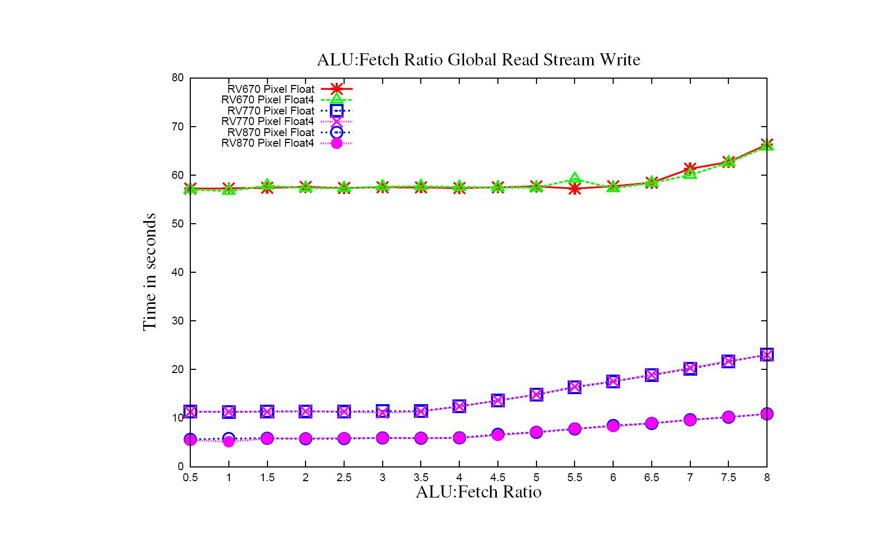
ALU:Fetch 16 Inputs Global Read and Stream Write

Slide 13
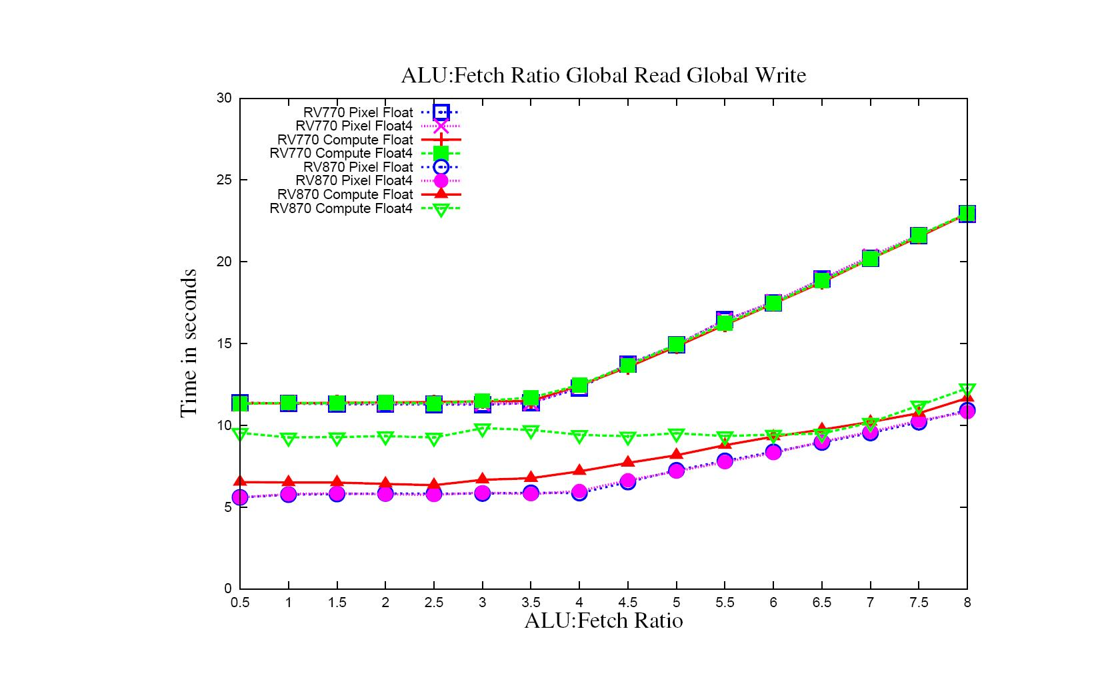
ALU:Fetch 16 Inputs Global Read and Global Write

Slide 14
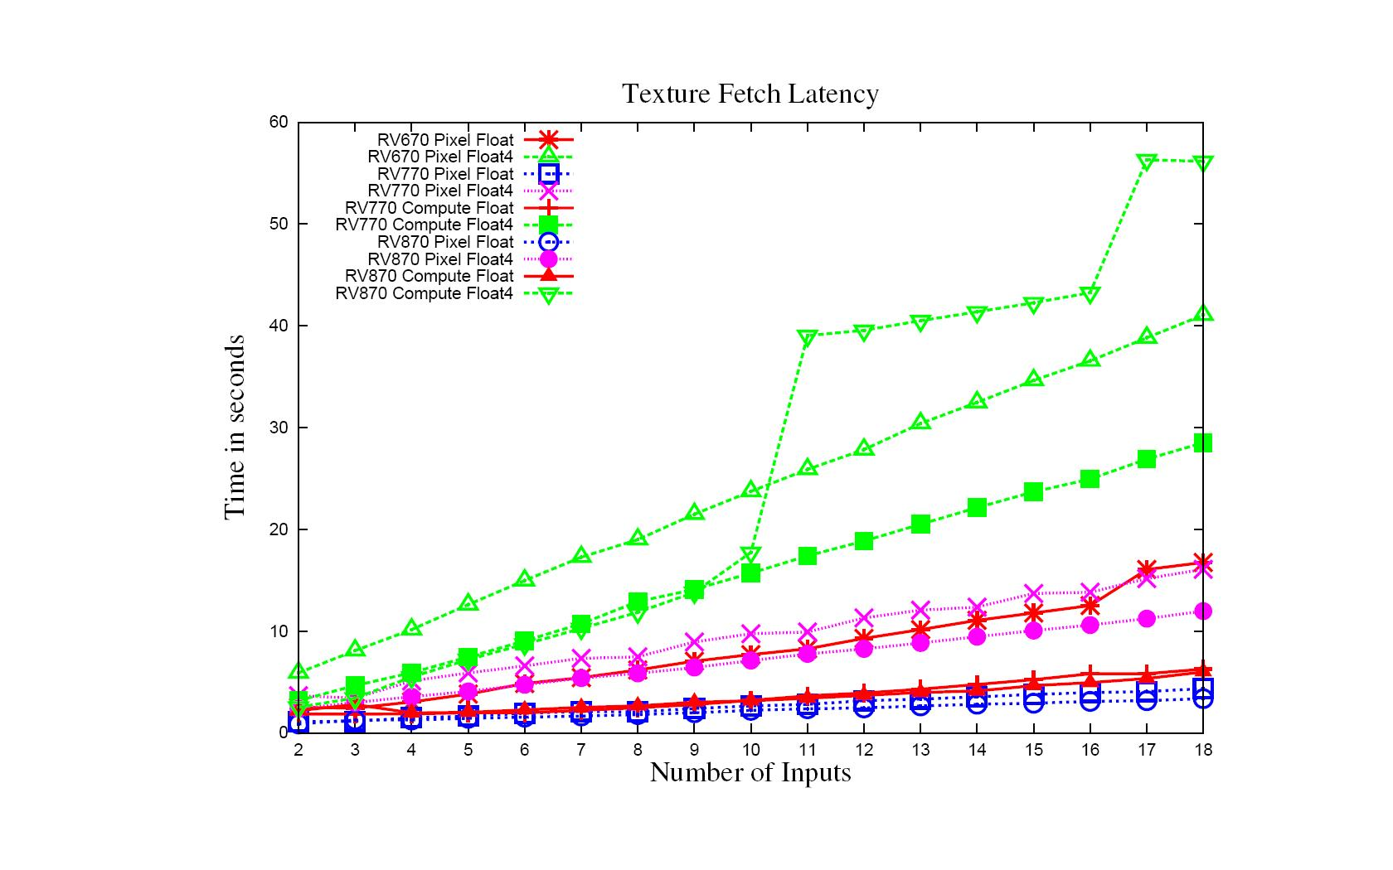
Input Latency – Texture Fetch 64x1
ALU Ops < 4*Inputs
Linear increase can be effected by cache hit ratio
Reduction in Cache Hit

Slide 15
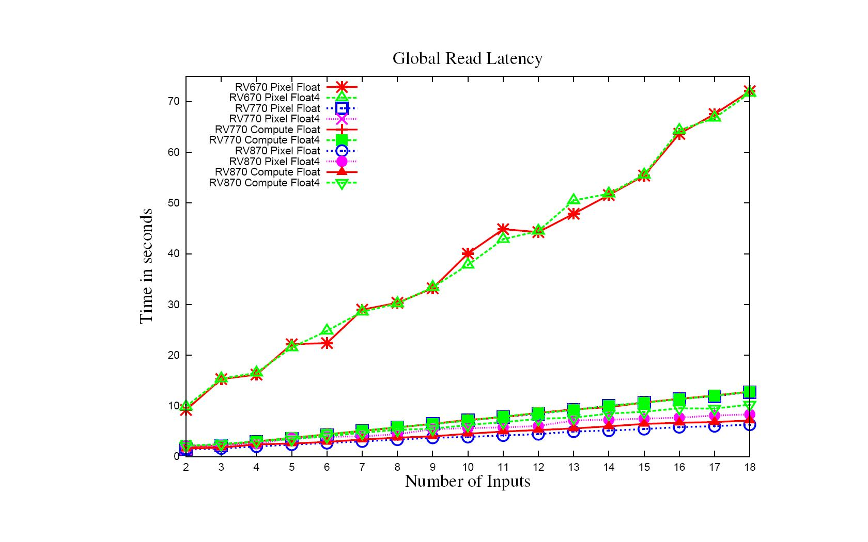
Input Latency – Global Read
ALU Ops < 4*Inputs
Generally linear increase with number of reads

Slide 16
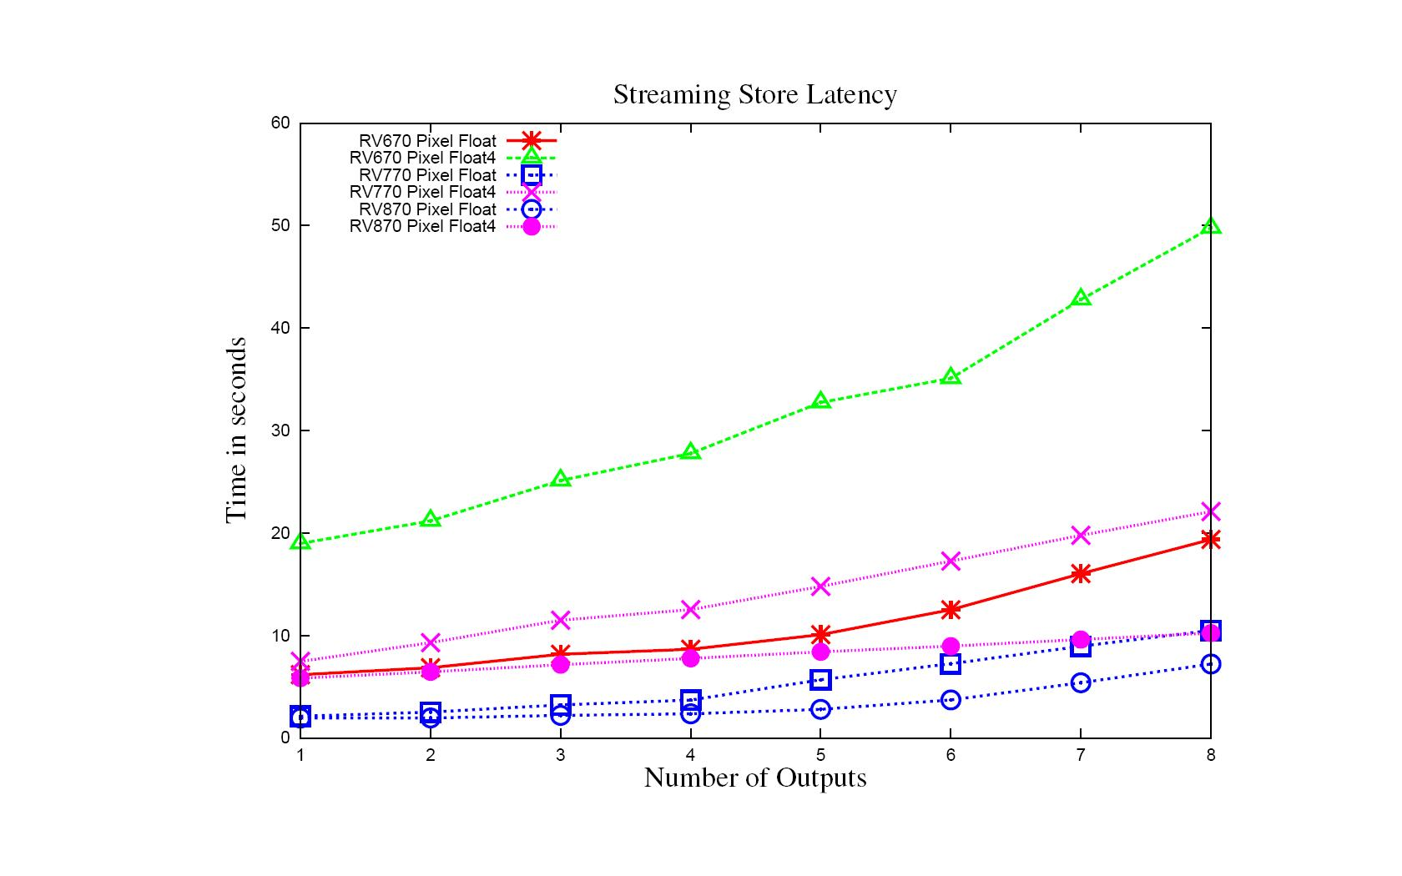
Write Latency – Streaming Store
ALU Ops < 4*Inputs
Generally linear increase with number of writes

Slide 17
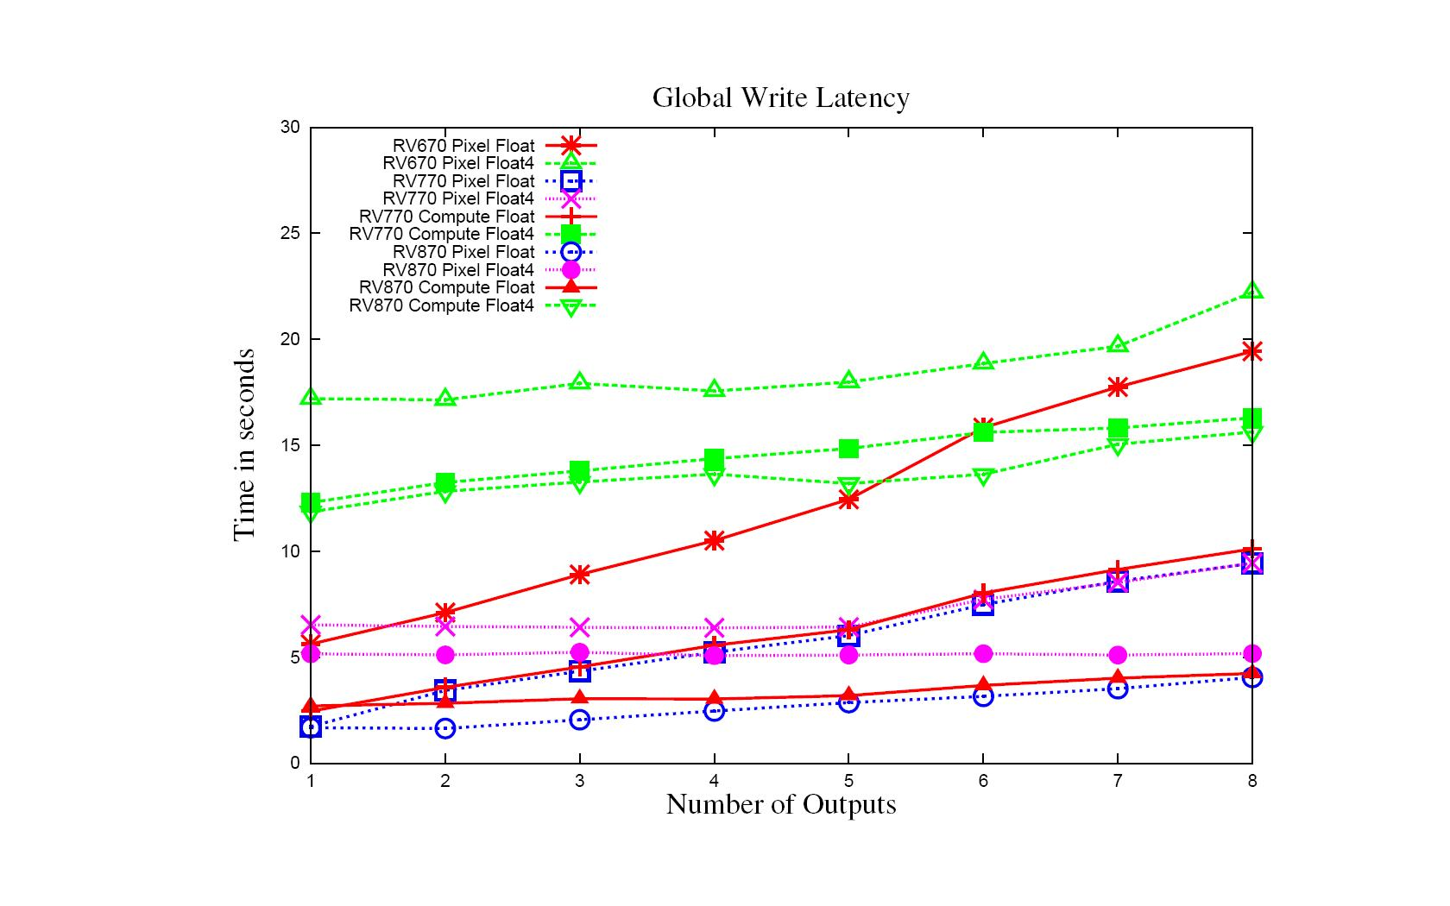
Write Latency – Global Write
ALU Ops < 4*Inputs
Generally linear increase with number of writes

Slide 18
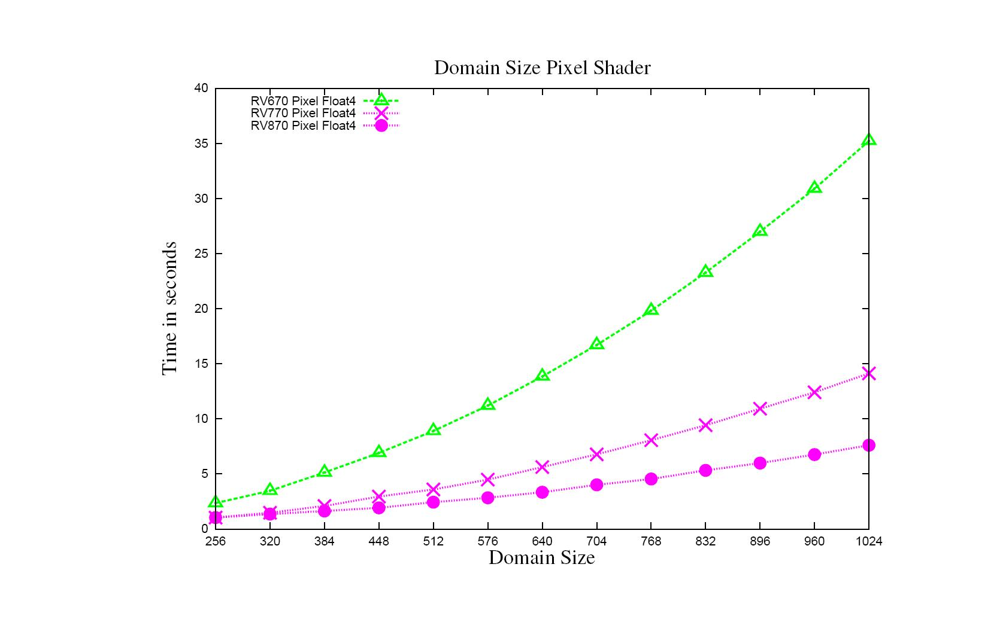
Domain Size – Pixel Shader
ALU:Fetch = 10.0, Inputs =8

Slide 19
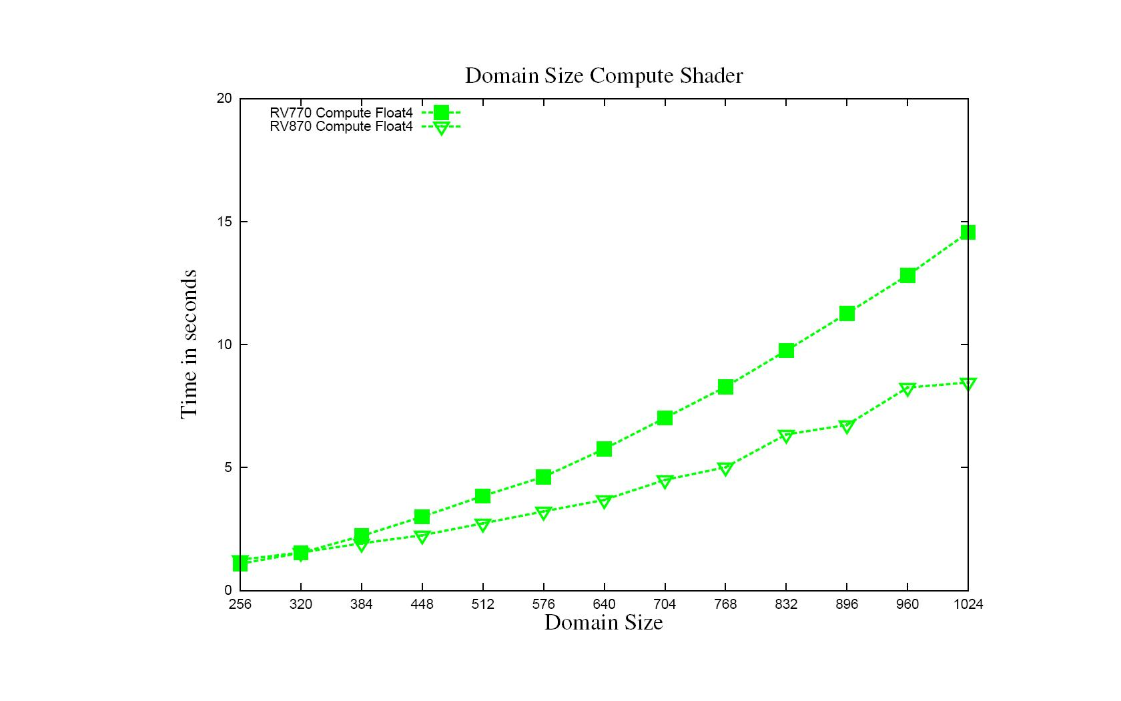
Domain Size – Compute Shader
ALU:Fetch = 10.0 , Inputs =8

Slide 20
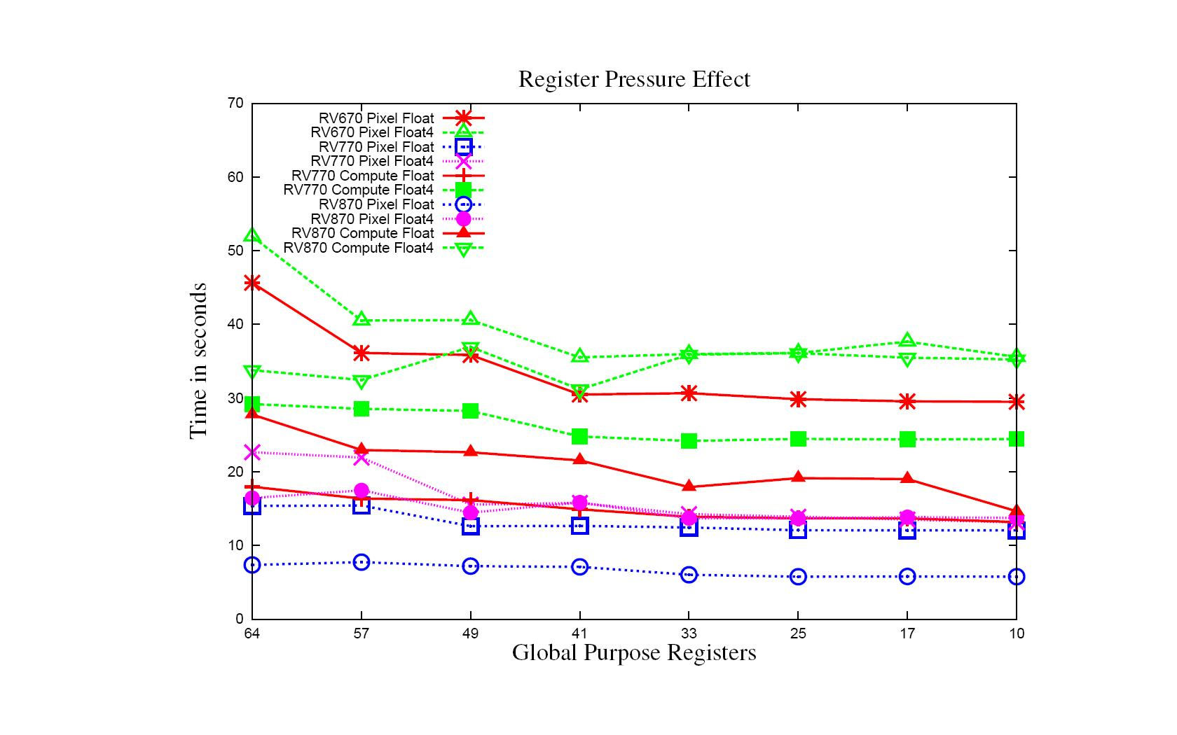
Register Usage – 64x1 Block Size
Overall Performance Improvement

Slide 21
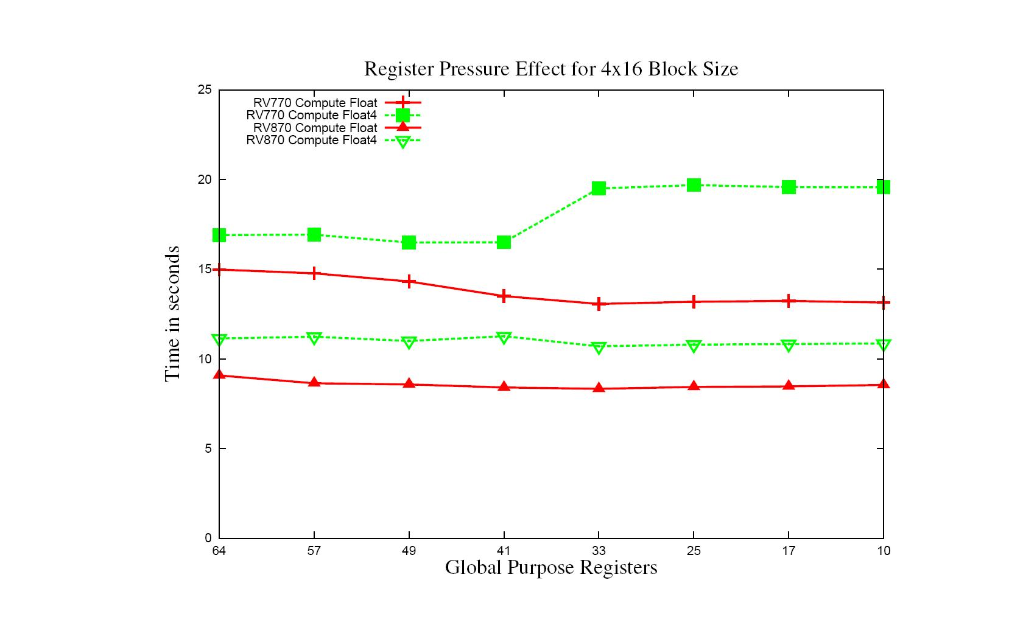
Register Usage – 4x16 Block Size
Cache Thrashing

Slide 22
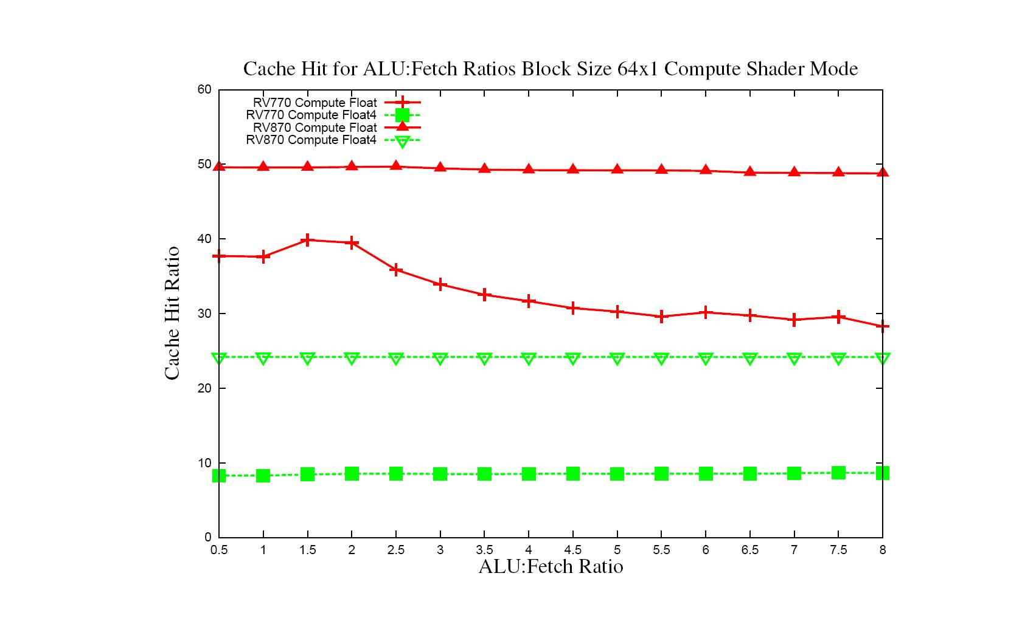
Cache Use – ALU:Fetch 64x1
Slight impact in performance

Slide 23
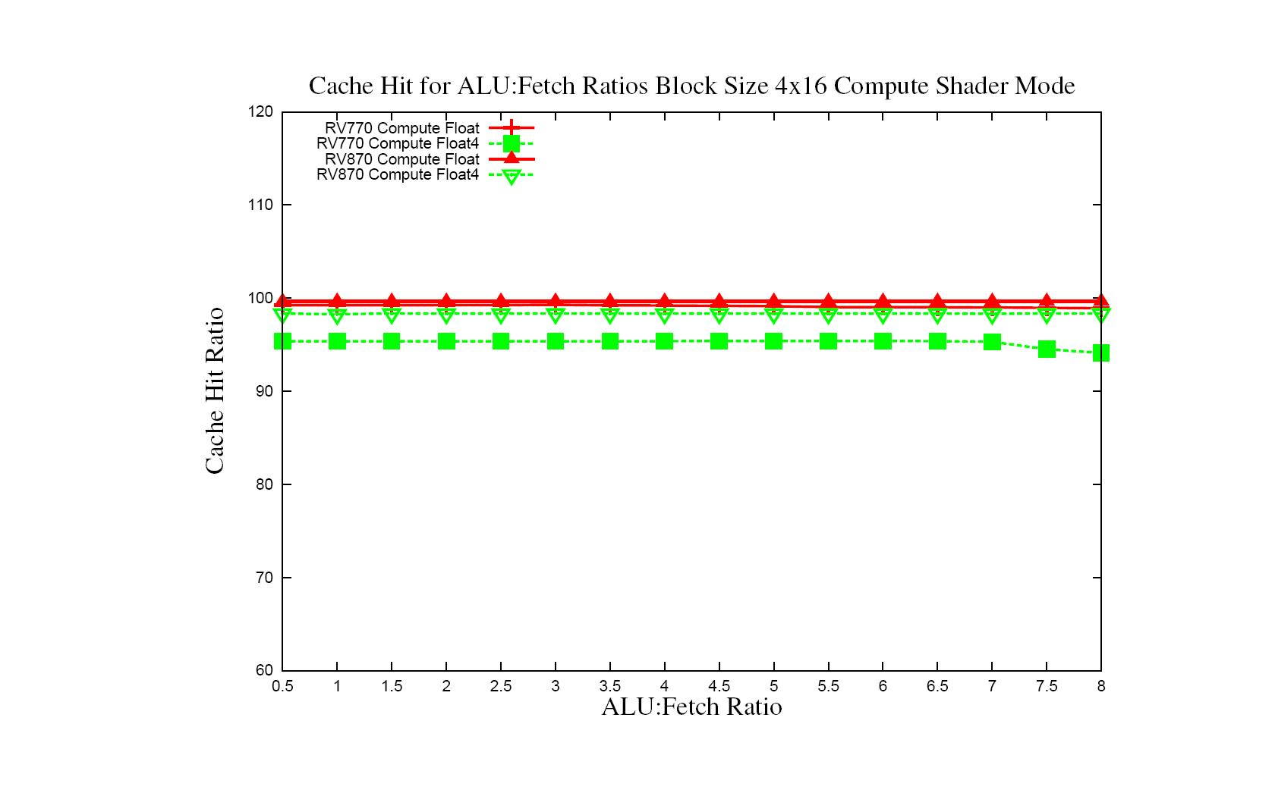
Cache Use – ALU:Fetch 4x16
Cache Hit Ratio not effected much by number of ALU operations

Slide 24
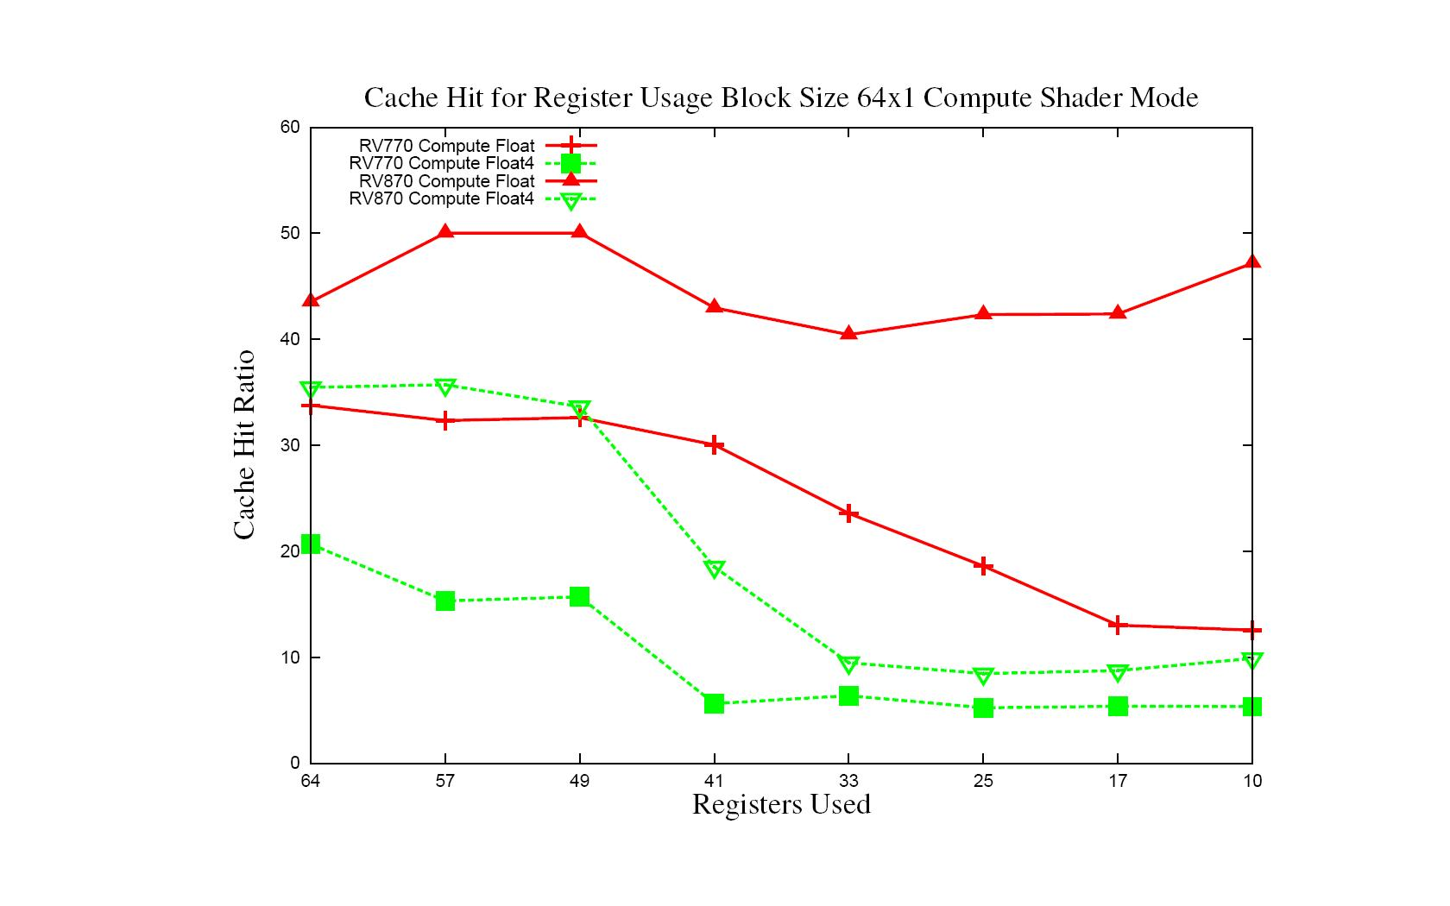
Cache Use – Register Usage 64x1
Too many wavefronts

Slide 25
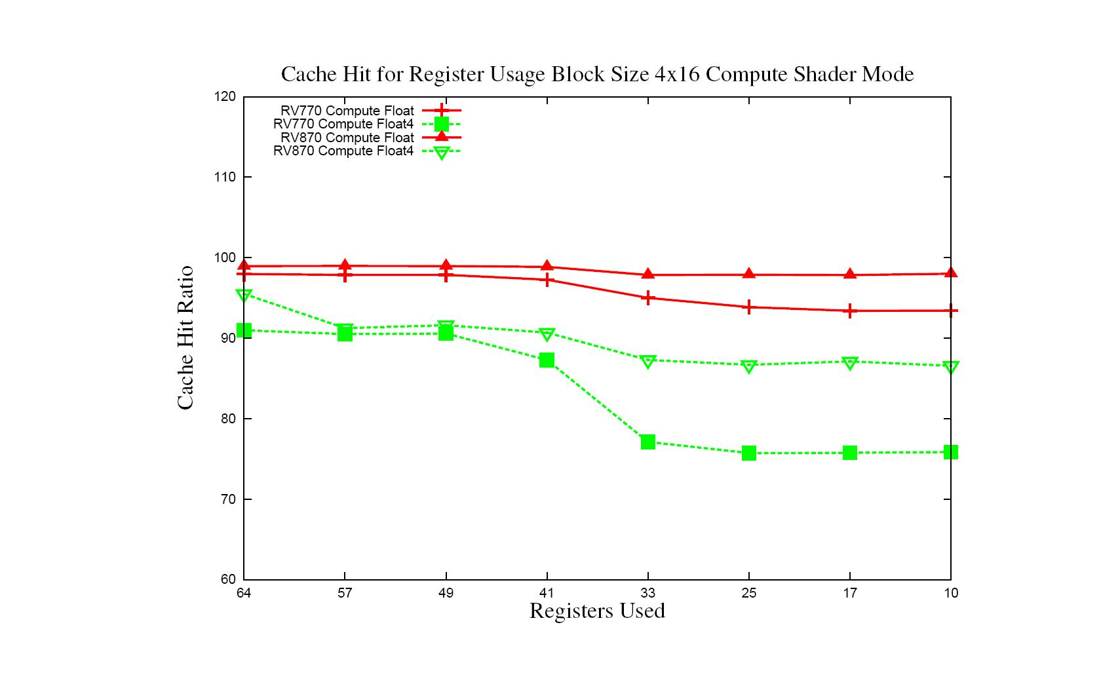
Cache Use – Register Usage 4x16
Cache Thrashing

Slide 26
Conclusion/Future Work
Conclusion
  Attempt to understand behavior based on program characteristics, not specific algorithm
    Gives guidelines for more general optimizations
  Look at major kernel characteristics
    Some features maybe driver/compiler limited and not necessarily hardware limited
      Can vary somewhat among versions from driver to driver or compiler to compiler
Future Work
  More details such as Local Data Store, Block Size and Wavefronts effects
  Analyze more configurations
  Build predictable micro-benchmarks for higher level language (ex. OpenCL)
  Continue to update behavior with current drivers

