Slide 1
Improving the Performance of MPI Parallel I/O
Phillip Dickens, Department of Computer Science, University of Maine.
In collaboration with Jeremy Logan, Postdoctoral Research Associate, ORNL.

Slide 2
Outline
Issues in providing high-performance parallel I/O in general.
Issues with MPI-IO in particular.
Interval-Based files.
How implemented in ROMIO.
Infrastructure required to support Interval-Based files.
Performance results.

Slide 3
General Problem Statement
I/O requirements of large-scale scientific applications are straining capacity of state-of-the-art parallel file systems
I/O dominating overall application performance
Further scientific discovery requires:
Higher resolution models
Larger, more complex data sets

Slide 4
Challenges of Providing Scalable I/O
Way data stored on disk (file data model) generally does not match way applications access their data (application data model).
Contention for file system resources, particularly when using shared file rather than one file per process.
Enforcing strict file consistency semantics
Mismatch between implementation of Parallel I/O API and the file system architecture

Slide 5
MPI I/O
MPI I/O
Defines powerful parallel API that enables applications to express complex, parallel I/O access patterns in a single request
Provides opportunities for implementation to optimize access to the underlying file system.
ROMIO
High performance implementation of MPI-IO developed and maintained at ANL
Provides important parallel I/O optimizations (two-phase I/O, data sieving), powerful parallel I/O infrastructure that we utilized in this research.
Notes:
Our work

Slide 6
How Challenges Apply to MPI I/O
Mismatch in file data model.
Supports only one file data format: “linear sequence of bytes”
Application data file model is more a collection of (perhaps) non-contiguous file regions
Use the term interval file data model
MPI-IO spends much of its time translating between these two data models at runtime.
Two-phase I/O, Data sieving, both aimed at converting between the way applications actually access data and the way it is stored in the file.

Slide 7
Contention for file system resources
MPI-IO is designed for shared files
Create significant contention because trying to write data back into the linear format.
File Consistency Semantics
MPI-IO defines atomic mode
Requires “sequential consistency”
Very difficult to implement with high performance

Slide 8
Implementation of API
ROMIO provides many important parallel I/O optimizations which work well in many cases
Underlying assumption is that performing large, contiguous writes in parallel provides maximum parallel I/O performance.
Can create significant contention in some file systems (e.g., Lustre).
Published a couple of papers on improving performance of MPI-IO on Lustre file systems if interested:
Dickens, P. and Logan, J. A High Performance Implementation of MPI-IO for a Lustre File System Environment. In Concurrency and Computation: Practice and Experience, Volume 22, Issue 11, pages 1433-1449, John Wiley & Sons, Ltd., (August, 2010).
Notes:
Deal specifically with this issue

Slide 9
Goal: Improve Performance While Supporting MPI-IO Interface
Areas of Improvement
Linear sequence of bytes file model
Resource contention from large, shared files
Strict file consistency semantics
Interval I/O does support MPI-IO Atomic Mode.
Notes:
Atomic mode; Forthcoming publications

Slide 10
Focus on Interval-Based File Format
Most important task is to create a file data format that reflects the way data is accessed by application.
MPI-IO provides file view mechanism that describes relationship between how processes will access their data and how data laid out on disk.
Use aggregate information from file views to:
Intelligently place data on processes
Store such data on disk as stored on processes
Notes:
Very valuable information.

Slide 11
MPI File Views
File views provide information about file access patterns.
Maps regions of a file in which will be active, and how that data is laid out on disk.
A process cannot “see” any file regions that are not declared in their file view.
Essentially maps a (perhaps) a contiguous window on (perhaps) non-contiguous file regions in which it will operate.

Slide 12
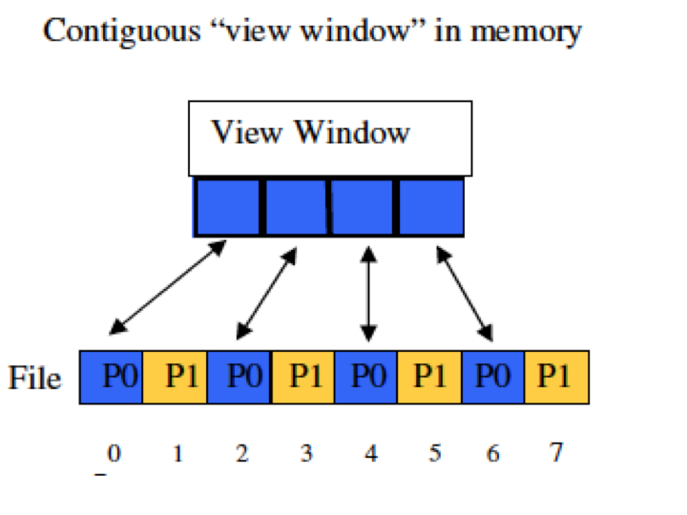
MPI File View
Notes:
Very simple example

Slide 13
P0
P0
P0
P0
P1
P1
P1
P1
Option 1: Each application can perform 4 separate I/O operations separated by a seek.
Option 2: Two-phase I/O
Notes:
Assume data is on process that needs it. To get back to linear file

Slide 14
P0
P0
P0
P0
P1
P1
P1
P1

Slide 15
P0
P1
P0
P1
P0
P1
P0
P1
Aggregate data to one process
Write to disk in a single operation
Mush better performance than multiple, independent writes. .

Slide 16
Our goal is to store data at process and on disk the way it is actually used
Process P0
P0
P0
P0
P0
Process P1
P1
P1
P1
P1
Term each file region an interval, maintain intervals accessed by process on that process.
Notes:
To the extent possible. Each non-contiguous file region is an interval. Collection of intervals per process

Slide 17
Simple Interval File
P0
P0
P0
P0
P1
P1
P1
P1
File (Meta data not shown)
Application can access data in one I/O operation
Minimizes file contention: Each process writes its data to own region of the file

Slide 18
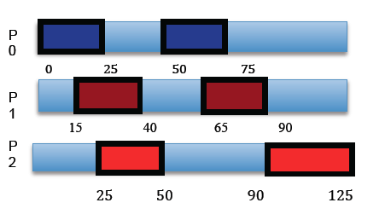
Treat file view as intervals on an integer line
Notes:
More complex example

Slide 19
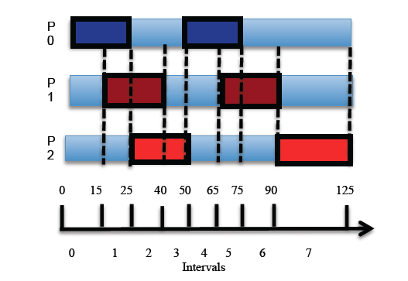
Take intersections of intervals, create set of elementary intervals.
Notes:
Each such interval is treated as file interval

Slide 20
Advantages
Elementary intervals are non-overlapping
Create highly efficient interval tree to store and retrieve information about interval sets at runtime.
Intervals can be identified as being private to a process or shared among two or more processes.
Only shared intervals require locking
Shared intervals encompass exactly the overlapping file regions
No false sharing (at least with respect to file views).
Shared intervals known at interval creation time
Each lock manager knows exactly those processes that can access shared region
Essentially create a set of centralized lock managers executing in parallel
No central lock manager.

Slide 21
Application
ROMIO
ADIO
GPFS
IBFS
NFS
Logical Implementation of IBFS
Notes:
Provide functionality to

Slide 22
Requires Infrastructure
Interval Integration Infrastructure:
Translate from MPI-IO speak to intervals
Interval cache:
Manages intervals
Interval Files:
Provides meta-data necessary to maintain view of file and to be able to map back to linear file,
Distributed locking system
Using intervals makes locking system much simpler and faster
Translator:
To translate between interval sets and/or linear file model.

Slide 23
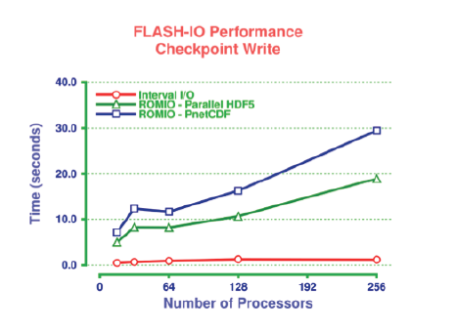

Slide 24
