Slide 1
Seventh International Workshop on Parallel Programming Models and Systems Software for High-End Computing (P2S2)
PavanBalaji
Yong Chen
Abhinav Vishnu

Slide 2
Organizing Committee
Steering Committee:
William Gropp, University of Illinois at Urbana-Champaign
Vijay Saraswat, IBM Research
Program Co-chairs
Pavan Balaji, Argonne National Laboratory
Yong Chen, Texas Tech University
Abhinav Vishnu, Pacific Northwest National Laboratory
Publicity Chair
Wesley Bland, Argonne National Laboratory

Slide 3
P2S2 2014 Statistics
25 paper submissions
P2S2 prides itself with a thorough review process
Each paper received at least 4 reviews, most had 5 reviews, some had 6 reviews
PC Meeting in Mid May for paper decisions; lots of discussion for each paper. We had to make some tough choices.
13 papers were accepted (52% acceptance rate)
21 PC Members
Many thanks for their hard work and diligent reviews!
Thanks to Wesley for undertaking the publicity/web chair role!

Slide 4
P2S2 2014 Logistics
Five sessions:
We will start with a keynote talk by Prof. Wu-chun Feng
Four sessions for regular technical paper presentations
For Presenters:
Please meet session chair before the session starts
Please provide a short bio
Presentations may need to be copied to a common presentation laptop before the session (please check with your session chair!)
Please send your slides to p2s2-chairs@mcs.anl.gov and we will post slides on program page

Slide 5
P2S2 2014 Sessions
Session 0: Keynote
Time: 8:15am – 9:15am
An Ecosystem for the New HPC: Heterogeneous Parallel Computing
Prof. Wu-chun Feng, Virginia Tech

Slide 6
P2S2 2014 Sessions (contd.)
Session 1: Tasking and Memory
Time: 9:15am – 11:15am (break at 10:15am)
Session Chair: Hari Subramoni, Ohio State University
“Local Search to Improve Task Mapping”, Evan Balzuweit, David Bunde, Vitus Leung, Austin Finley, and Alan Lee
“A Framework for Tracking Memory Accesses in Scientific Applications”, Antonio Pena and Pavan Balaji
“Checksumming Strategies for Data in Volatile Memories”, Humayun Arafat, Sriram Krishnamoorthy, and P. Sadayappan

Slide 7
P2S2 2014 Sessions (contd.)
Session 2: Heterogeneous Computing
Time: 11:15am – 12:45pm
Session Chair: Michela Taufer, University of Delaware
“Pruning Strategies in Adaptive Offline Tuning for Optimized Composition of Components on Heterogeneous Systems”, Lu Li, Usman Dastgeer, and Christoph Kessler
“Energy and Power Characterization on Parallel Programs Running on Intel Xeon Phi”, Joal Wood, Ziliang Zong, Qijun Gu, and Rong Ge
“Delivering Parallel Programmability to the Masses via the Intel MIC Ecosystem: A Case Study”, Kaixi Hou, Hao Wang, and Wu-chun Feng

Slide 8
P2S2 2014 Sessions (contd.)
Session 3: Data Movement and I/O
Time: 13:45pm – 16:15pm (break at 15:15pm)
Session Chair: Antonio Pena, Argonne National Laboratory
“Using Working Set Reorganization to Manage Storage Systems with Hard and Solid State Disks”, Junjie Chen, Jialin Liu, Philip Roth, and Yong Chen
“Benchmarking the Performance of Scientific Applications with Irregular I/O at the Extreme Scale”, Stephen Herbein, Scott Klasky, and Michela Taufer
“Improving Data Movement Performance for Sparse Data Patterns on Blue Gene/Q Supercomputer”, Huy Bui, Eun-Sung Jung, Venkatram Vishwanath, Jason Leigh, and Michael Papka
“Decoupled I/O for Data-Intensive High Performance Computing”, Chao Chen, Yong Chen, Kun Feng, Yanlong Yin, Hassan Eslami, Rajeev Thakur, Xian-He Sun, and William D. Gropp

Slide 9
P2S2 2014 Sessions (contd.)
Session 4: Programming Models
Time: 16:15pm – 17:45pm
Session Chair: Patrick Bridges, University of New Mexico
“A Distributed Dataflow Model for Task-uncoordinated Parallel Program Execution”, Lucas Wilson and Jeffrey Von Ronne
“Beehive: A Framework for Graph Data Analytics on Cloud Computing Platforms”, Anand Tripathi, Vinit Padhye, and Tara Sasank Sunkara
“NestedMP: Taming Complex Configuration Space of Degree of Parallelism for Nested-Parallel Programs”, Jiangzhou He, Wenguang Chen, and Zhizhong Tang

Slide 10
P2S2 2013 Journal Special Issue (with Journal of Supercomputing: JoS)
Special Issue on “Parallel Programming Models and Systems Software”
Editors: Abhinav Vishnu, Yong Chen, and Pavan Balaji
By-invitation only special issue for P2S2 2013 accepted papers
Paper notifications are out; still waiting for the special issue to be published
Expected publishing date: Dec. 2014

Slide 11
P2S2 2014 Journal Special Issue (with Journal of Supercomputing: PARCO)
Special Issue: “Parallel Programming Models and Systems Software”
Editors: Pavan Balaji, Yong Chen, and Abhinav Vishnu
By-invitation only for P2S2 2014 accepted papers
All 13 accepted papers were invited; all of them intend to submit
Deadline: Oct. 1st
Journal requirements on acceptance:
Needs to have 30% additional material
New results, more analysis, etc., are OK for the additional material
No strict plan for the number of accepted papers
We are internally planning to notify authors by early 2015
But journal reviews are often delayed, so bear with us if we are late
Target date for special issue publication mid 2015

Slide 12
Plans for the Eighth P2S2 Workshop, 2015
Approved for continuing to be associated with ICPP 2015, Beijing, China
Journal Special issue is planned (journal will likely be JoS)
Please Get Involved !
Paper submissions
Workshop attendance
Advertising

Slide 13
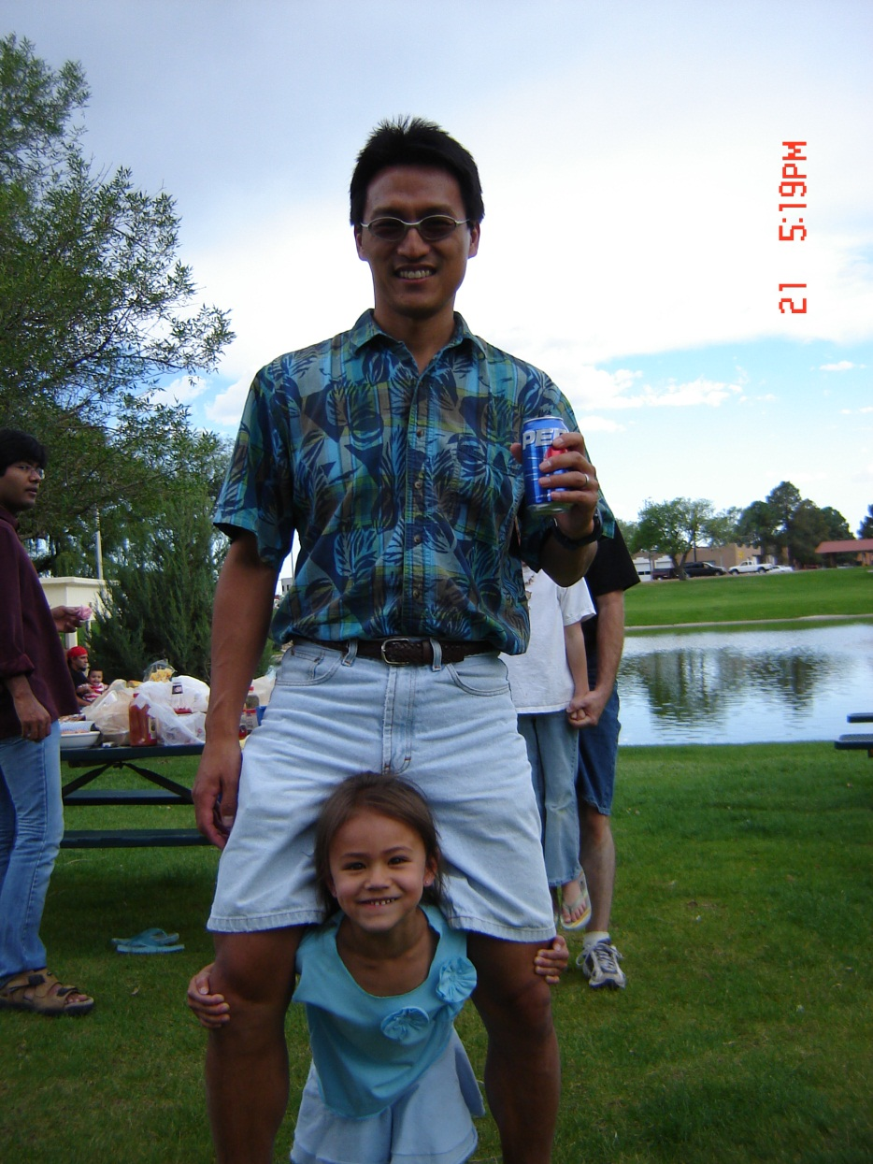
P2S2 2014 Keynote
An Ecosystem for the New HPC: Heterogeneous Parallel Computing
Prof. Wu-chun Feng
Virginia Tech

