Slide 1

OpenJDK Meets Xeon Phi:
A Comprehensive Study of Java HPC on Intel Many-core Architecture
Yang Yu, Tianyang Lei, Haibo Chen, Binyu Zang
Fudan University, China
Shanghai Jiao Tong University, China
Institute of Parallel and Distributed Systems
P2S2 2015

Slide 2
HPC and Many-core Architectures
    High-performance computing (HPC) continually evolves
    Spread all practical fields
    Massive parallel processing
    Strong computing power
    Stimulates new processor architecture
    More cores onto one single chip
    GPUs, Xeon Phi, etc.

Slide 3





Java on HPC
    Easy and portable programmability
    Built-in multithreading mechanism
    Strong community/corp. support

Slide 4
Gap between Java HPC and Many-core
    Works focusing on running Java on GPU
    JCUDA, Aparapi, JOCL, etc.
    Convert Java bytecodes into CUDA/OpenCL
    Deficiencies
    Not running managed runtime on many-core
    Cannot utilize good Java features
    No official support for Java on Intel’s MIC

Slide 5
Agenda
  Bridge the gap
  Experiments
  Observations
  Semi-automatic vectorization

Slide 6
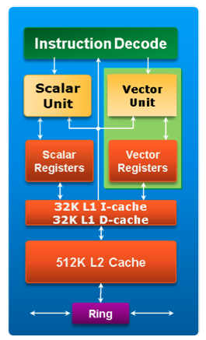
Intel Xeon Phi Coprocessor
    Intel® Knight Corner(KNC)
    More than 60 in-order coprocessor cores, ~1GHz
    Based on x86 ISA, extended with new 512-bit wide SIMD vector instructions and registers.
    Each Coprocessor core
    Supports 4 hardware threads
    32KB L1 data & instruction cache, 512KB L2 cache
    No traditional LLC
    Interconnected L2 caches
    Memory controllers
    Bidirectional ring bus
Architecture overview of an Intel® MIC Architecture core

Slide 7
Java Platform
    OpenJDK
    A free and open-source implementation of the Java Platform, Standard Edition (Java SE)
    Consist of HotSpot (the virtual machine), Java Class Library and javac compiler, etc.
    Execution engine – HotSpot VM
    Execute Java bytecodes in class files
    Class loader, Java interpreter, just-in-time compiler (JIT), garbage collector, etc.

Slide 8
Challenges
    Lack of dependent libraries for cross-building
    Libraries related to graphics, fonts, etc.
    μOS on Xeon Phi is oversimplified
    Lack of necessary tools for developing and debugging
    Incompatibility between HotSpot’s assembly library and Xeon Phi ISA
    Floating-point related, SSE and AVX
    mfence, clflush, etc.

Slide 9
Porting OpenJDK to Xeon Phi
    Lack of dependent libraries for cross-building
    A “headless” build of OpenJDK – no graphics support
    μOS on Xeon Phi is oversimplified
    Cross-compile missing tools from source packages
    Incompatibility between HotSpot’s assembly library and Xeon Phi ISA
    512-bit vector instructions & legacy x87 instructions
    Fine-grained modification based on semantics in HotSpot

Slide 10
Agenda
  Bridge the gap
  Experiments
  Observations
  Semi-automatic vectorization

Slide 11
Environment
Parameter | Intel Xeon PhiTM Coprocessor 5110P | Intel^{(R)} Xeon^{(R)} CPU E5-2620
Chips | 1 | 1
Physical cores | 60 | 6
Threads per core | 4 | 2
Frequency | 1052.630 MHz | 2.00 GHz
Data Caches | 32 KB L1, 512 KB L2 per core | 32 KB L1d, 32 KB L1i 256 KB L2, per core 15 MB L3, shared
Memory Capacity | 7697 MB | 32 GB
Memory Technology | GDDR5 | DDR3
Peak Memory Bandwidth | 320 GB/s | 42.6 GB/s
Vector Length | 512 bits | 256 bits (Intel^{(R)} AVX)
Memory Access Latency | 340 cycles | 140 cycles

Slide 12
Experiment Setup
    Java environment and benchmarks
    OpenJDK 7u6 version (build b24)
    Thread version 1.0 of Java Grande benchmark suite
    Crypt, Series, SOR, SparseMatmult, LUFact
    Single-threaded execution
    Java and C versions
    -no-vec, -no-opt-prefetch, -no-fma
    Multi-threaded execution
    Application threads pinned evenly onto each physical core
    1, 20, 40, 60*, 120, 180 and 240 threads on Xeon Phi
    1, 2, 4, 6*, 9 and 12 threads on CPU
    Average of 5 iterative runs for each benchmark-thread pair

Slide 13
Benchmark Characteristics
Computation dominating | Crypt | Multiple integer operations
 | Series | Double-precision math functions
Memory intensive | SOR | Sequential access pattern
 | LUFact | Contiguous access limited within small loops
 | SparseMatmult | Array elements selected randomly

Slide 14
Agenda
  Bridge the gap
  Experiments
  Observations
  Semi-automatic vectorization

Slide 15
Single-threaded performance – CPU vs MIC
Significant degradation of throughput for SparseMatmult
Java
C
Memory latency: 140 vs. 340 cycles
Instruction decoder: 4 decoder units vs. two-cycle unit
Execution engine: out-of-order vs. in-order
Clock frequency: 2.0 vs. ~1 GHz

Slide 16
Single-threaded performance – CPU vs MIC
Porting overhead
On-chip caches critical to performance
JVM memory management, TLAB, garbage collector

Slide 17
Scalability of Multi-threads
CPU
MIC
    Much better scalability for all programs can be observed on Xeon Phi
    Throughputs increase before 120 threads for all programs on Xeon Phi
    SparseMatmult scales up to 240 threads on Xeon Phi
    Crypt is not able to scale even a little after exceeding two running threads per core

Slide 18
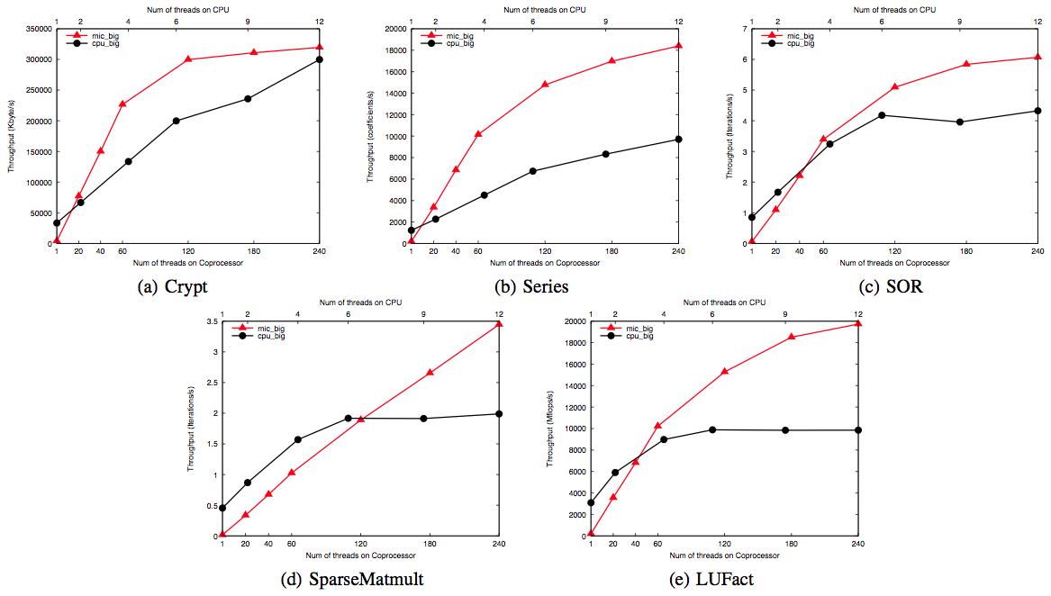
Throughputs

Slide 19
Optimizing Solutions
    Enable 512-bit vectorization
    Software prefetching in JIT
    Optimization for in-order execution mode

Slide 20
Agenda
  Bridge the gap
  Experiments
  Observations
  Semi-automatic vectorization

Slide 21
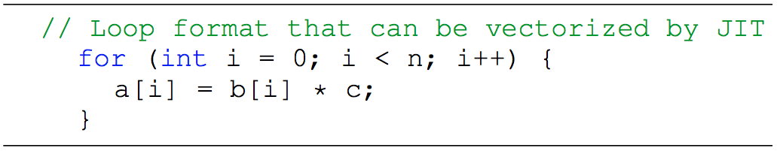

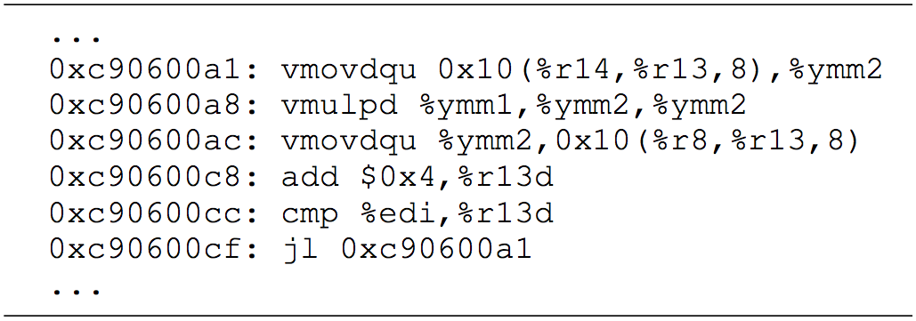
Auto-vectorization in HotSpot
X86 platform

Slide 22
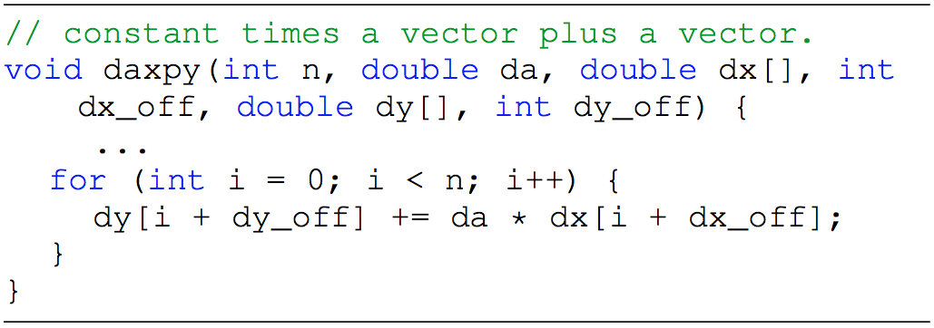

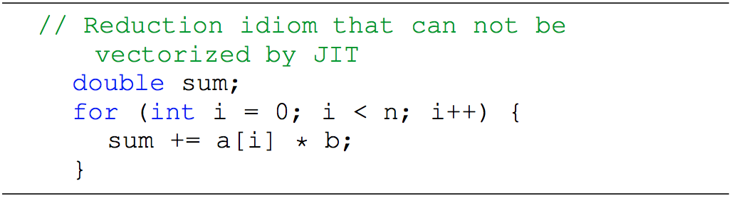
Restrictions

Slide 23
Semi-automatic Vectorization
    Front-end scheme in Javac
    Annotation before innermost loop
    New “vector bytecodes”
    Implementation in HotSpot
    Parse “vector bytecodes”
    Generate 512-bit vector instructions
    Meet 64-byte alignment

Slide 24
Speedup of Throughput
Throughput of LUFact with varying number of threads

Slide 25
Throughput Comparison -- CPU & MIC
>3x
Performance gains by vectorization for LUFact

Slide 26
Conclusions
    First porting of OpenJDK to Intel Xeon Phi coprocessor
    A build of complete Java runtime environment on modern many-core architecture
    A comprehensive study on performance issues of Java HPC benchmarks on Xeon Phi
    Single-threaded and multi-threaded runs
    Throughput and scalability
    Semi-automatic vectorization scheme in Hotspot VM
    Up to 3.4x speedup for LUFact on Xeon Phi compared to CPU

Slide 27

Thanks
Questions

