Slide 1
HetroCV: Auto-tuning Framework and Runtime for Image Processing and Computer Vision Applications on Heterogeneous Platform
Daihou Wang, David J. Foran, Xin Qi and Manish Parashar
1. Rutgers Discovery Informatics Institute (RDI2)
Rutgers, The State University of New Jersey
2. Rutgers Cancer Institute of New Jersey
ICPP-P2S2 2015 9/1/2015

Slide 2
OUTLINE
Introduction and Background
Problem statement
Related work
Main contributions
Characterize Image-processing Computation
Patterns in image-processing pipelines
Pattern-units performance optimization
HetroCV Auto-tuning Framework and Runtime
Overview
HetroCV auto-tuning framework
HertoCV runtime
Experimental Evaluation
Conclusion and Future Work

Slide 3
1. Introduction and background
Problem Statement
Related Work
Main Contributions

Slide 4
Trends in Image-processing Applications
High-volume:
Society media
Medical Imaging:
532 TB unstructured image data
per hospital, by year 2015^{[1]}
High-resolution:
Whole-slide imaging (WSI)
Up to 20,000 x 20,000 pixels
Range from 1~5 GB per image
Complex workflows:
High-dimension feature
Deep-learning
High-performance Image-processing
[1] NetApp. https://communities.netapp.com

Slide 5
Challenges from High-performance Image-processing
Challenges:
System Heterogeneity
Accelerator-based HPC
systems, from Top500 List^{[2]}
System Diversity
Program Portability
Need tuning / re-tuning after
transplanted to a different platform
Program Programmability
Auto-tuning strategies
[2] Top500 List, http://www.top500.org/list
System | Accelerator | Rank/Year
Tianhe-1 | Nvidia GPGPU | 1 / 2010
Titan | Nvidia GPGPU | 1 / 2012
Tianhe-2 | Intel Xeon Phi | 1 / 2013

Slide 6
Auto-tuning Algorithms
Proposed to optimize the performance of application:
with variable input scale and application parameters
under system load variation
after transferred between platforms
Previous auto-tuning algorithms:
[3] PetaBricks, http://www.projects.csail.mit.edu/petabricks
Category | Example | Description
Off-line tuning | PetaBricks^{[3]} | Optimal parameter is searched through heuristic searching over the parameter space.
On-line tuning | Sibling Ravalry | Chose optimal parameter at runtime.
Learning-based tuning | Nitro | Learning from the optimal parameters got from offline tuning of the training sets.
Notes:
?? G3/G4 vs G5 can be better classified, while G3/G4 are not

Slide 7
Main Contributions
Pattern-based representation for computation units in image processing pipeline.
A machine learning based auto-tuning framework for multi-core processor and MIC co-processor.
Runtime scheduler for dynamic work balance between processor and co-processor.

Slide 8
2. CHARCTIZE Image-processing Computation
Patterns in Image-processing Pipelines
Pattern-units Performance Optimization

Slide 9
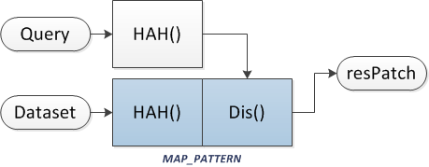
Image-processing Pipelines
Image-processing applications as streams of computation-units.
Patterns from image-processing CUs:
based on computation & data access patterns, the streamed computation units (CU) can be grouped into several basic categories.
computation units from the same category share the same parameter searching space for performance optimization.
(a) Example IP pipeline A
(b) Example IP pipeline B
Fig-1 Examples of image-processing pipelines

Slide 10
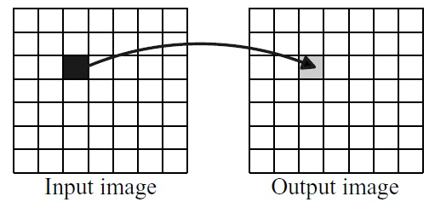
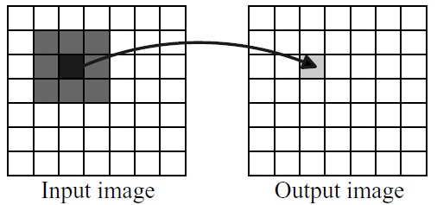
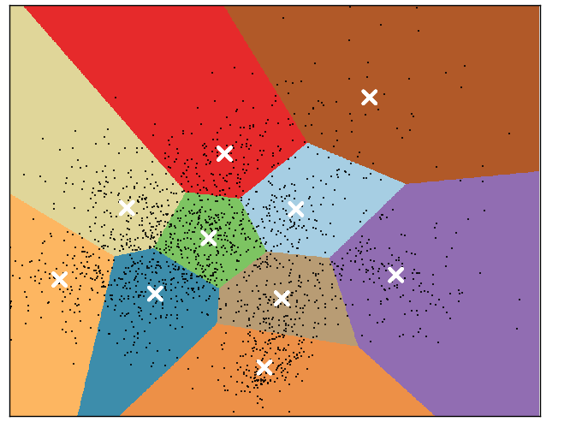
Patterns in Image-processing Pipelines
Map-pattern:
group of data- parallel operations which are independent
Stencil-pattern:
operations conducted on image patches
the image patches have overlaps
MapReduce-pattern:
2-phase pattern
phase 1 is composed of group of independent operations
phase 2 works on the combination of independent results from phase 1
(a) Map-pattern operation
(b) Stencil-pattern operation
(c) MapReduce-pattern operation
Fig-2 Illustrations of pattern-based operations

Slide 11
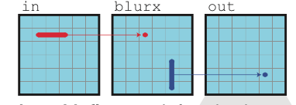
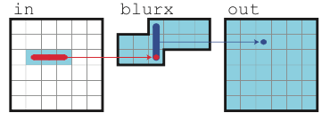
Parallel Pattern-unit Computation
Computation-unit performance optimization:
D-1: computation granularity
D-2: storage granularity
CU performance optimization:
1. Tiling:
distribute the data-independent computation onto parallel computation units.
[HetroCV] image is evenly distributed into blockY_num x blockX_num tiles.
2. Vectorization:
indicate whether the inner most loop IS/NOT vectorized.
[HetroCV] iSimd = 1 indecates the inner most loop IS vectorized
3. Breadth first / sliding window:
Breadth first and sliding window are computation-granularity optimizations for stencil computations, instead of basic pixel-wise stencil computation.
[HetroCV] index_PW = 1 / index_BF = 1 / index_SW = 1 indicates PW / BF / SW stencil computation.

Slide 12
Parallel Pattern-unit Computation
CU performance optimization (continued):
4. Partition:
distribute the output of map() function onto parallel computation units.
[HetroCV] output is evenly distributed into iR_blockY_num x iR_blockX_num sets.
5. Multi-threading:
OpenMP software thread # for CPU / MIC
[HetroCV] thNp and thNc for processor / coprocessor
Table-1 Optimization parameters for pattern-units
CU Pattern | Shortcomings
Map-pattern | blockY_num, blockX_num, iSimd, thNi
Stencil-pattern | blockY_num, blockX_num, iSimd, index_PW, index_BF, index_SW, thNi
MapReduce-pattern | blockY_num, blockX_num, iSimd, iR_blockY_num, iR_blockX_num, thNi

Slide 13
3. HetroCV auto-tuning framework and runtime
Overview
HetroCV Auto-tuner
HetroCV Runtime

Slide 14
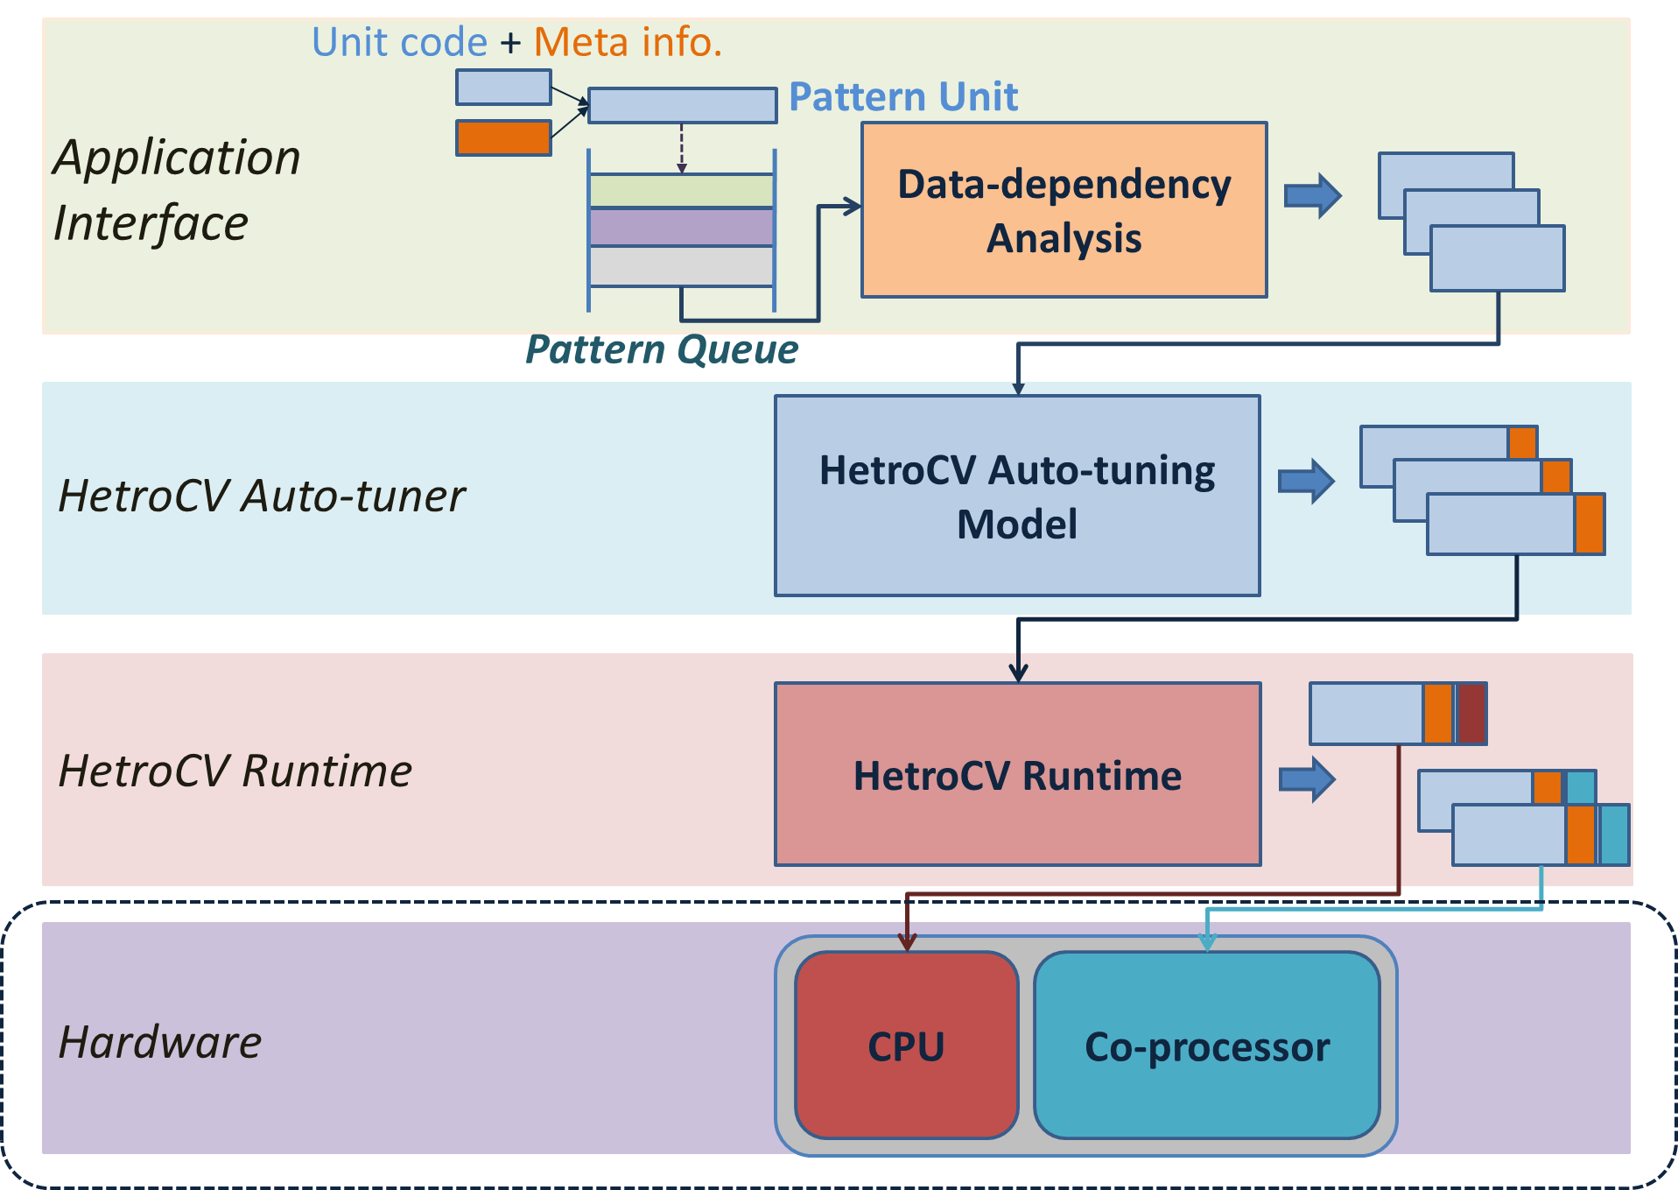
HetroCV Overview
HetroCV:
Application interface:
gather function variants and meta-information for computation units
Generated PU for each computation unit into a pattern queue.
HetroCV auto-tuner:
Performance prediction models built from trial run of training sets.
HetroCV consult the corresponding model to select the tuning parameters.
HetroCV runtime:
performance models for processor / co-processor built to predict the prospective time performance
section mapped to processor/co-processor
Fig-3 Overview of HetroCV auto-tuning framework and runtime

Slide 15
Application Interface
Function variations and meta-information:
In HetroCV, function variants were presented to the auto-tuning framework through application interface.
In addition to function variants, meta-information was passed through the application interface.
Data-dependency analysis:
In HetroCV, a data dependency graph was built for all the patten units in the pattern queue, and updated after a pattern unit was added or completed.
In this way, all the “data ready” pattern units will be tuned and launched in parallel.

Slide 16
HetroCV Auto-tuner
Learning based auto-tuning:
We built 3 classifiers for the 3 types of computation units using support-vector machine (SVM).
Before the application was launched, exhaustive-searching based tuning was first performed on a set of training applications for each pattern.
The classifiers were trained using the computation unit statistics and the optimal parameters from these sets.
Later when a new pattern unit from the application arrives at the auto-tuner, the tuning classifier of this pattern type would predict optimal tuning parameters based on the computation unit statistic feature of the unit.

Slide 17
HetroCV Auto-tuner
Computation-unit Statistics:
Performance of the computation unit is determined by
Computation pattern
Data access pattern
Optional parameters are also determined by computation / data access pattern.
We design a histogram to capture these computation statistic feature of each CU.
For a computation unit CU_{i}, define the computation statistic basicHist_{i} as:
basicHist_{i} = [ num_dRead_{i}, num_dWrite_{i}, num_Read_{i}, num_Write_{i},
num_addsub_{i}, num_muldiv_{i}, num_complex_{i} ]
In which, num_dRead_{i}, num_dWrite_{i}: # of delayed-read/write in CU_{i}.
We define delayed-read/write operations as column-major operations of an array.
num_Read_{i}, num_Write_{i} : # of row-major operations.
num_addsub_{i}, num_muldiv_{i}, num_complex_{i} : # of add/sub, multiple/division, complex operations.

Slide 18
HetroCV Auto-tuner
Training set:
We built a training set for each pattern from element IP operations:
RGB to HSI color-space transformation.
Gradient computation.
Mean-value filtering.
Gaussian filtering.
Color histogram calculation.
Table-2 Auto-tuning classifier training set applications
Training Apps. | Pattern Type
RGB to HSI transformation | M
Gradient Computation | M
Mean-value filtering | S
Gaussian filtering | S
Color histogram calculation | MR

Slide 19
HetroCV Runtime
Runtime:
Offloading is the most widely used mode for computing on heterogeneous platforms composed of CPU(s) and coprocessor(s).
In some cases, data transferring overhead between CPU and coprocessor becomes too large and deteriorates the overall performance.
And for a certain application, this balance often varies based on the input data scale, which made hard- coded application using offloading not robust to input scale changes.
On the other side, even for cases when the kernel speed-ups weren’t out-beat by the overheads, offloading often leaves the CPU(s) idle and wait on the results from the coprocessos(s), which would to a waste of the CPU computing power.

Slide 20
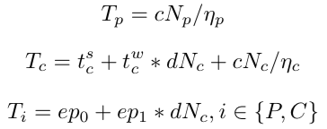
HetroCV Runtime
Performance model and performance prediction:
Overall computation Time = P / C computation time + Data transfer time
Computation model CPU / MIC
Data-transfer model:

Slide 21
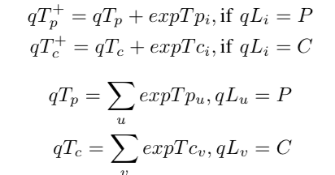
HetroCV Runtime
Computation unit scheduling:
HetroCV runtime keeps 2 queues for efficient pattern-unit mapping, one for processor and the other for coprocessor.
Based on scheduling strategy, each CU will be mapped to the P/C queue.
Maximum-throughput mapping strategy:
a computation unit CU_{i} will be given a queu
In which,

Slide 22
4. Experimental evaluation
Experiment Testbed and Applications
HetroCV Auto-tuner Evaluation
HetroCV Runtime Evaluation

Slide 23
Experiment Testbed and Applications
Stampede @ Texas Advanced Computing Center (TACC).
Each compute nodes on Stampede
2 Xeon E5-2680 processors
1 Intel Xeon Phi SE10P coprocessor
Processor/co-processor connected through PCIe express interface.
Testing applications:
Content-based image retrieval (CBIR)
works to retrieve image patches that shares resemblance to the input query image from the dataset images
Histopathology cell detection (CD)
detects the center of all the cells in the image according to the gray-level information

Slide 24
Testing Applications
(a) IP pipeline of testing application CBIR
(b) IP pipeline of testing application CD
Fig-4 Examples of image-processing pipelines
Table-3 Element pattern-unit summary from testing applications
PU Name | Pattern Type
HAH+Dis (CBIR) | M
Grad_x (CD) | M
Grad_y (CD) | M
Mag (CD) | M
Ang (CD) | M
mFilter (CD) | S
aFilter (CD) | M
Voting (CD) | MR

Slide 25
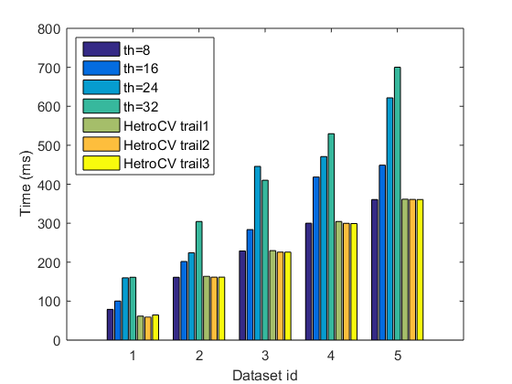
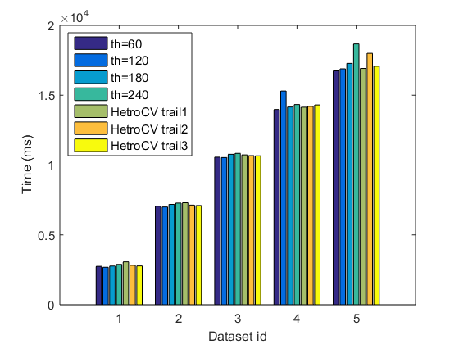
HetroCV Auto-tuner Evaluation
Exp 1-1: HetroCV auto-tuner v.s. naïve OpenMP tuning
Pattern-units performances comparison
HetroCV auto-tuner v.s. OpenMP thread number naive tuning
(a) performance comparison on multi-core CPU
(b) performance comparison on Xeon Phi coprocessor
Fig-5 Performance comparison between naïve OpenMP and HetroCV of the CBIR testing application.

Slide 26
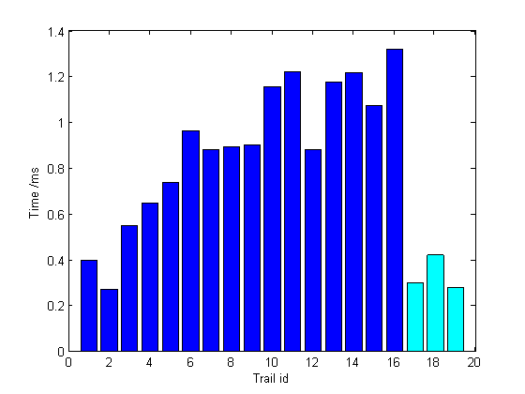
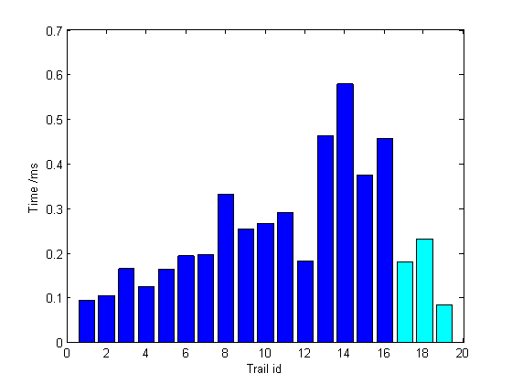
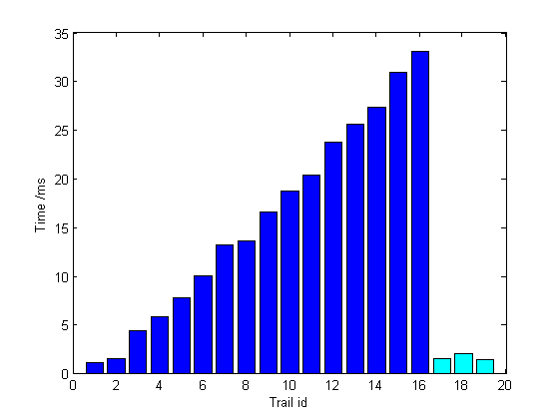
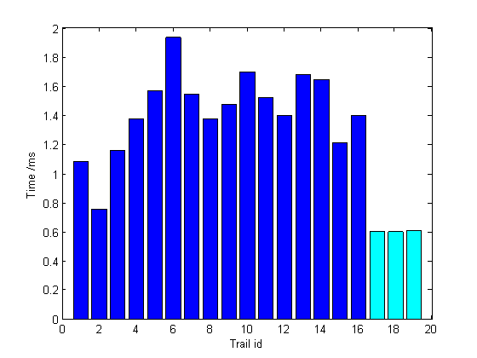
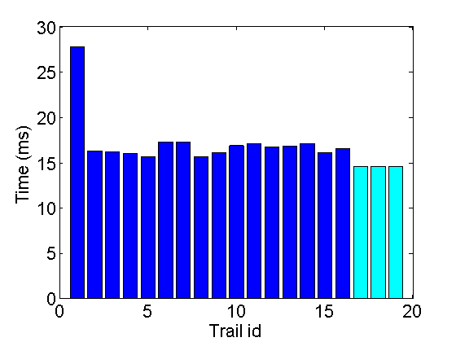
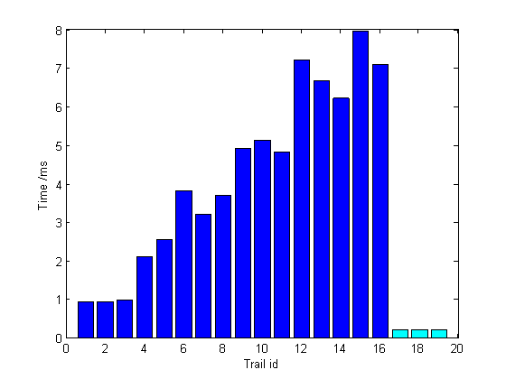
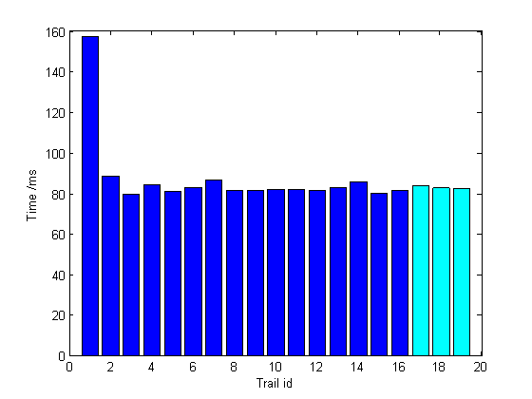
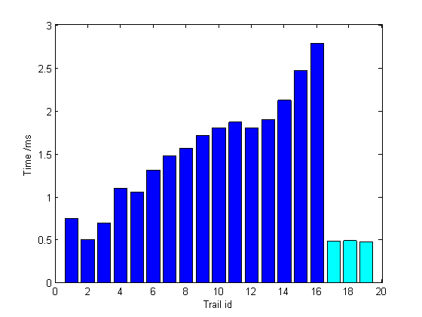
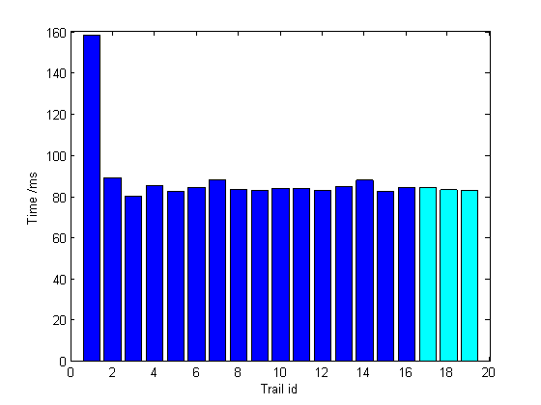
HetroCV Auto-tuner Evaluation
Exp 1-2: HetroCV auto-tuner v.s. heuristic searching
Pattern-units performances comparison
HetroCV auto-tuner v.s. GA-based tuning
CD testing application, CPU
Fig-6 Performance comparison between naïve OpenMP and HetroCV of the CD testing application on multi-core CPU.

Slide 27
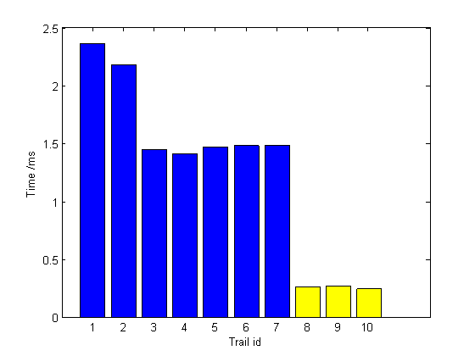
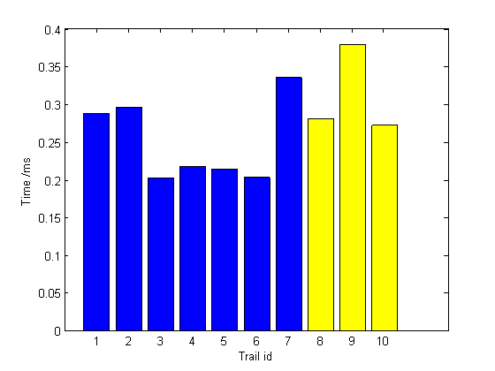
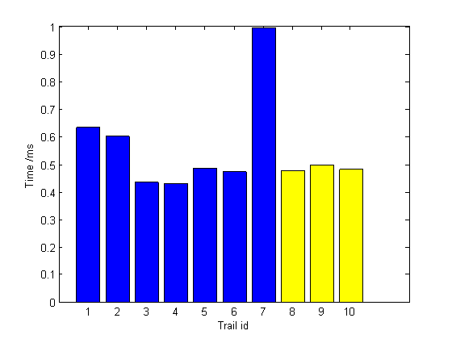
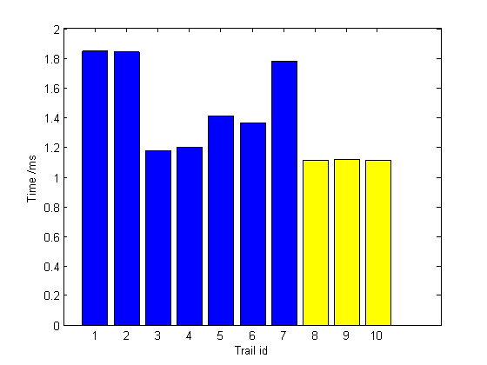
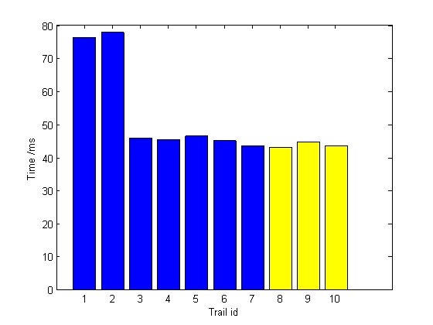
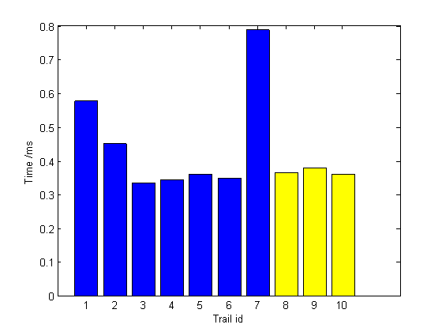
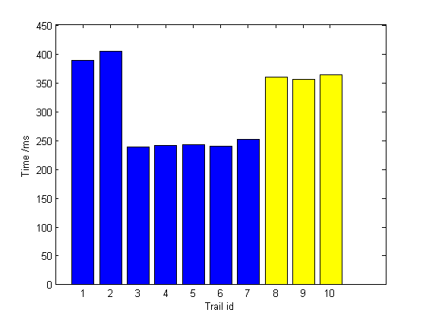
HetroCV Auto-tuner Evaluation
Exp 1-2: HetroCV auto-tuner v.s. heuristic searching
Pattern-units performances comparison
HetroCV auto-tuner v.s. GA-based tuning
CD testing application, MIC
Fig-7 Performance comparison between naïve OpenMP and HetroCV of the CD testing application on Intel Phi coprocessor

Slide 28
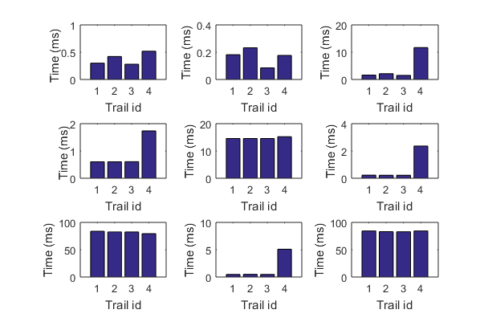
HetroCV Auto-tuner Evaluation
Exp 3: HetroCV auto-tuner v.s. heuristic searching
Pattern-units performances comparison
HetroCV auto-tuner v.s. GA-based tuning
CBIR testing application, CPU
Fig-8 Performance comparison between naïve OpenMP and HetroCV of the CD testing application
Trail id = 1, 2, 3 represents performance results from HetroCV; Trail id = 4 represents result from GA-based tuning

Slide 29
HetroCV Runtime Evaluation
Exp 3: Evaluation of the HetroCV runtime scheduler
The heuristic parameters in computation model and the unit data offload (uploading) time are summarized
Table-4 Runtime heuristic parameters
Parameter Type | Value
CPU computation time | ep0=1.89, ep1=1.77e⁻⁸
MIC computation time | ep0=5.69, ep1=-2.63e⁻⁸
CPU-MIC data transfer time | tTrans_{ON}=8.54e⁻¹², tTrans_{OFF}=6.57e⁻¹⁰

Slide 30
5. Conclusion and future Work
Conclusion
Future work

Slide 31
Conclusion
A programmer-directed auto-tuning framework and runtime for computer vision applications on heterogeneous MIC platform.
Auto-tuner:
Performance prediction models built from trial run of training sets.
HetroCV consult the corresponding model to select the tuning parameters.
Runtime:
performance models for processor / co-processor built to predict the prospective time performance
section mapped to processor/co-processor using Maximum-throughput scheme
2 real-world medical image processing testing applications running on heterogeneous CPU-MIC nodes, showed promising performance.
Future Work
Analytical-model based auto-tuning.

Slide 32
Acknowledgements
This research was funded, in part, by grants from NIH contract 5R01CA156386-10 and NCI contract 5R01CA161375-03, NLM contracts 5R01LM009239-06 and 5R01LM011119-04, NSF Office of Industrial In- novation and Partnerships Industry/University Cooperative Research Center (I/UCRC) Program under award 0758596, and the National Center for Research Resources and the National Center for Advancing Translational Sciences, National Institutes of Health, through Grant UL1TR000117 (or TL1 TR000115 or KL2 TR000116).

Slide 33
“Science. It is a drive--a thirst. It is what makes supercomputing so super!”
- Nathan Stone, PSC's Advanced Systems Group

