Slide 1
CellPilot
A Seamless Communication Solution for Hybrid Cell Clusters
Natalie Girard
Bill Gardner, John Carter, Gary Grewal
University of Guelph, Canada

Slide 2
Outline
Introduction
Motivation, purpose & related work
Pilot library overview
Cell Background
Architecture and programming challenges
CellPilot Solution
Additions to Pilot API
Communication
Conclusion & Future Work

Slide 3
Motivation
Our HPC consortium has a Cell cluster
4 x dual Xeon dual/quad core @ 2.5 GHz
8 x dual PowerXCell 8i @ 3.2 GHz
28 x86-64 + 32 PPEs + 128 SPEs
Why is (almost) no one using this system??
Grad-level parallel programming course abandoned setting a Cell assignment on it

Slide 4
Purpose
Introduce a simple programming model for the internal communication of the Cell.
Reduce the number of libraries needed to communicate across a heterogeneous cluster.
Only need one library for an application that spans Cell and non-Cell nodes in a hybrid cluster.
Seamless communication between any processes on the cluster.

Slide 5
Some related works for Cell BE
IBM’s libraries
DaCS (Data Communication and Synchronization)
ALF (Accelerated Library Framework)
CML (Cell Messaging Layer)
MPI Microtask
StarPU (also targets GPGPU)
Some change the way users write programs
None provide seamless HPC cluster solution

Slide 6
Method and Goals
Extend the Pilot library for the Cell Broadband Engine processor.
Simple message-passing API styled on fprintf, fscanf
Based on process/channel abstractions from Communicating Sequential Processes (CSP)
Implemented as thin layer on top of standard MPI
Reduce the difficulties with developing applications for a Cell cluster.
Allow novice scientific programmers to use these systems more readily.

Slide 7
Pilot code sample
#include “pilot.h” //Configuration phase
Create 2 processes, yellow and green:
PI_PROCESS *yellow = PI_CreateProcess( yellow_func, 0, NULL );
PI_PROCESS *green = PI_CreateProcess( green_func, 0, NULL );
Like POSIX pthread_create(), function can execute multiple processes
Create a channel from yellow to green:
PI_CHANNEL *chan = PI_CreateChannel( yellow, green );
//Execution phase
int yellow_func( int n, void *v ) { PI_Write( chan, “%d”, 25 ); }
int green_func( int n, void *v ) { int data; PI_Read( chan, “%d”, &data ); }
25

Slide 8
Cell Architecture
1 (2) Power Processor Element (PPE)
8 (16) Synergistic Processing Element (SPE)
Element Interconnect Bus (EIB)
Memory Interface Controller (MIC)
Bus External Interface (BEI)
PPE
RAM
BEI
EIB
MIC
BEI
MIC
RAM
SPE
SPE
SPE
SPE
SPE
SPE
SPE
SPE

Slide 9
Cell SDK
Consists of programming libraries and tools:
Data Communication and Synchronization library (DaCS).
Accelerated Library Framework (ALF).
SIMD math, MASS (parallel math), crypto, Monte Carlo, FFT libraries (and more).
SPE Runtime Management Library (libspe2).
Simulator.
Performance analysis tools.

Slide 10
Cell Communication
Three ways to communicate between PPE and SPE:
Mailboxes:
Queues for exchanging 32-bit messages.
Two mailboxes for sending (SPE to PPE): SPU Write Outbound Mailbox, SPU Write Outbound Interrupt Mailbox.
One for receiving (PPE to SPE): SPU Read Inbound Mailbox.
Signal notification registers:
Each SPE has two 32-bit signal-notification registers.
Can be used by other SPEs, PPE or other devices.
DMA: to transfer data between main memory and the local stores.

Slide 11
DMA transfers
DMA transfers can be 1, 2, 4, 8 and n*16 bytes, with a maximum of 16KB per transfer, and need quad-word alignment.
DMA lists can execute multiple transfers, containing up to 2K transfers.
16-element queue for SPE-initiated requests. (Preferable)
8-element queue for PPE-initiated requests.
Each DMA command is tagged with a 5-bit identifier used for polling status and waiting for completion.

Slide 12
Cell Programming
PPE runs Linux, manages SPE processes as POSIX threads.
The libspe2 library handles SPE process management within the threads.
Compiler tools embed SPE executables into PPE executable: one file provides instructions for all units.

Slide 13
Responsibilities
Programmer must handle:
A set of processors with varied strengths and unequal access to data and communication.
Data layout for SIMD instructions.
Local store management:
data localization
overlapping communication and computation
limited space of 256KB (code, data, stack, heap)

Slide 14
CellPilot Overview
Hides creation and scheduling of SPE threads.
Communicates between processes, regardless of location (PPE, SPE, non-Cell node), via channels.
No need for user alignment of data (as for DMA transfers).
PPE
BEI
EIB
MIC
RAM
BEI
MIC
RAM
SPE
SPE
SPE
SPE
SPE
SPE
SPE
SPE

Slide 15
Additions to Pilot
Added the “SPE” process.
Doesn’t run automatically like regular Pilot processes.
Has a local PPE “parent” process that can run it.
SPEs are created during configuration phase with PI_CreateSPE(executable, parent, rerun).
SPEs can be started multiple times during the execution phase with PI_RunSPE(PI_PROCESS*, int_arg, ptr_arg).

Slide 16
The Co-Pilot process
Communication is done via channels by using an automated Co-Pilot process.
The Co-Pilot process is another MPI process started on the second PPE of a Cell Blade.
Invisible to the user.
Handles communication for the SPEs: on-node (SPE to SPE/PPE) and off-node (SPE to any type of process on a different node in the cluster using MPI).

Slide 17
Communication
There are 5 types of channels possible.
Type 5
Type 3
Type 1
Type 2
Type 4
SPE
Non-Cell
PPE
SPE
SPE
User code
User code
User code
User code
User code
CellPilot
Pilot
CellPilot
CellPilot
CellPilot
MPI
MPI
Cell node
Cell node
Interconnect

Slide 18
Sample CellPilot Code
#include “cellpilot.h”
#include <stdio.h>
extern PI_CHANNEL *__ea chan;
PI_SPE_PROCESS(arg1, arg2)
int num;
PI_Read(chan, “%d”, &num);
printf(“Hello %d!\n”, num);
PI_SPE_END
#include “pilot.h”
PI_SPE_FUNC hello_spe;
PI_PROCESS *worker;
PI_PROCESS *spe;
PI_CHANNEL *chan;
int workerFunction (int id, void *ignore) {
int num=8;
PI_Write(chan, “%d”, num);
return 0;
}
int main (int argc, char **argv) {
int size;
size = PI_Configure(&argc, &argv);
worker = PI_CreateProcess(workerFunction, 1, NULL);
spe = PI_CreateSPE(&hello_spe, PI_MAIN, 0);
chan = PI_CreateChannel(worker, spe);
PI_StartAll();
PI_RunSPE(spe, 1, NULL);
PI_StopMain(0);
return 0;
}
This channel is between the worker and SPE(red), however the data travels through the Co-Pilot process (orange).
SPE
PI_MAIN
copy
Co-Pilot
chan
MPI
These processes are on a Cell node.
worker
30 lines of code in total!
This process is on another node (Cell or non-Cell).

Slide 19
Cell SDK code example
//spe_program.c
#include <stdio.h>
#include <spu_mfcio.h>
int main(unsigned long long speid, unsigned long long arg, unsigned long long envp){
int num;
//get integer value from Main
num = (int)spe_read_in_mbox();
printf(“Hello %d!\n”, num);
return 0;
}
//cellexample.c
#include <libspe2.h
#include <pthread.h>
#include <mpi.h>
extern spe_program_handle_t spe_program;
voic *spe_thread(void *ctx){
spe_context_ptr_t *spe_context = (spe_context_ptr_t *)ctx;
unsigned int runflags = 0;
unsigned int entry = SPE_DEFAULT_ENTRY;
spe_context_run(spe_context, &entry, runflags, NULL, NULL, NULL);
pthread_exit(NULL);
}
int main(int argc, char **argv){
int rank, num;
MPI_Init(&argc, &argv);
MPI_Comm_rank(MPI_COMM_WORLD, &rank);
if(rank==1){
//send number to Main
num=8;
MPI_Send(&num, 1, MPI_INT, 0, 0, MPI_COMM_WORLD);
}
else if(rank==0){
//create SPE process
pthread_t thread;
spe_context_ptr_t spe_context;
spe_context = spe_context_create(0, NULL);
spe_program_load(spe_context, &spe_program);
pthread_create(&thread, NULL, &spe_thread, &spe_context);
//receive integer from worker via MPI
MPI_Status status;
MPI_Recv(&num, 1, MPI_INT, 1, 0, MPI_COMM_WORLD, &status);
//relay integer to SPE process
unsigned int *add, data;
int retVal=0;
while(spe_in_mbox_status(spe_context)==0);
do{
data=(unsigned int)&num;
add=&data;
retVal=spe_in_mbox_write(spe_context, add, 1, SPE_MBOX_ANY_NONBLOCKING);
} while(retVal!=1);
//end SPE process
pthread_join(thread, NULL);
spe_context_destroy(spe_context);
}
MPI_Finalize();
return 0;
}
59 lines of code!

Slide 20
Pingpong performance
CellPilot vs. hand-coded memory-mapped copy vs. DMA
“Slow” types involve Co-Pilot process locally

Slide 21
Conclusion
CellPilot allows the users to overcome the communication complexities of programming the Cell architecture.
CellPilot offers a uniform communication abstraction for the heterogeneous Cell cluster.

Slide 22
Future Work
Improve performance of SPE communication relative to hand-coded I/O
Avoided burdening user with buffer alignment/size for DMA transfers, but speed suffers
Implement collective communication
Pilot does broadcast, scatter, gather, reduce, select
Among SPEs on a Cell node.
Across the entire cluster.
Deadlock detection
Pilot has integrated deadlock detector
CellPilot does not yet access it

Slide 23
Questions?
Thank you!
Download will be available from Pilot website:
http://carmel.socs.uoguelph.ca/pilot/
Reference:
IBM: http://www.research.ibm.com/cell/

Slide 24
Entire CellPilot API
Configuration
PI_Configure
PI_CreateProcess
PI_CreateSPE
PI_CreateChannel
PI_CreateBundle
PI_CopyChannels
Utilities
PI_Set/GetName
PI_GetBundleChannel/Size
PI_Start/EndTime
PI_Abort
Execution
PI_StartAll
PI_RunSPE
PI_StopMain
PI_Write
PI_Read
PI_ChannelHasData
PI_Select
PI_TrySelect
PI_Broadcast
PI_Gather
Added for CellPilot

Slide 25
Makefile
#PPE makefile
CELL_TOP = /opt/cell/sdk/
DIRS = spu
PROGRAM_ppu = example
IMPORTS = -lspe2 –lpthread –lmpi –lsync spu/spu_program.a
include $(CELL_TOP)/buildutils/make.footer
#SPE makefile
CELL_TOP = /opt/cell/sdk/
PROGRAM_spu = spu_program
LIBRARY_embed = spu_program.a
IMPORTS = -lmisc –lsync
include $(CELL_TOP)/buildutils/make.footer

Slide 26
To run a CellPilot program
prickly $ mpirun –n 2 –H pri05 example4cell : -n 1 -H pri02 example4xeon
Specifies the host node
PI_MAIN
worker
Co-Pilot
The order of the MPI processes does matter!
SPE
“-n 2” need to allow extra MPI
process for co-pilot

Slide 27
Channel types
2 MPI processes:
a) PPE -- remote PPE; b) PPE -- non-cell node; c) 2 non-cell nodes
PPE and local SPE
MPI process and SPE (remote):
a) PPE; b) non-cell node
2 SPEs (local)
2 SPEs (remote)

Slide 28
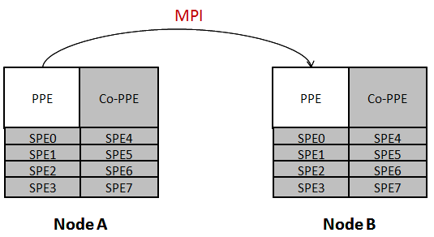
Channel Type 1
Type 1: PPE to/from PPE

Slide 29
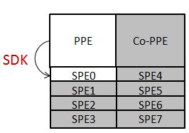
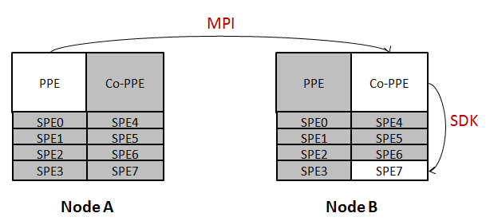
Channel Type 2 & 3
Type 2: PPE to/from SPE
Type 3: PPE to/from remote SPE

Slide 30
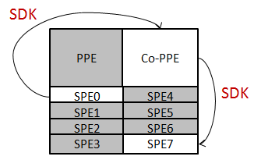
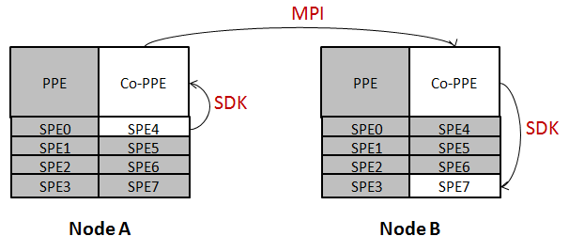
Channel Type 4 & 5
Type 4: SPE to/from local SPE
Type 5: SPE to/from remote SPE

Slide 31
Size of library
One of our goals was to use as little of the limited local store on the SPEs as possible.
CellPilot only uses a small fraction of the Cell SDK functionality (no malloc/free).
SPE part of the CellPilot library is smaller than that of DaCS.
 | PPE files (bytes) | SPE files (bytes)
CellPilot | 65,851 | 10,336
Cell SDK: libmisc.a | 4,332 | 11,224
Cell SDK: libsync.a | 1,092 | 8,784
DaCS | 56,743 | 36,600

