Slide 1
Eighth International Workshop on Parallel Programming Models and Systems Software for High-End Computing (P2S2) Sep. 1st, 2015, Beijing, China
Yong Chen
Pavan Balaji
Abhinav Vishnu

Slide 2
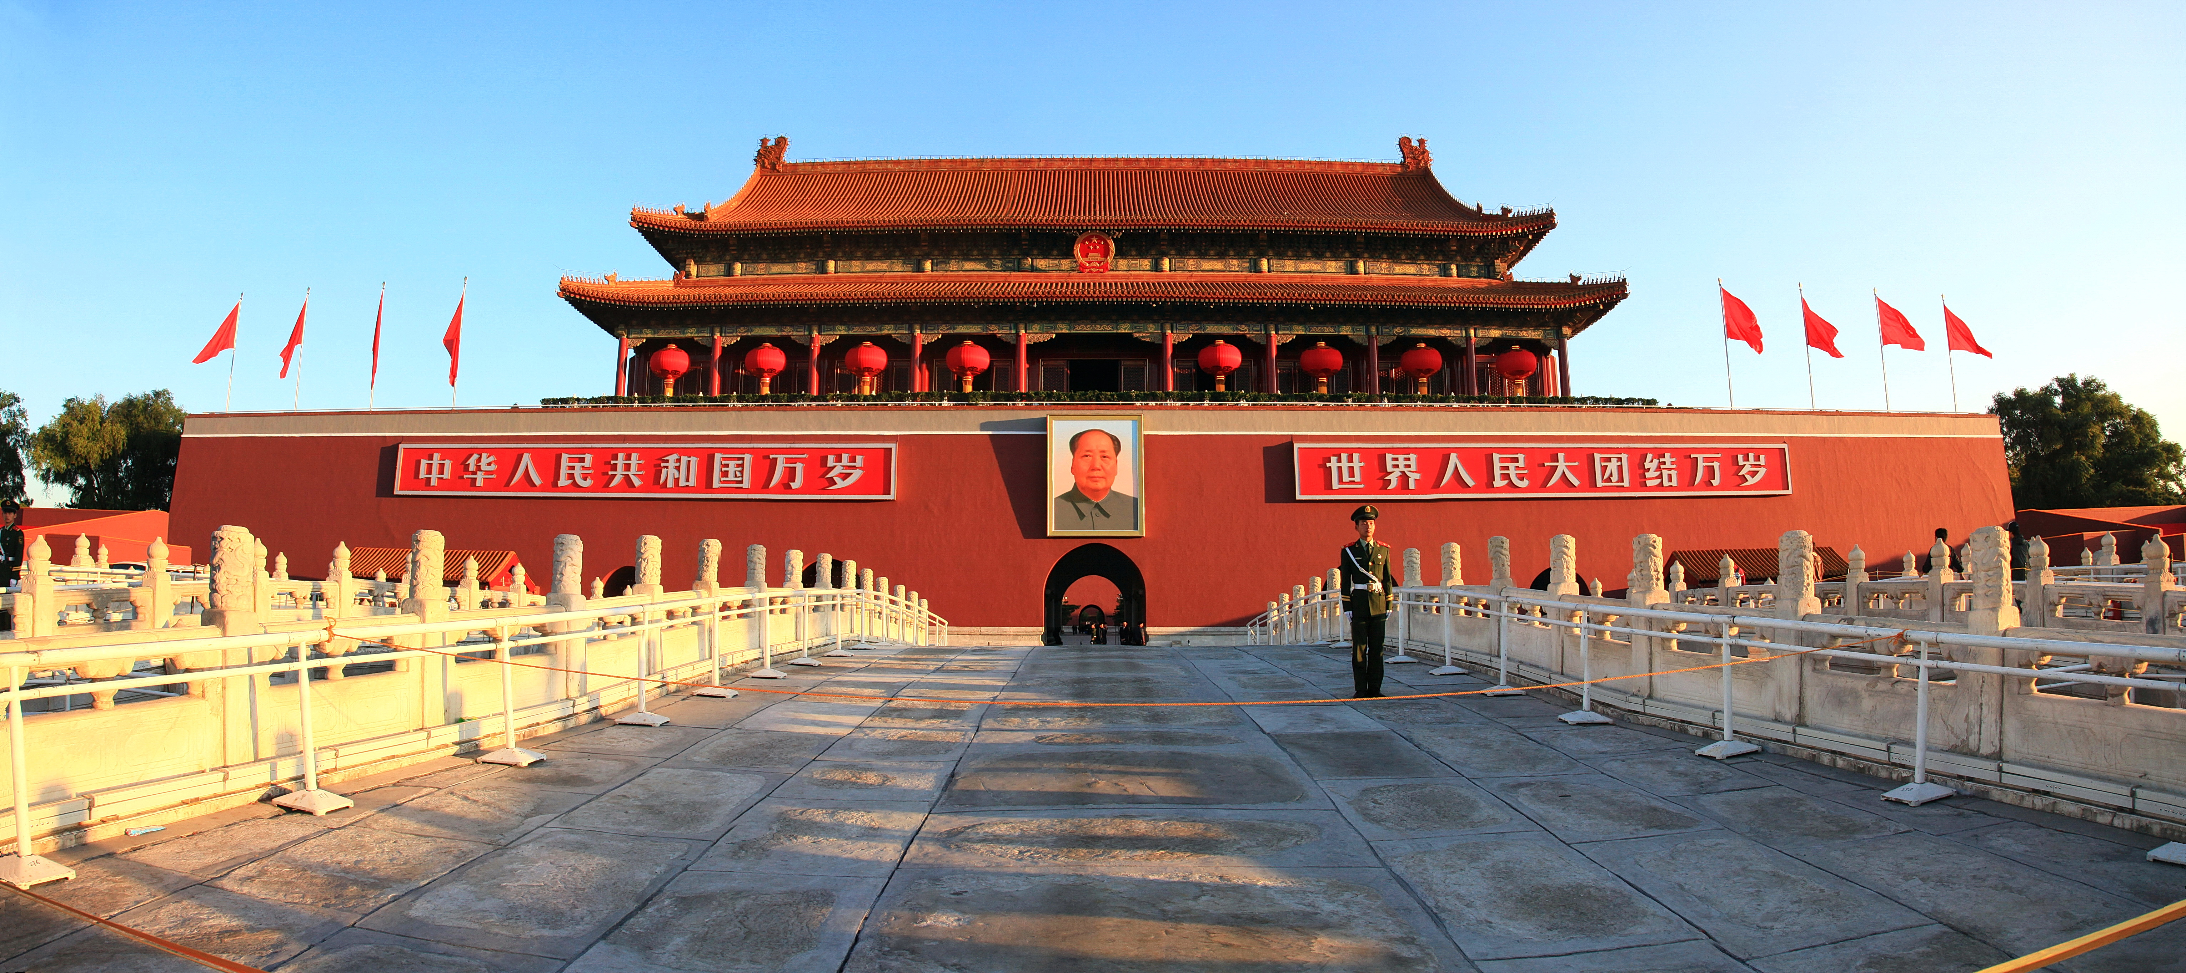
Venue: Beijing, China (with ICPP 2015)

Slide 3
Organizing Committee
Steering Committee:
William Gropp, University of Illinois at Urbana-Champaign
Vijay Saraswat, IBM Research
Program Co-chairs
Yong Chen, Texas Tech University
Pavan Balaji, Argonne National Laboratory
Abhinav Vishnu, Pacific Northwest National Laboratory
Web/Cyber and Publicity Chair
T.B.D.

Slide 4
Review Process
PC will be similar to 2014 (some additions and some will be dropped)
If you are interested in serving on the PC, please let us know!
Review process will be similar to previous years
Each paper is planned to have 4-5 reviews (or more if there is contention)
Reviews will be followed by online discussion and a PC telecon to finalize the papers

Slide 5
P2S2 2015 Journal Special Issue (with Journal of Supercomputing: JoS)
Not approved yet, but we don’t expect a problem
Special Issue on “Parallel Programming Models and Systems Software”
Editors: Yong Chen, Pavan Balaji, and Abhinav Vishnu
By-invitation only special issue for P2S2 2015 accepted papers
Submission deadline will be around 1 month after the workshop (approx. Oct 1st, 2015)
We would like to have the special issue published by mid 2016

Slide 6
Get involved!
Please Get Involved !
Paper submissions
Workshop attendance
Advertising

