Slide 1
Foundation Models at the Edge
Raghu Ganti
Principal Research Staff Member
Notes:
1

Slide 2
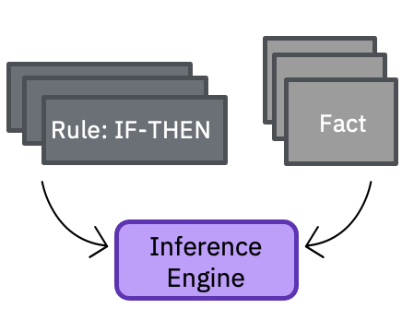
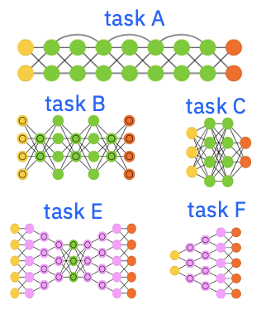
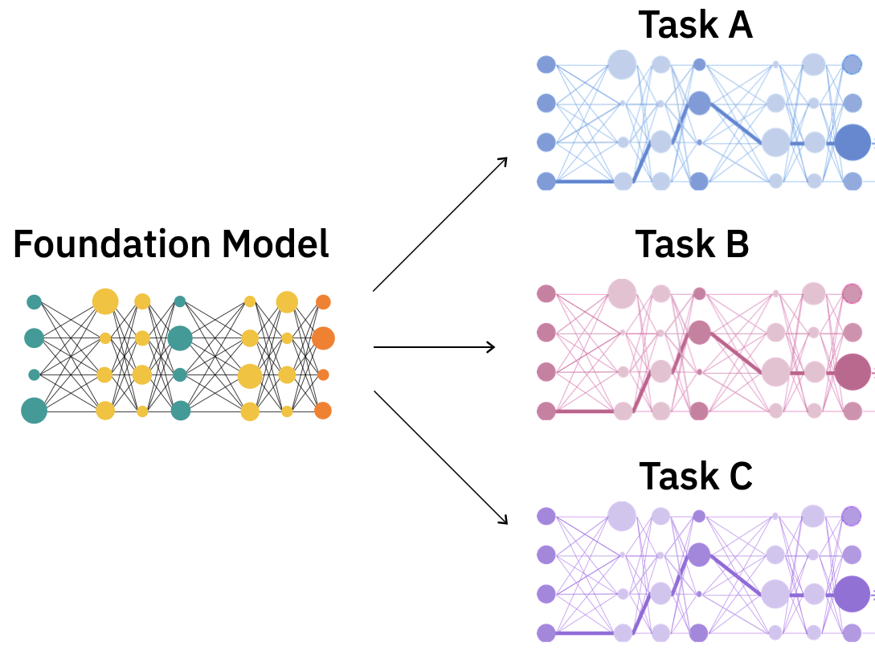
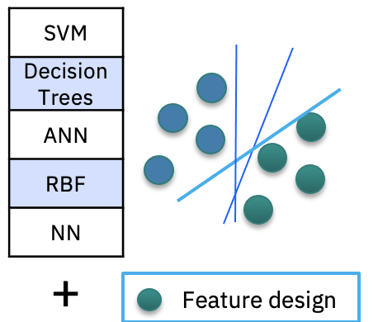
The history of AI can be described in terms of the evolution of representations
1980s
Big data
Massive
labeled data
+
Compute
2010-2017+
Self-supervision at scale
+
Massive unlabeled data
+
Compute
1980s to ~2010
Expert Systems
Machine Learning
Deep Learning
Foundation Models
Hand-crafted symbolic
representations
Task-specific hand-crafted feature representations
Task-specific learnt feature representations
Generalizable & adaptable learnt representations
IBM Research / © 2022 IBM Corporation

Slide 3


Foundation models
Google | BERT, T5, LaMDA,MUM
Facebook | BART, RoBERTa, XLM
OpenAI | GPT-3…
NVIDIA | Megatron MT-LM
NVIDIA Microsoft | Megatron MT-NLG
An emerging era of adaptable models
Born in NLP and have transformed it
Raw data
Efficient model adaptation
Insights
Foundation
models
IBM
Foundation models on controlled data sets already part of our commercial capabilities and in research tech
Conversational systems
Language & Document Understanding
NLP Leaderboards
#1 in TiDy (multilingual question answering)
#1 in Xor-TIDY (cross lingual QA)
#3 in Natural Language Queries (QA)
#1 in Wizard of Wikipedia/KILT (content grounded dialog )
#1 in Fact Checking/KILT
#1 in Table Question Answering
#1 in DREAM (multiple choice questions for dialog)
#1 in Switchboard 500 (English Speech to Text )
IBM Research / © 2022 IBM Corporation

Slide 4
How do foundation models work?
IBM Research / © 2022 IBM Corporation

Slide 5
Classical AI models: purpose-built and siloed
Translation
Summarization
Question Answering
Each model performs a discrete task
IBM Research / © 2022 IBM Corporation
Notes:
Let’s first set the context. Classical AI models are purpose built and siloed, which each performing a discrete task

Slide 6
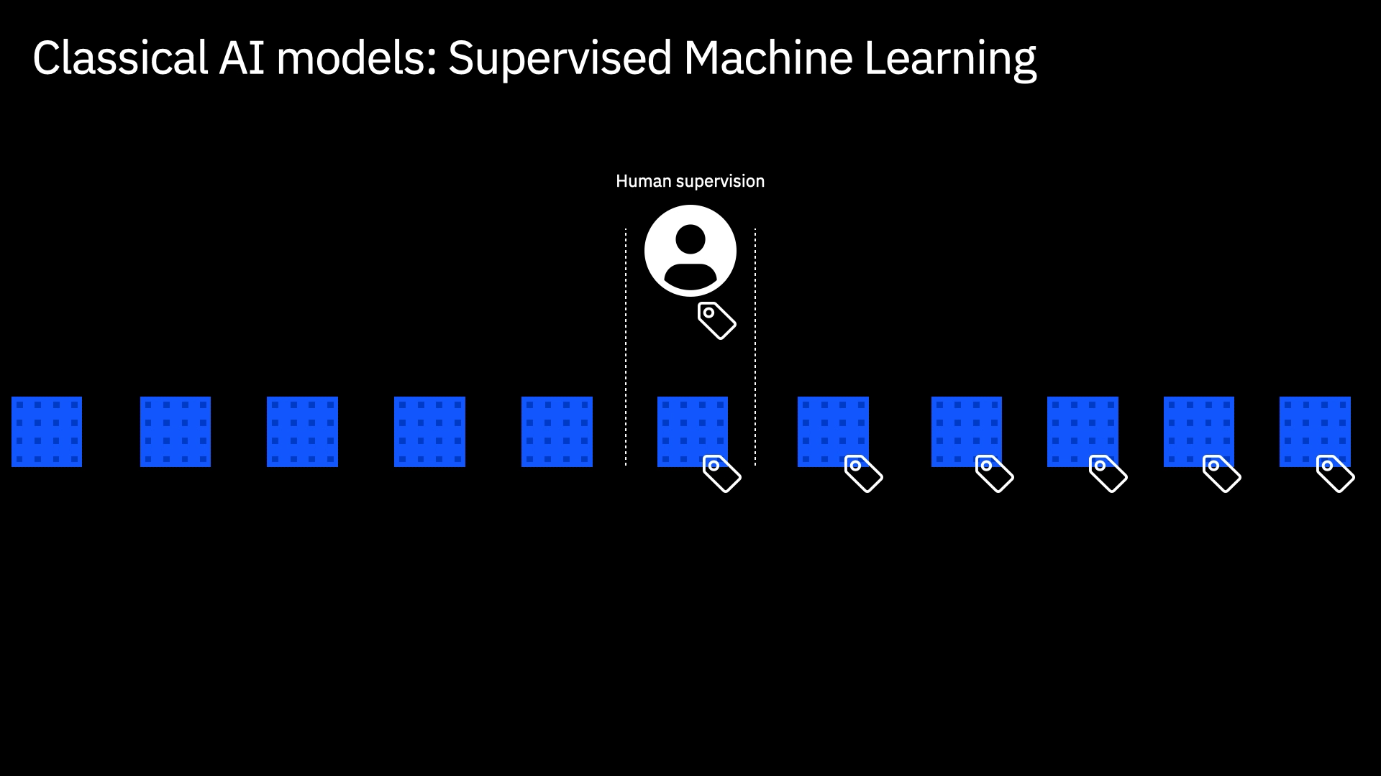
100,000+ labeled samples
IBM Research / © 2022 IBM Corporation
Notes:
Classical AI models – require a lot of human expertise, cost, and time

Slide 7

IBM Research / © 2022 IBM Corporation
Notes:
But what’s different about foundation models is their ability to train on a really huge amount of available data. The trick is that this data is unlabeled - just pure text
Pause to land: about the labeled
Foundation model training:
a lot of unlabeled data + a little labeled data

Slide 8
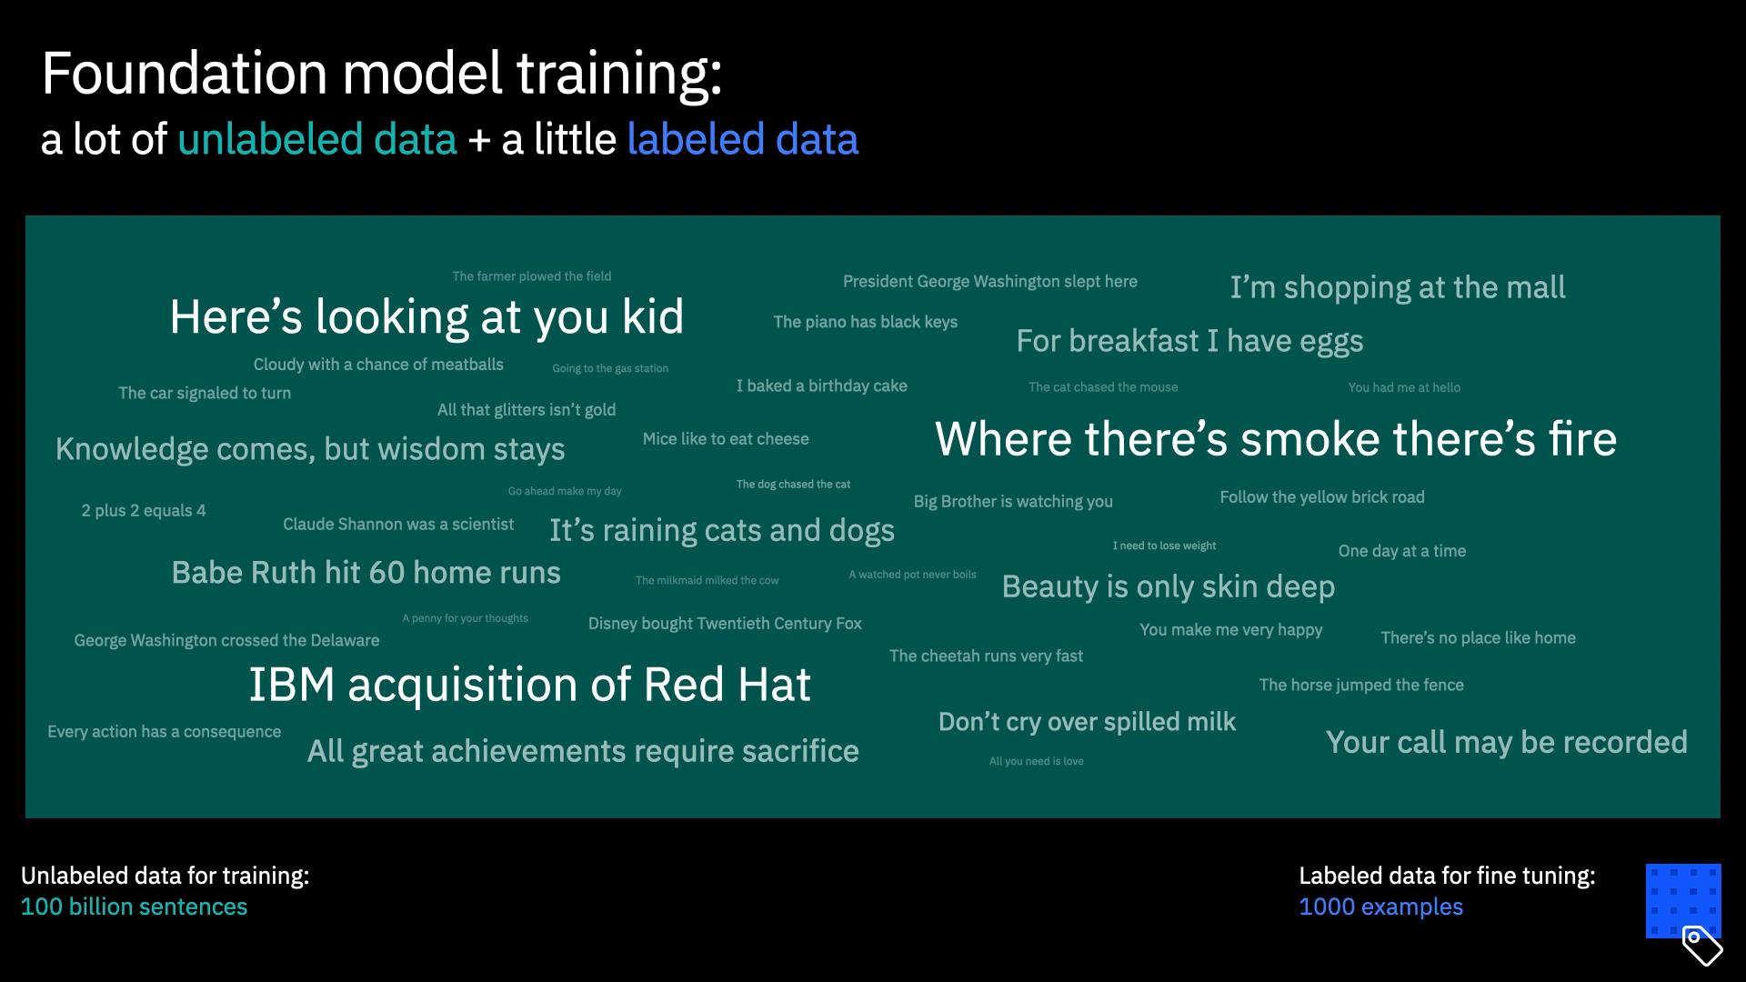
IBM Research / © 2022 IBM Corporation
Notes:
How does a foundation model train on unlabeled data? It takes a sequence of text and plays predict the next word, by pretending to not know how the sequence ends.
This approach is known as self-supervision.
------------
The change is slight, but it’s there - the model has learned something by comparing its guesses to what was the right answer.

Slide 9
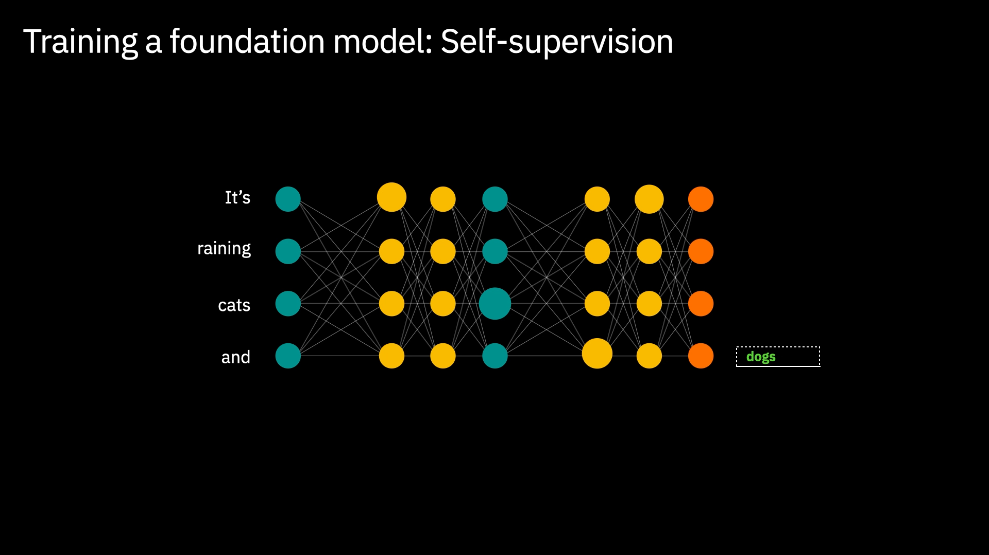
IBM Research / © 2022 IBM Corporation
Notes:
And then the model plays the game again. And again, and again, and again. 100 billion times, until it has learned a complex representation of associations based on the training data.

Slide 10
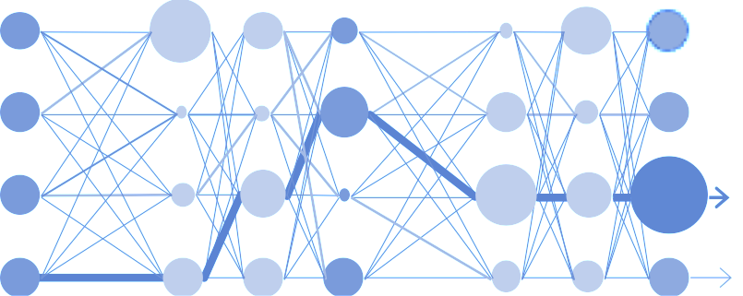


Fine tuning a trained Foundation Model
(1,000+ labeled samples per task)
Translation
El gato de Alice se llama
Snickers.
Alice’s cat is named Snickers.
La hermana de Bob vive en
Nueva York.
Bob’s sister lives in New York.
A Carol le gustaría un pez de
mascota.
Carol would like a pet fish.
Labeled data for fine tuning
IBM Research / © 2022 IBM Corporation
Notes:
At this point, it’s as if the model has learned English generally. How does it now learn to do a downstream task? Let’s take translation as an example.

Slide 11
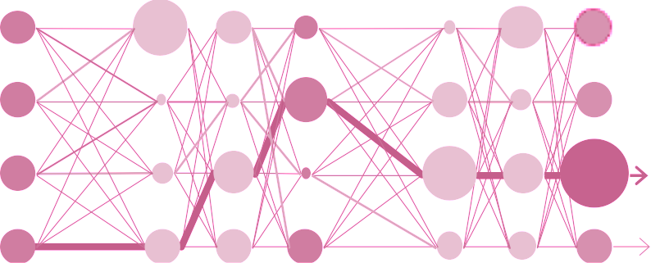

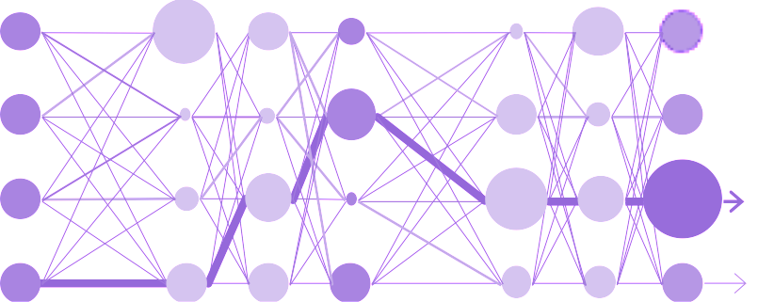

Fine tuning: One foundation model for many tasks
Translation
Question Answering
IBM Research / © 2022 IBM Corporation
Summarization
Notes:
And with different fine tuning, different tasks, all on the same model

Slide 12








But the implications of foundation models go well beyond NLP
Computer
Vision
Chemistry
Time Series
Digital Interactions
Natural
Language
Programming Languages
IBM Research / © 2022 IBM Corporation

Slide 13

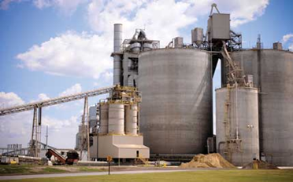

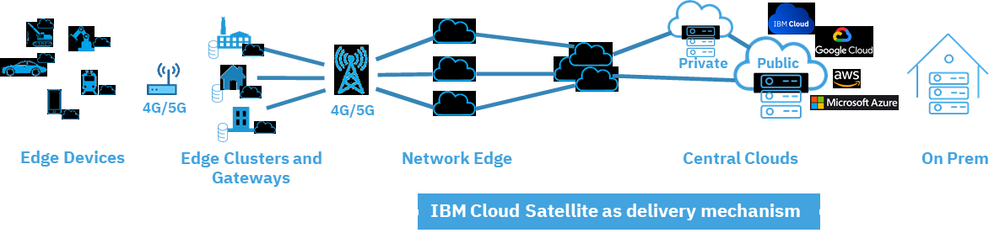

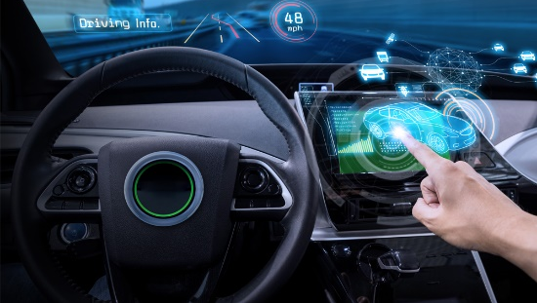
Edge: A $200B opportunity
Intelligent Operations
Telco
Exemplar industries | Main use cases | Top Players
Industry 4.0 | Visual inspection, production optimization, asset performance management | GSIs, OT vendors, Hyperscalers, Telcos
 | Supply Chain
Telcos | 5G slice management, MEC for low latency applications – visual inspection, video analytics, inventory and asset management | Hyperscalers, Telcos
Retail, Enterprise campus, branches | POS, inventory, security, Omni channel, loss prevention, Over-the-air update | ISVs, Hyperscalers Cisco / HP / Telcos
Software Defined Vehicle | Fleet management, telemetric ,self-driving | Vehicle / device vendors
Intelligent Operations
Retail Automation
Connected Vehicles
IBM Research / © 2022 IBM Corporation

Slide 14




First 15 years of Cloud
public/private
cloud
+
+
traditional IT
cloud
multicloud
Chapter I
New application development, lift & shift, experiment with new technologies
Cloud = Public Cloud
Chapter II
Mission-critical applictions moving to the cloud
Nature of cloud is changing - from public cloud to hybrid cloud and multicloud
IBM Research / © 2022 IBM Corporation

Slide 15
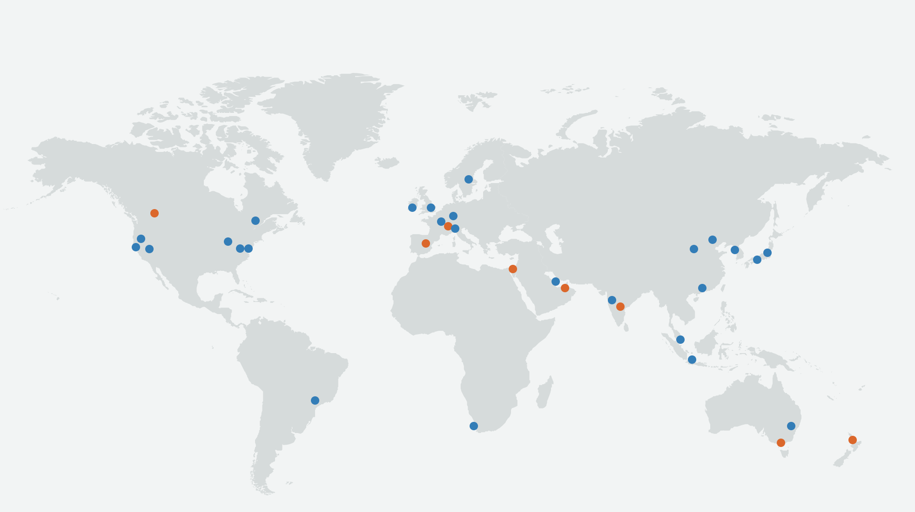
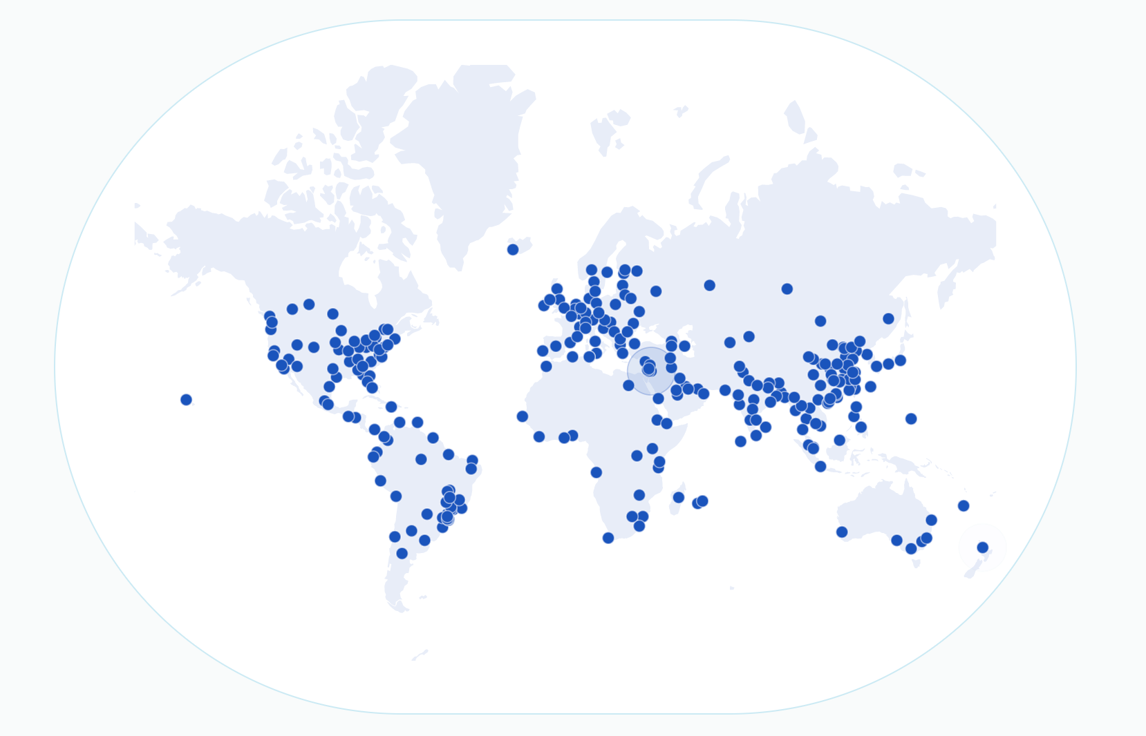
Chapter III of Cloud: Decentralization
DISAGGREGATED
DISAGGREGATED
MONOLITH
DISAGGREGATED
From siloed hyperscaler public clouds to disaggregated and decentralized clouds
public/private
cloud
Disaggregated & Decentralized
+
+
Ability to have cloud services available in a larger number of smaller geographically distributed clusters
Ability to combine services and technologies from different vendors across all layers
Ability to easily switch service providers
cloud
multicloud
decentralized
< 20 countries
100+ countries
Driving Forces
Sovereign Cloud, Latency sensitive edge applications
Break the Cloud silos and have true multicloud applications
Flexibility to choose and combine best-of-breed technologies to optimize performance, cost, latency, sustainability
Specialization
Few Siloed Vendors
Large Ecosystem
IBM Research / © 2022 IBM Corporation
Notes:
Merge trend and driving forces.
Color coded driving forces to corresponding figures on the right.

Slide 16
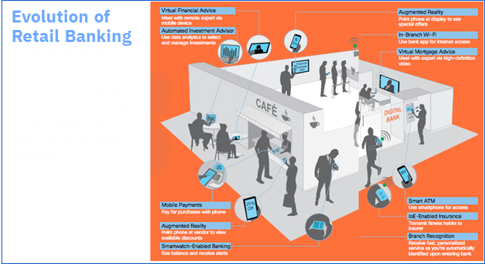
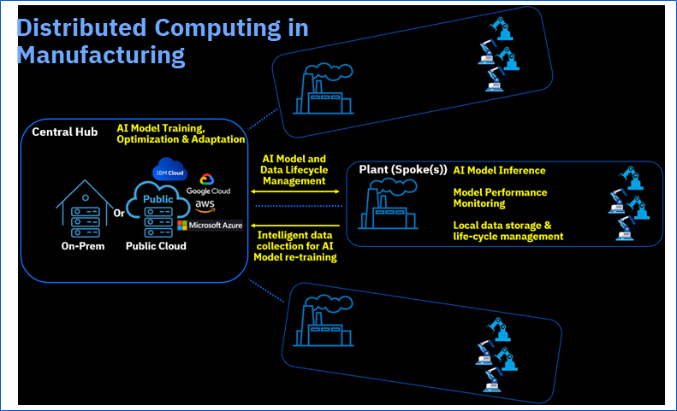
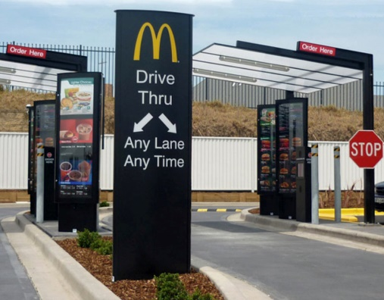
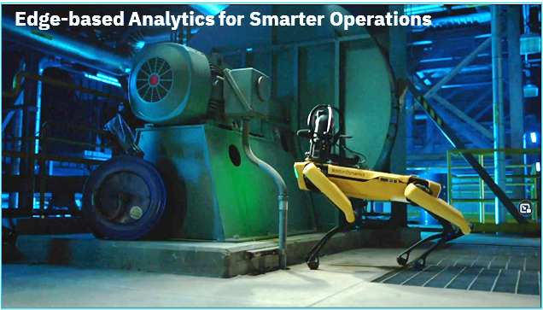
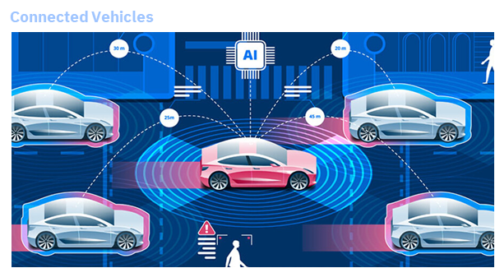
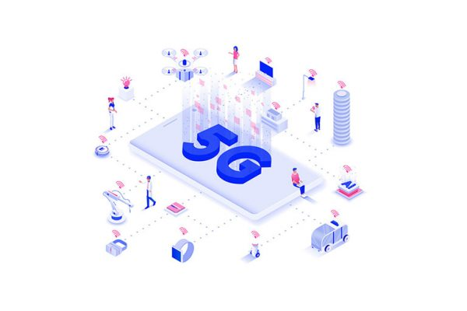
Automated
drive-thru
AI-based speech-to-intent recognition technology for automated drive-thru order taking
Industry 4.0
It's already happening…
5G Enablement
Connected Vehicles
… fueled by edge computing
IBM Research / © 2022 IBM Corporation
Notes:
Merge trend and driving forces.
Color coded driving forces to corresponding figures on the right.

Slide 17


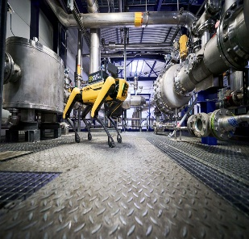
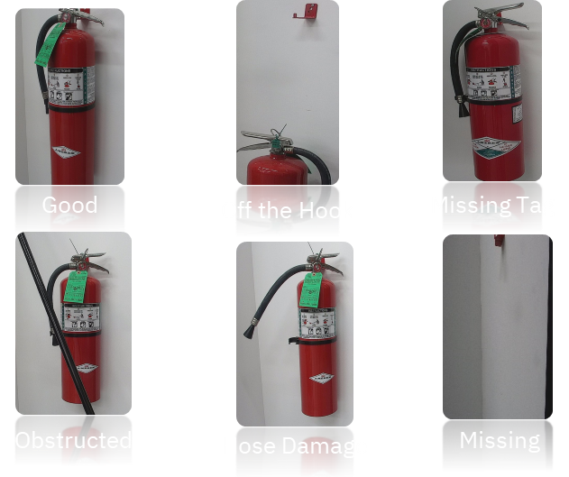
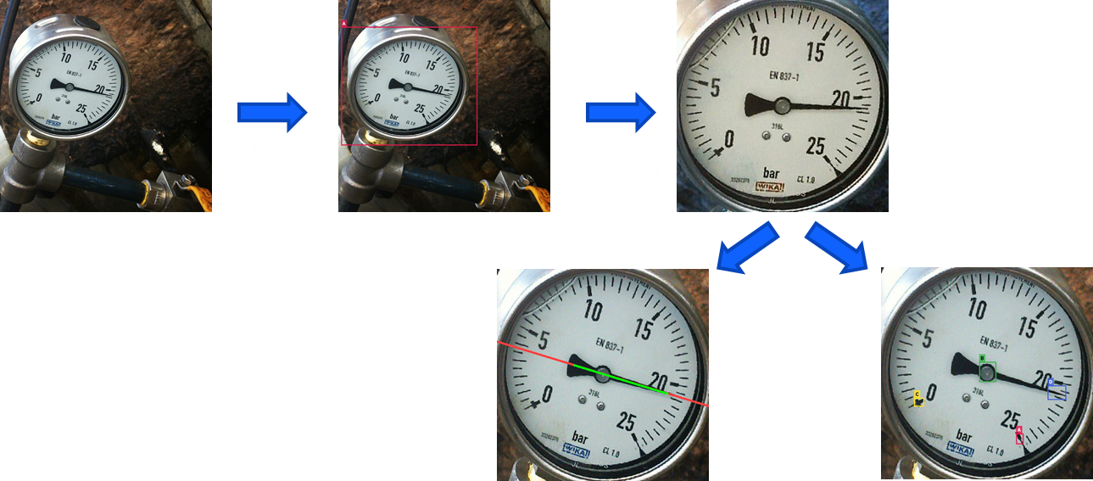
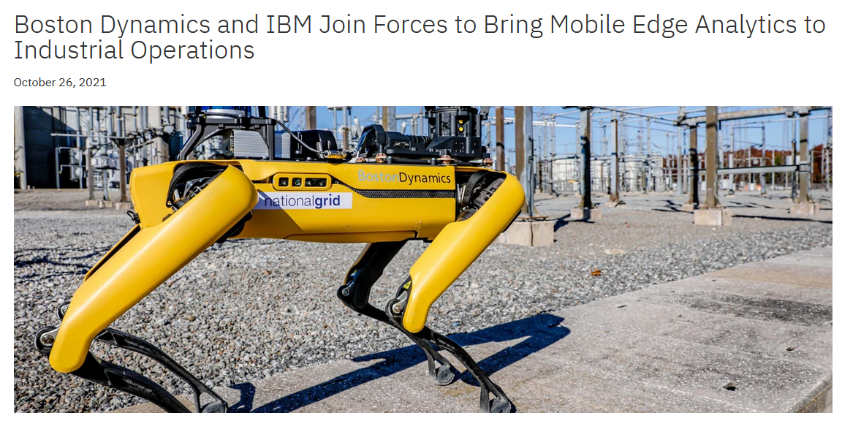
Edge AI Industry Example
Consulting Partnership
Visual Inspection of Fire Extinguishers
Analog Gauge Reading
+
Navigate the facility and visually inspect fire extinguishers
Identify issues and initiate Work Orders or service requests
Readings on a continuous analog scale
< 3% error margin
“It exceeded my expectation in how it all came together - it’s a success”
- Client exec feedback
Large Industrial Client
Up to 10x speed up in automating manual tasks
IBM Research / © 2022 IBM Corporation

Slide 18
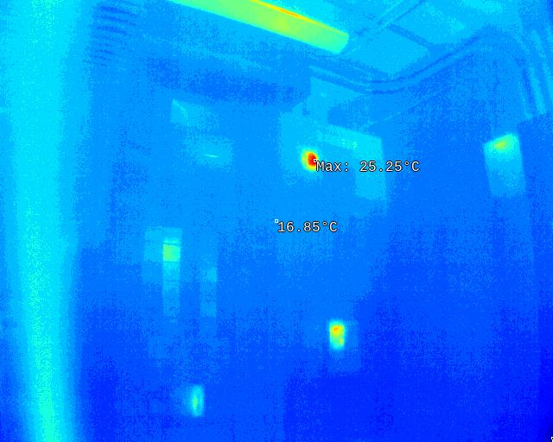
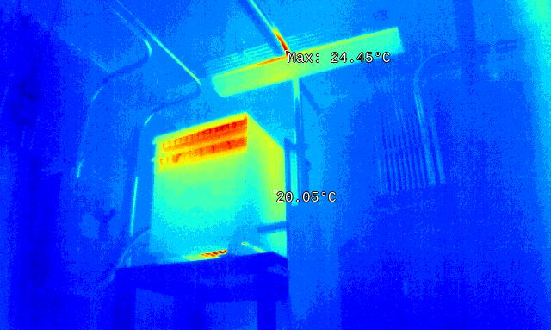
Edge AI Industry Example
Use-case example: Inspection of an Electrical room to capture the heat signatures of assets (Electrical Panel & Transformer)
98% accuracy in predicting hotspot temperatures
IBM Research / © 2022 IBM Corporation
18

Slide 19
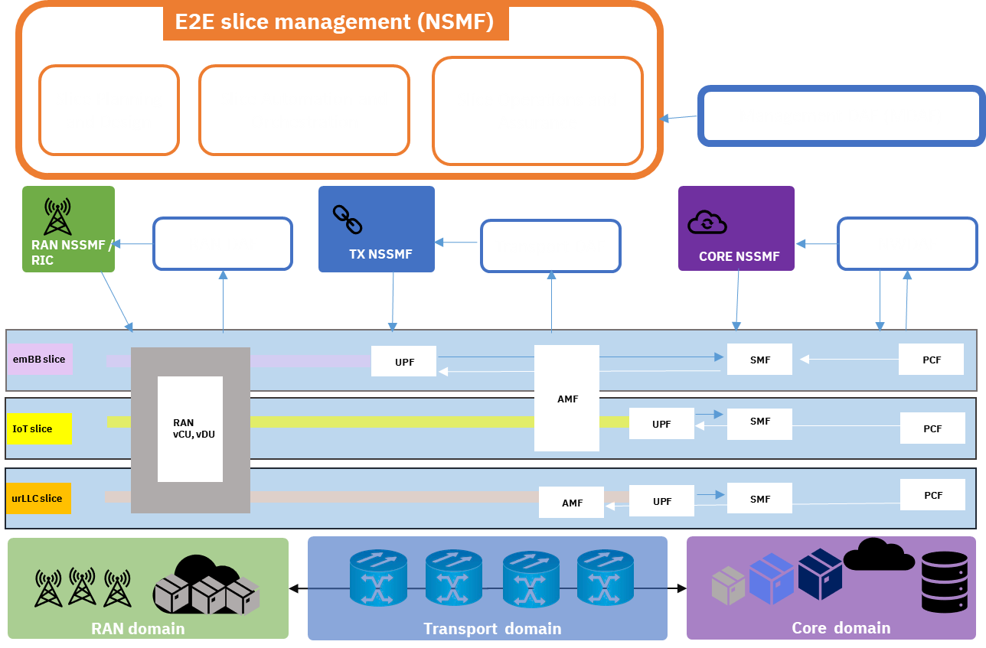
Edge AI Telco Example
End-to-end 5G network slice management – including planning & design, automation & orchestration and operations & assurance
Network Data and AI Function (NWDAF) for slice monitoring, AI and Analytics
Improved operational efficiency and reduced cost
CSPs can monetize their operational data and insights with slice customers
IBM Research / © 2022 IBM Corporation
Notes:
5G network slicing presents a tremendous business opportunity for telecom service providers to monetize their network by offering a wide range of edge applications with different QoS requirements such as high bandwidth, low latency and support for a large density of devices. However, managing network slices can be extremely complex, especially across multiple domains (Core, transport and RAN) spread across a wide area network. IBM Research is working on developing innovative capabilities around all aspects of slice management including planning, design, automation, orchestration, operations and assurance, leveraging AI-based network intelligence.
IBM’s CloudPak for Network Automation (CP4NA) is developing capabilities to support NSMF (Network Slice Management Function) and NSSMF (Network Slice Subnet Management Function) slice management capabilities as per 3GPP specifications with contributions from IBM Research. The Data and Analytics Functions, NWDAF, Transport DAF and RAN DAF, as per 3GPP, act as a single mode of consumption of all data and analytics pertaining to slices for their respective domains. This ensures that regardless of having infrastructure and network functions from multiple vendors, data insights and analytics derived from metrics, alarms, logs, traces and topology can be consumed in a uniform manner by orchestration and management components (NSMF, NSSMF), client apps (including RAN xApps and rApps) and optionally even exposed directly to clients and monetized! Leveraging AI-based analytics to manage network slices can significantly improve operational efficiency and reduce cost. As a vendor-neutral Hybrid Cloud and AI software provider, IBM is ideally suited to provide 5G slice management and analytics capabilities for telecommunications providers.

Slide 20
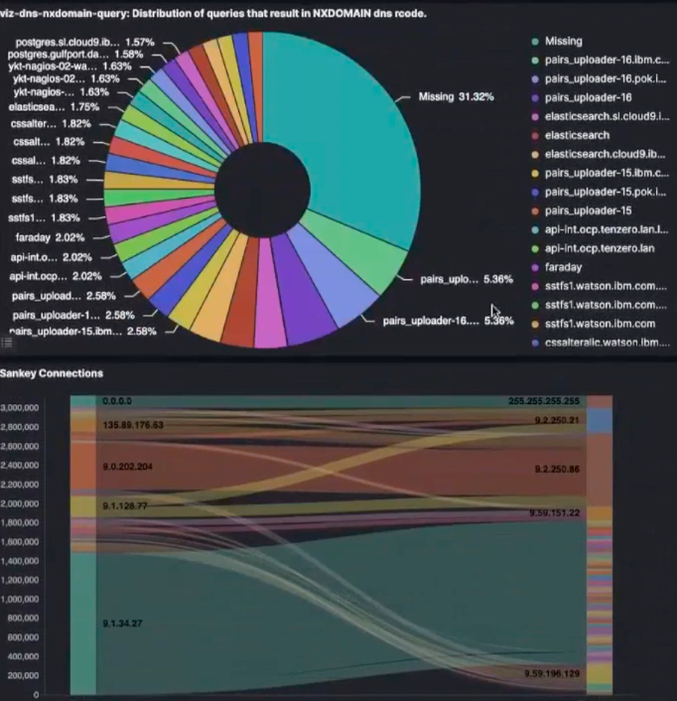
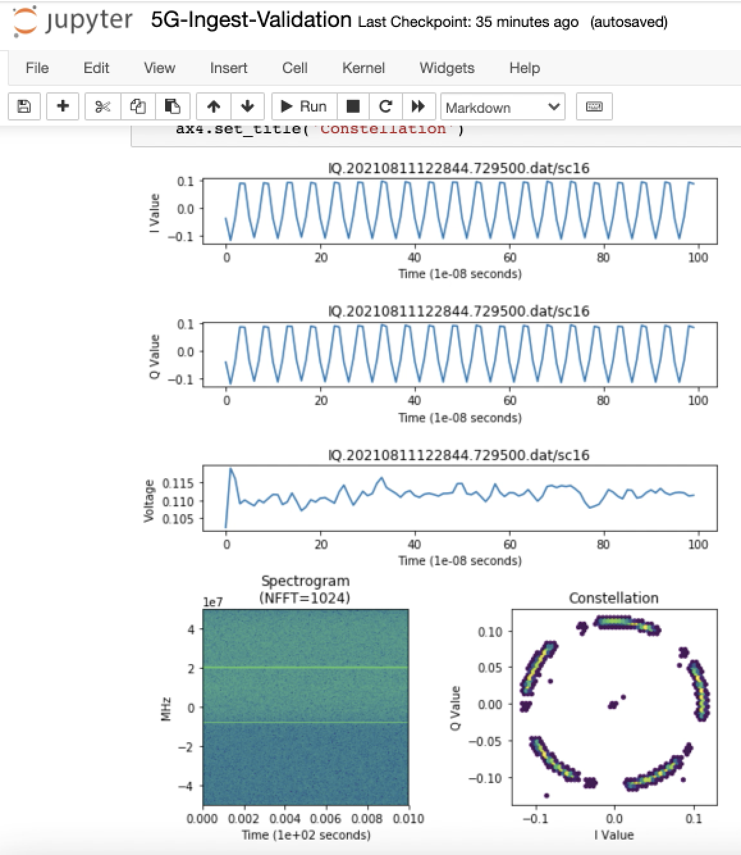
Edge AI Network Situational Awareness
Connection analysis
Spectrum Analysis
IBM Research / © 2022 IBM Corporation

Slide 21
Challenges of Foundation Models at Edge
Unique characteristics of Edge | New AI requirements for Edge
Scale Edge sites are large in numbers, possibly with intermittent connectivity | Automation of data and AI lifecycle is essential for scaling AI to the large number of unattended edge sites Data and AI algorithms must scale to multiple data-modalities and usecases
Heterogeneity Each edge site is a different and dynamic environment, one model does not fit all | Select and adapt the models for each edge site given pre-trained cloud-based model repo Monitor the accuracy of the models deployed at each edge site, without ground truth Detect environment shift and re-train, re-select, re-deploy models to the edge
Data Gravity Edge sites produce vast amounts of raw data, may be in different formats, noisy, sensitive, regulated | Minimize the cost of collecting edge data while retaining the utility Assess and address data quality and reconciliation issues before collecting raw data Learn from data residing at edge sites without exporting any raw data
Resource-Constraints Edge sites are heterogeneous and constrained in computational and energy resources | Dynamically optimize AI pipelines for target edge resources
IBM Research / © 2022 IBM Corporation

Slide 22

Post Training Model Optimization
Problem (e.g., image classification)
Where model shall be deployed
(resource limits or type: ipad, laptop,…)
Sample data (if available)
Optimized Model(s) for each deployment
Fine-tuned on sample data if provided
API
IBM Research / © 2022 IBM Corporation

Slide 23
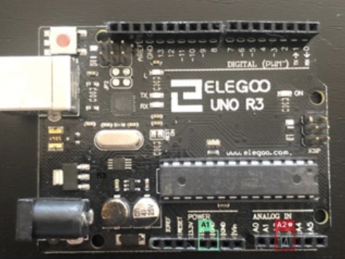

Inferencing: Out-of-Distribution Detection
Key Problem: How to determine if a model’s inference can be trusted?
Approach: Embed an out-of-distribution detector within a model to catch incorrect inferences
Training data
Pre-trained model
OOD-enabled model
Input for inference
No: No prediction, defer to a human expert
Calculate OOD parameters and embed in the model
model inputs
Can inference be trusted?
Yes: use prediction for downstream automation
Input for inference
Inference result
+
trust score
Challenges
No control of training process
No knowledge of what inputs cause incorrect inferences
Resource constraints for inference at the edge devices
OOD-enabled model
No need to train a separate model, almost zero overhead during inference
Up to 10x reduction in time to create new models without the aid of a data scientist
State-of-the-art performance in OOD detection in visual domain (ICPR’2021)
IBM Research / © 2022 IBM Corporation
23
Notes:
This is an area of active research. IBM has developed model fingerprinting techniques (ICPR'21 paper) to detect inaccurate model inferences. The key idea is to summarize a model's response to training data at multiple layers of abstraction. These summaries are called model fingerprints. Then, during inference time, the model's response to a given input is examined and contrasted with the fingerprints. The further away the inference response is from the fingerprints, increased likelihood it is an erroneous inference

Slide 24
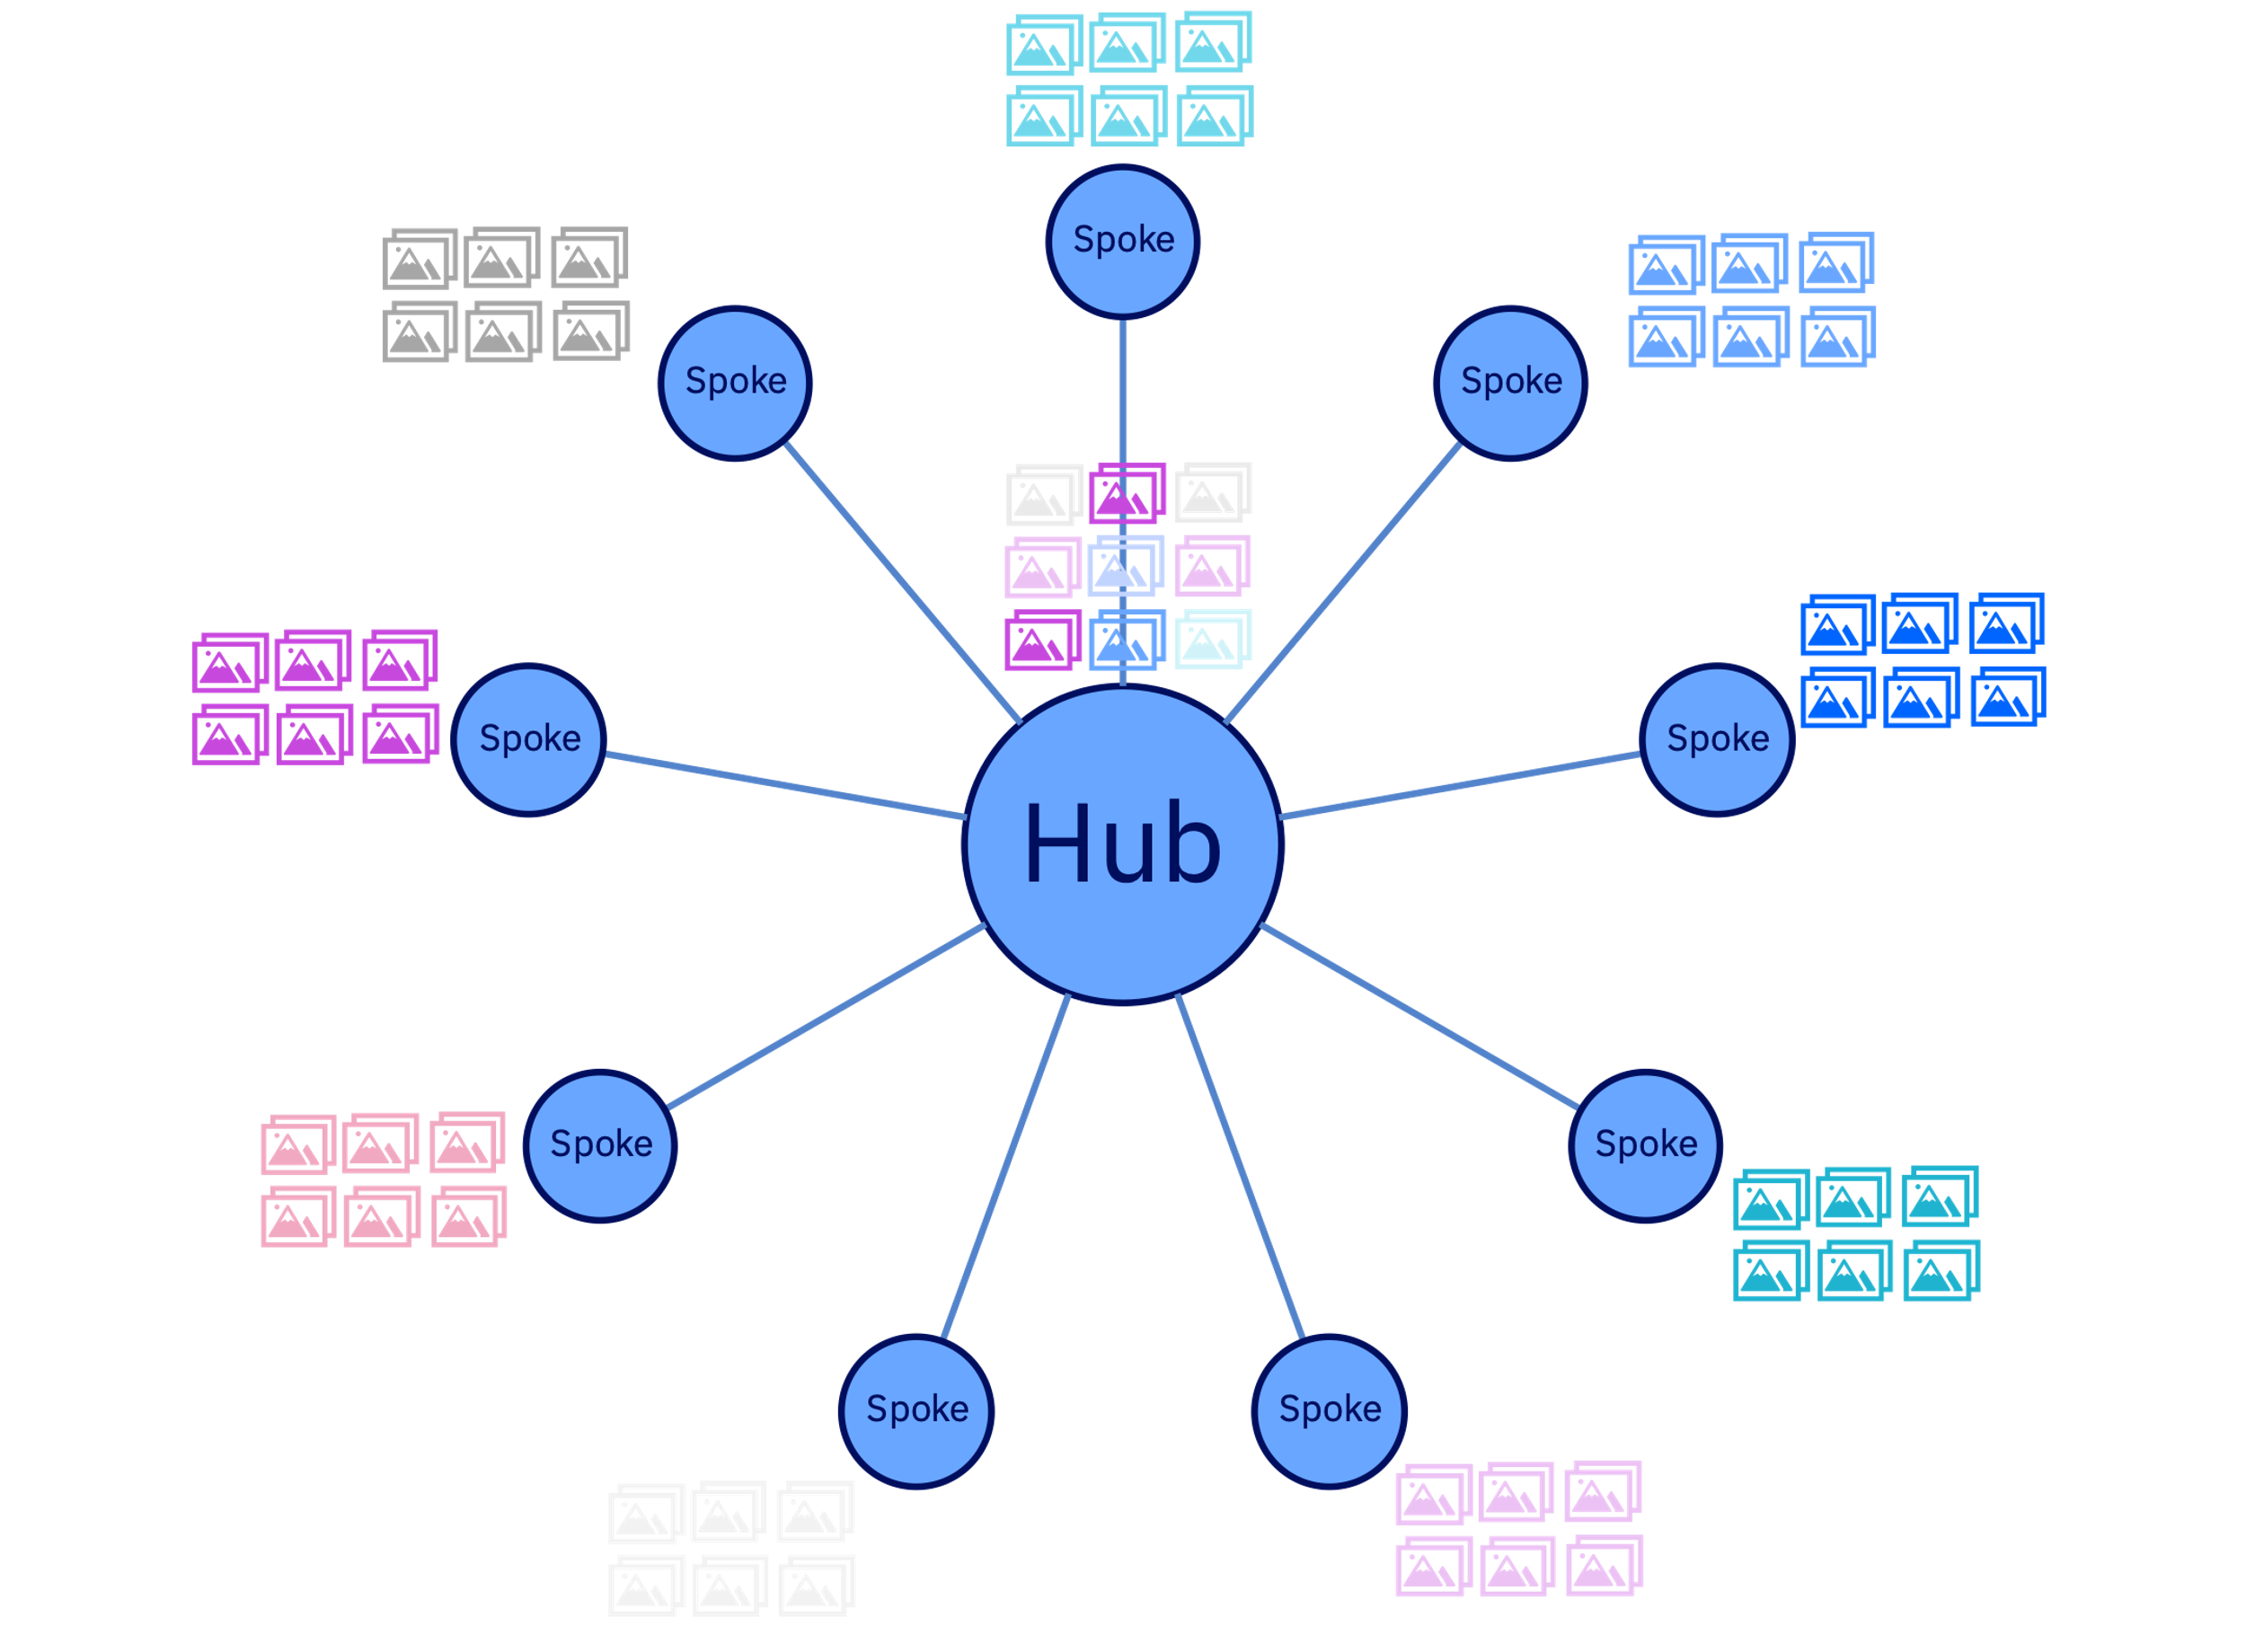


AI-infused Data Lifecycle Management
Sample Transfer
Polices
Transfer to hub with any FailedLabels == "valve_open" AND TriggerString == "InletValve".
Transfer to hub with Location == ”123" AND Confidence <98.5.
Sample Expiry
Polices
Delete with TriggerString == "FuseBox" AND (now - Timestamp) > days(365).
Delete with Result == Neg AND Confidence >99 AND (now– Timestamp) > days (7)
Datum = unstructured data + structured metadata
IBM Research / © 2022 IBM Corporation

Slide 25


Data Selection for Labeling and Retraining
Reduce labeling cost by creating an easy-to-use tool for interactive data selection
Training Server
Inspection images
Training Server
Inspection images
Device
Device
Data Selection
(Manual)
Data Selection
Summarization
Inspection Model
Inspection Model
Data Labeling
Model Creation
Data Labeling
Model Creation
As-is: Manual data selection slows down model improvement cycles
Manually sifting through 1000s of images to select a small set for annotation and re-training.
Tedious and time-consuming
Impossible to inspect all images -> low data selection quality and suboptimal model performance
To-be: Provide guidance and automation for training data selection
Interactive (HIL) data selection using vector data captured during inferencing (diversity sampling, agglomerative clustering)
Faster data selection -> reduced manual labor
Better selection quality -> better model performance
Reduce human effort in data labeling by 10-100x
IBM Research / © 2022 IBM Corporation

Slide 26
Thank you
Raghu Ganti
Principal Research Staff Member
rganti@us.ibm.com

