Slide 1
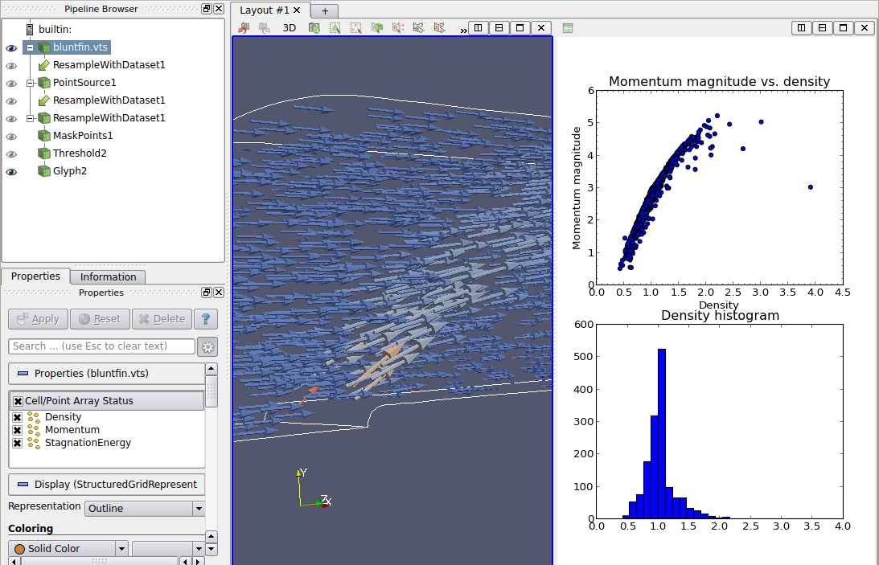
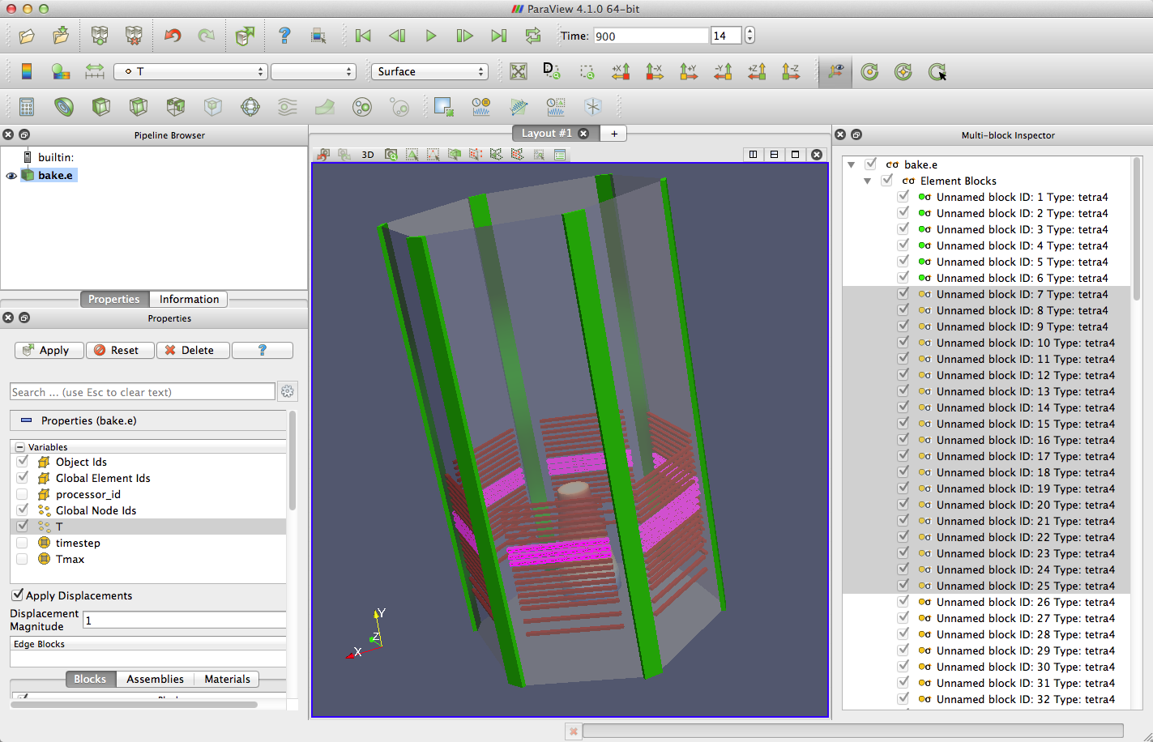
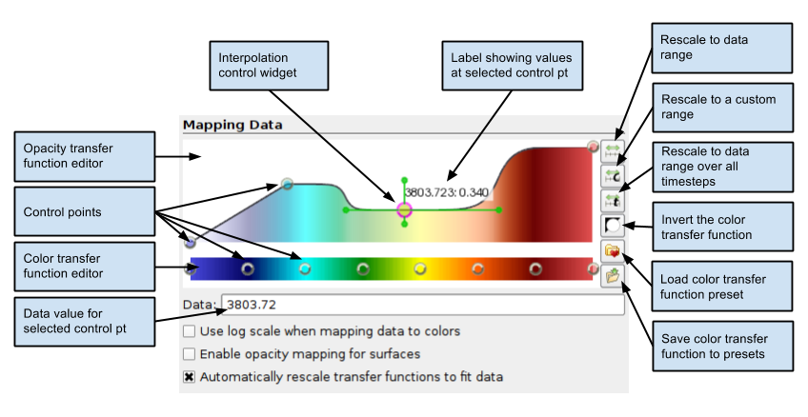
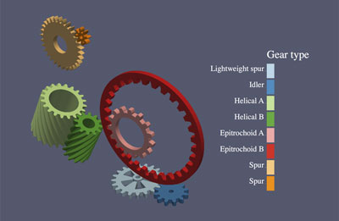
What’s New in ParaView
DOECGF 2014
April 22, 2014
Kenneth Moreland Sandia National Laboratories

Slide 2
Boring Crap
Releases during the last 12 months: 4.0.1 (June 2013), 4.1.0 (January 2014)
SC 2013 Tutorial
Users at Sandia: ~110/month
  DART metric: 2+ uses, non-support
Downloads from Kitware past year: > 100K
  Counts button clicks on web form
  Duplicate IP’s removed
  Includes binary and source packages. Not data nor plugins
Over 3K emails exchanged on mailing list in 2013

Slide 3
Sandia Monthly ParaView Usage

Slide 4
Kitware ParaView Downloads

Slide 5
HPC Installations (That We Know Of)
ORNL: Titan, Lens, Everest, Rhea
ANL: Mira, Eureka, Tukey
LANL: Cielo
Sandia: Red Sky
TACC: Longhorn, Lonestar, Maverick
NERSC: Hopper, Carver, Edison
NICS: Nautilus
DoD HPCMP: Herold, Pershing, Garnet

Slide 6
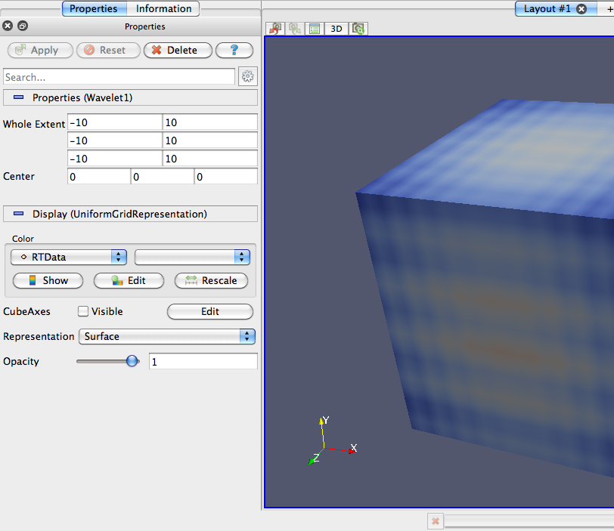
Properties Panel
Notes:
* Simplified properties panel with capabilities to go "advanced"
* combined source/display settings
* Ability to search based on property names
Context senstitive : i.e. when showing "Slice" representation, the widget to select the slice number get shown by default
Expanded capability for supporting plugins and custom widgets

Slide 7
Multi-block Data Visual Properties

Slide 8
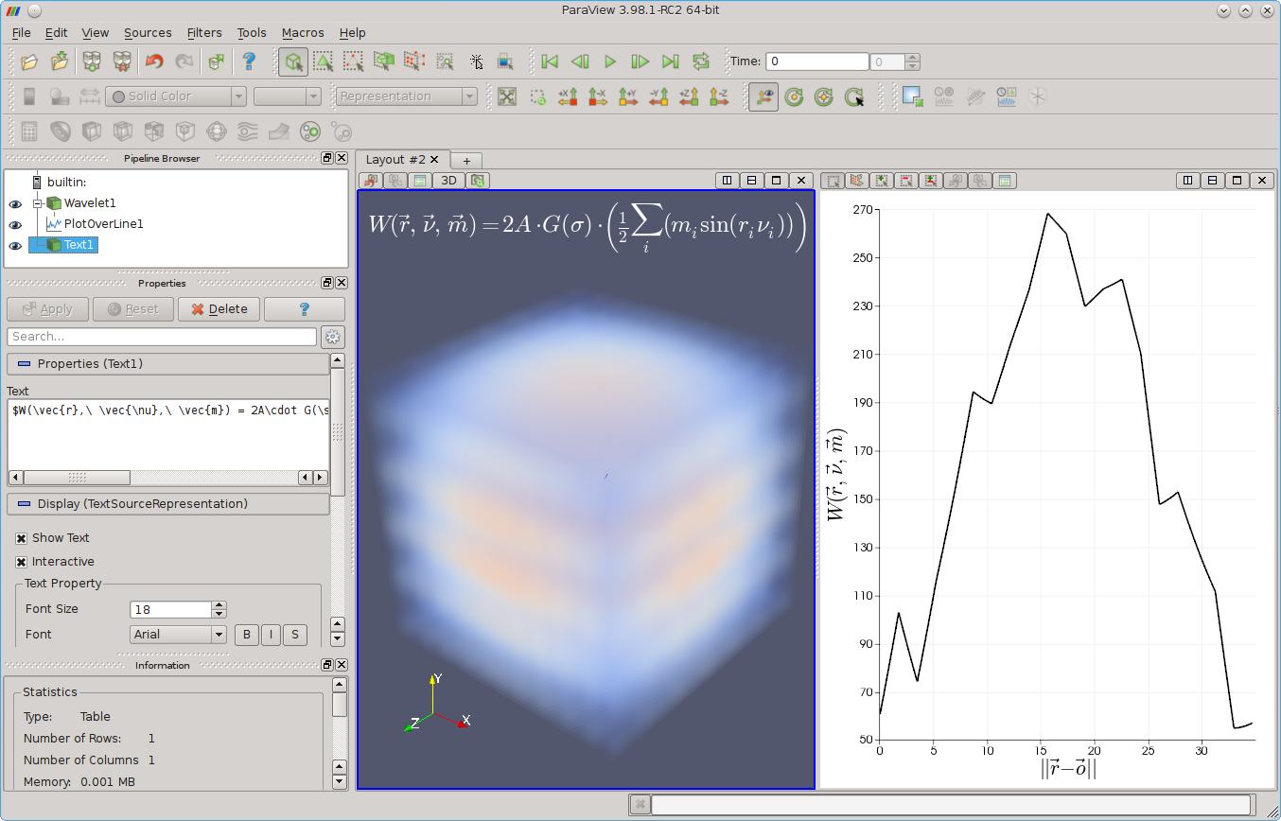
Math Text
Notes:
Ability to add Mathtext in 3D views and charts
Expanded to include chart titles and scalar bar labels.

Slide 9
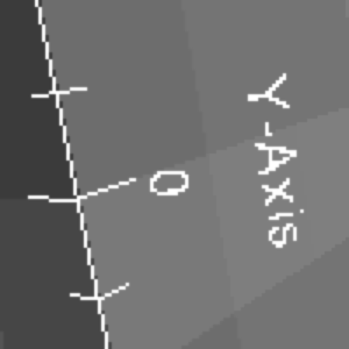
Vector Graphics Export
Notes:
Can export images with raster effects for text, annotations, widgets, etc.
These images magnified 400x.

Slide 10
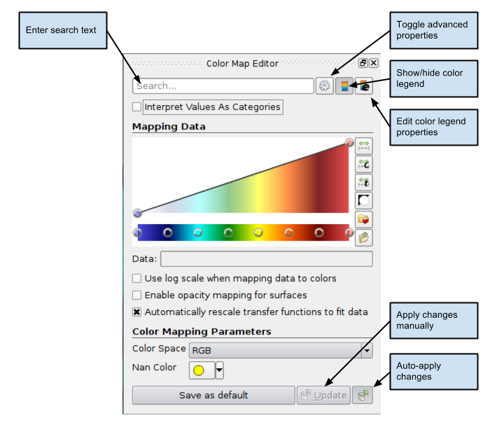
Redesigned Color Map Editor
Notes:
Color Map Editor now dockable window
Redesigned GUI has standard/advanced controls
Simplifies use while allowing us to add specialized features

Slide 11
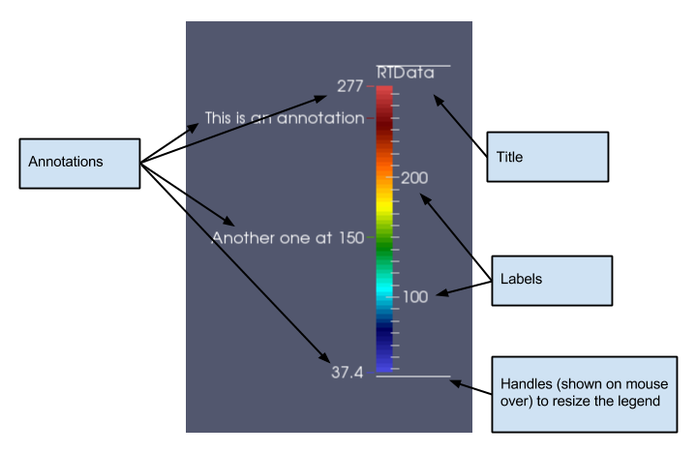
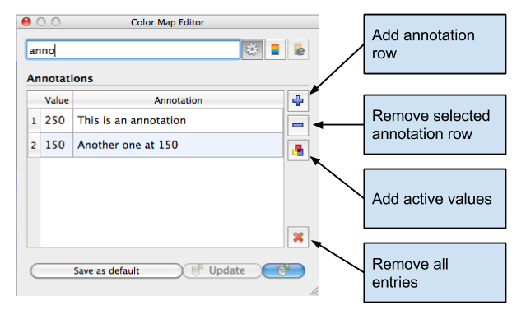
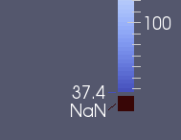
Color Map Annotations

Slide 12
Categorical Color Maps

Slide 13
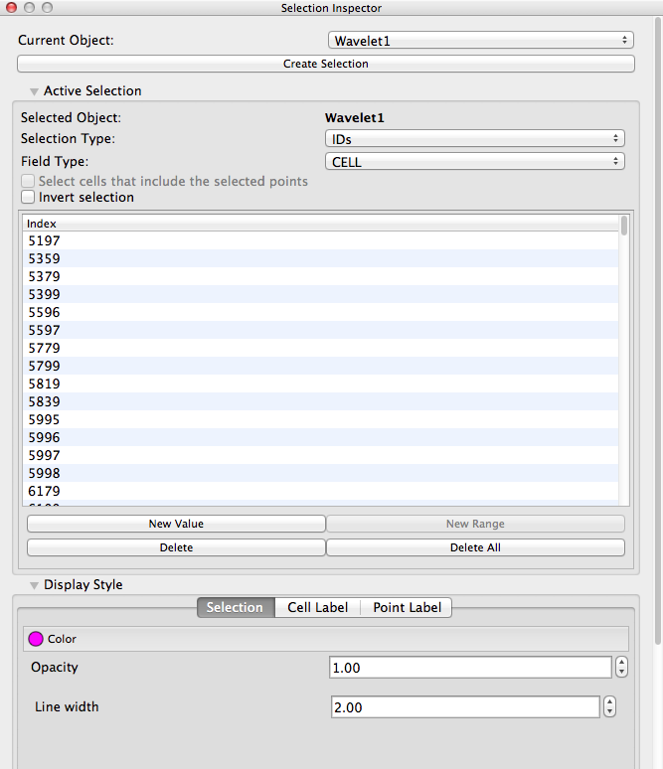
Die, Selection Inspector! DIE!

Slide 14
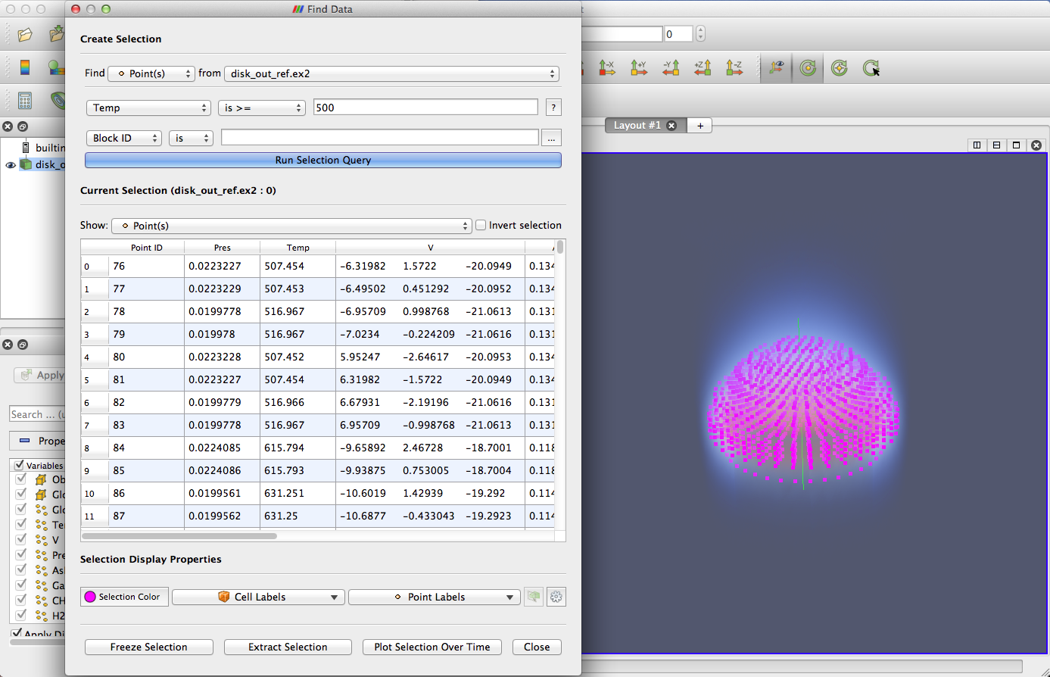
Long Live Find Data
Simple and Powerful Query Controls
Comprehensive Selection Inspection
Spreadsheet links selected elements with field values
Works with selections created elsewhere
Quick Access to Selection Display and Actions

Slide 15
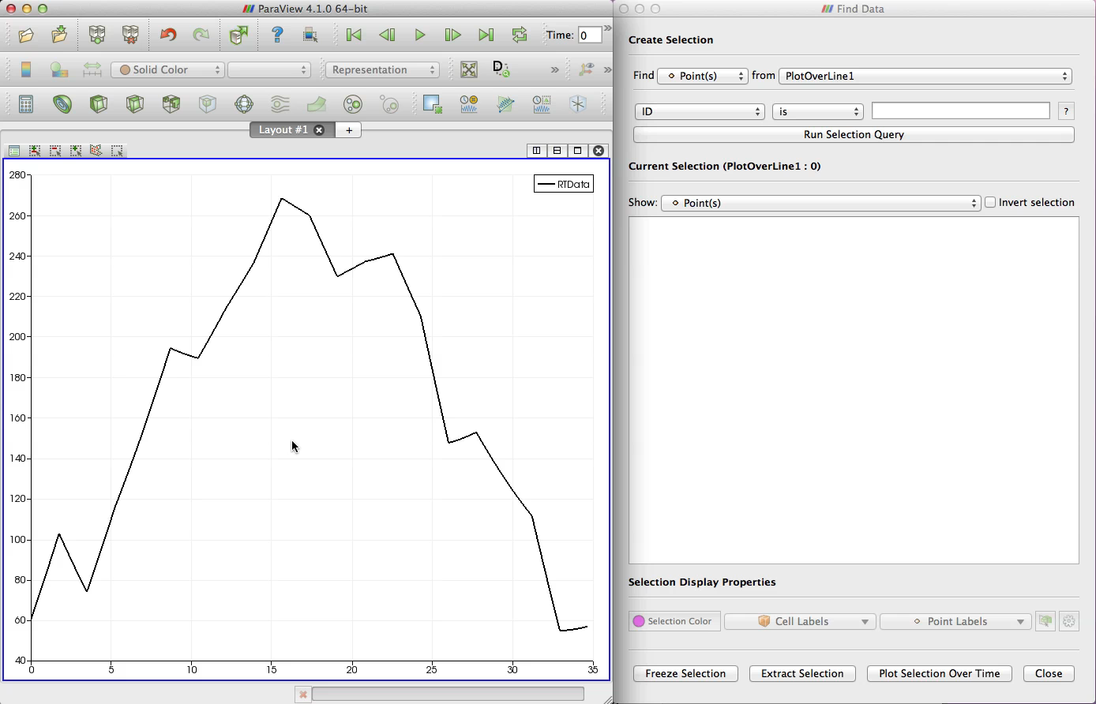
Improved Chart Interaction

Slide 16
Quick matplotlib Views

Slide 17
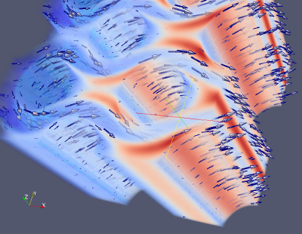
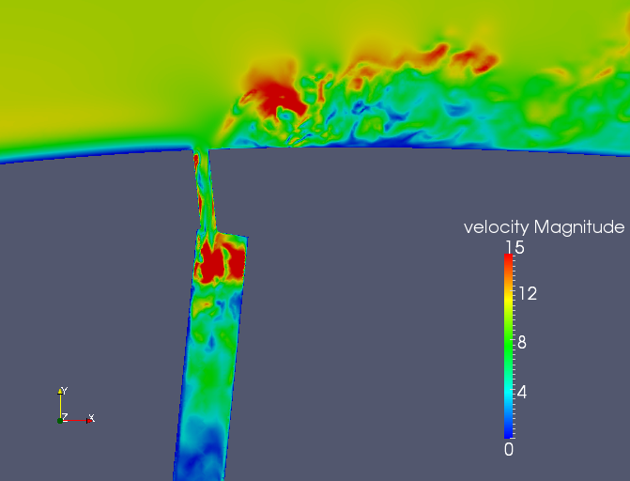
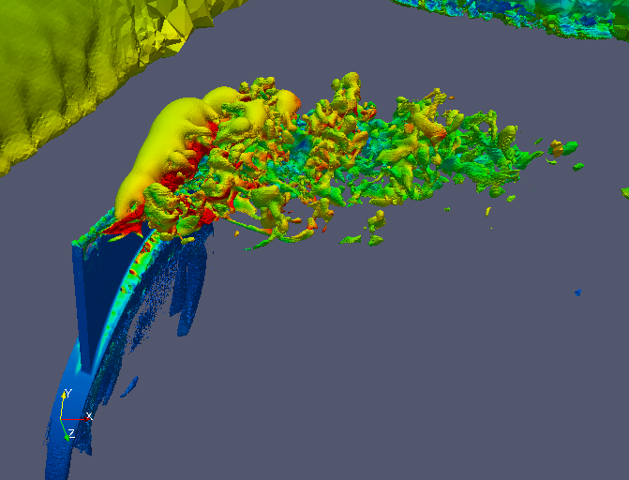
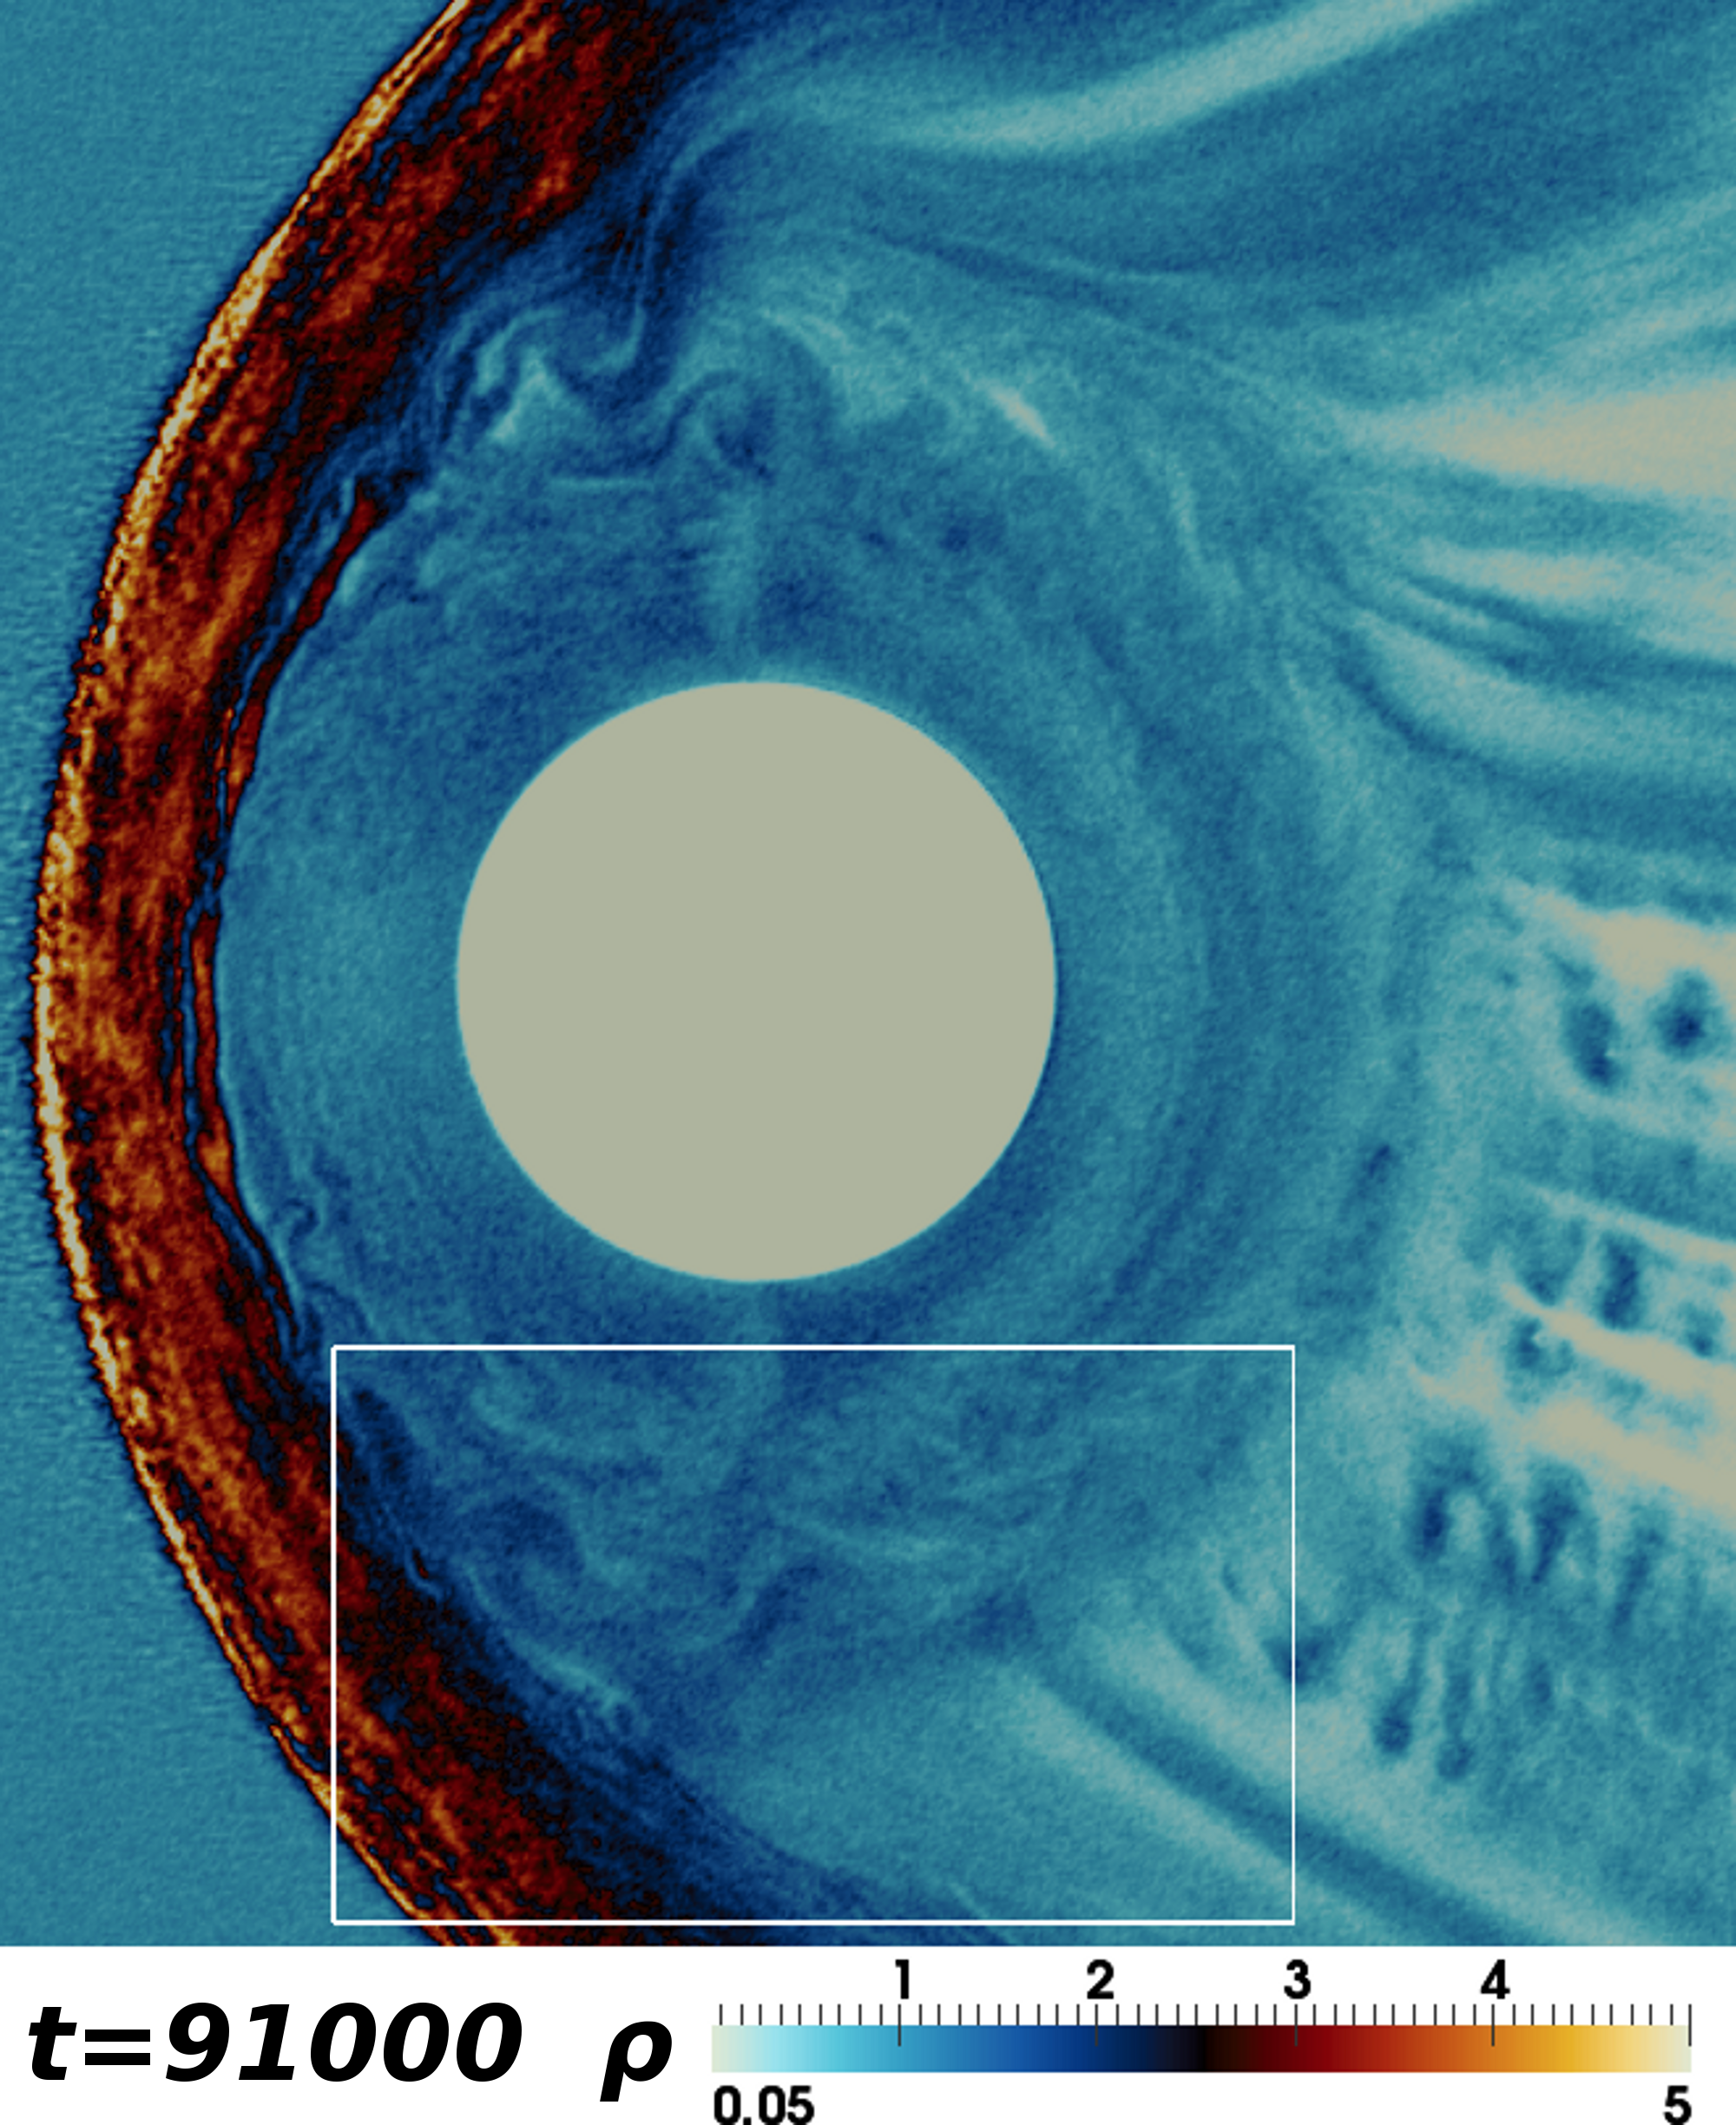
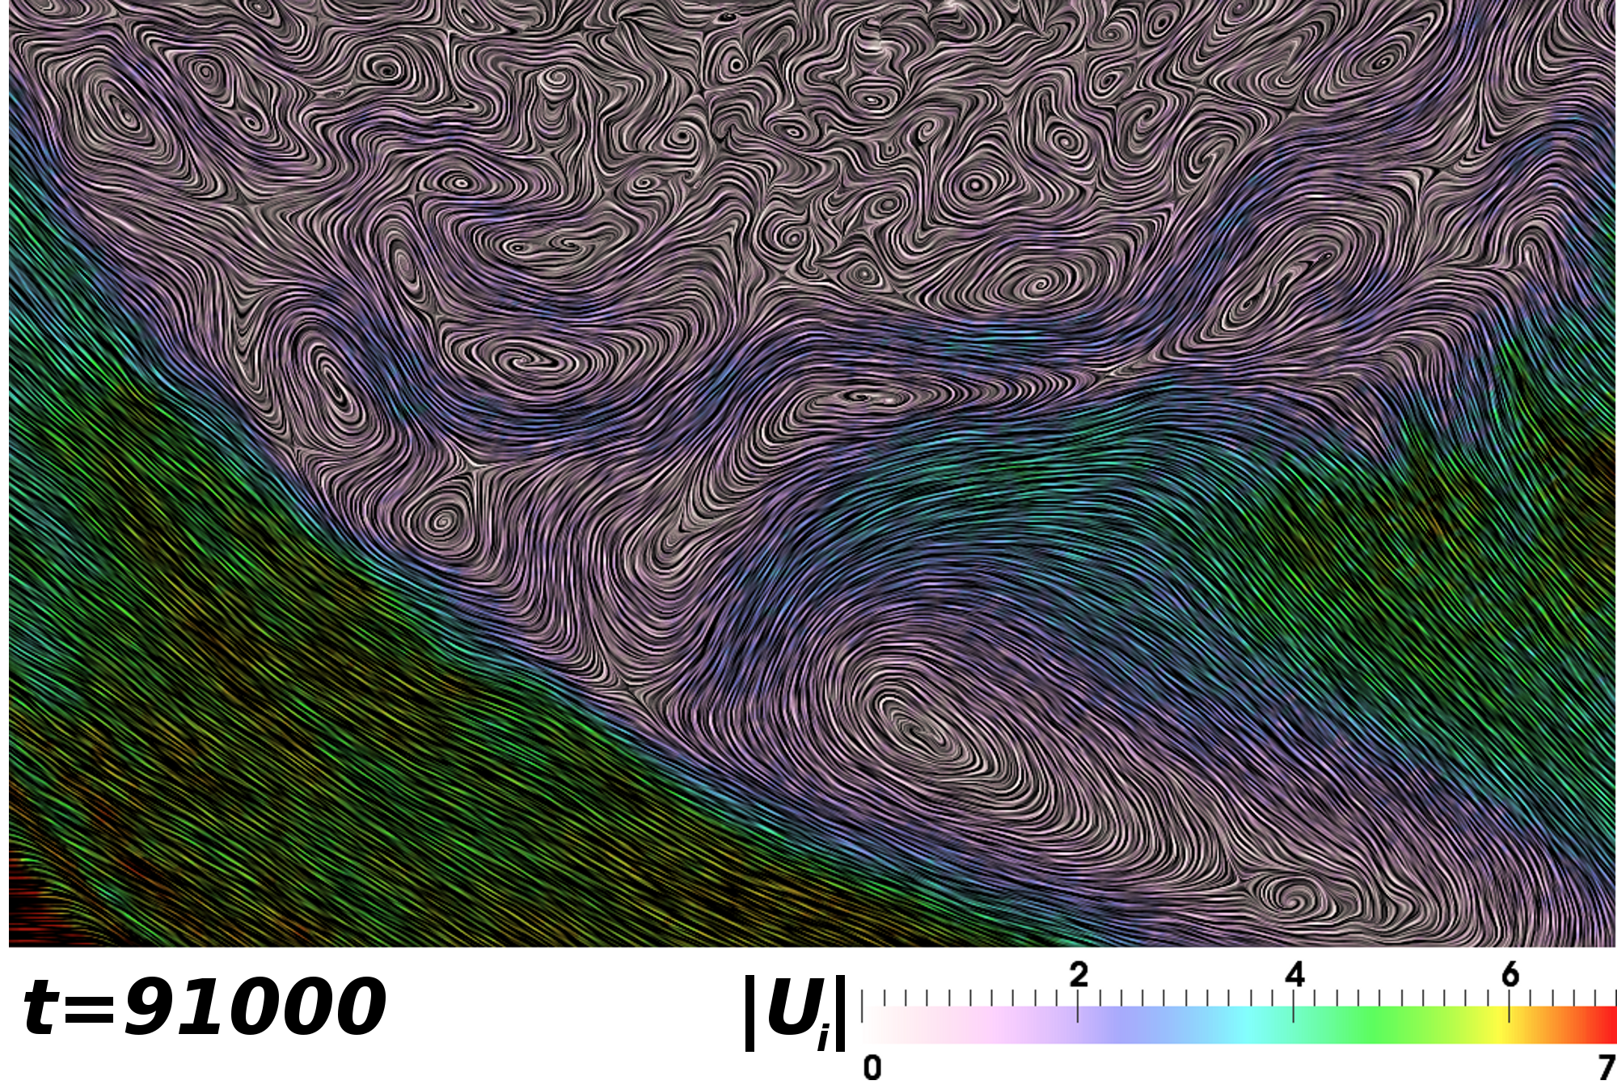
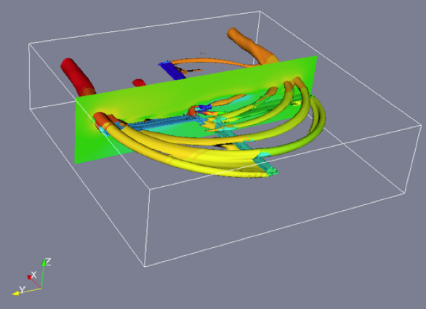
Related Stuff in Catalyst
Lorendeau, Fournier, and Ribes. “In-Situ visualization in fluid mechanics using Catalyst: a case study for Code_Saturne.”
Krimabadi, O’Leary, Tatineni, Loring, Majumdar, and Geveci. “In-Situ Visualization for Global Hybrid Systems.”

Slide 18
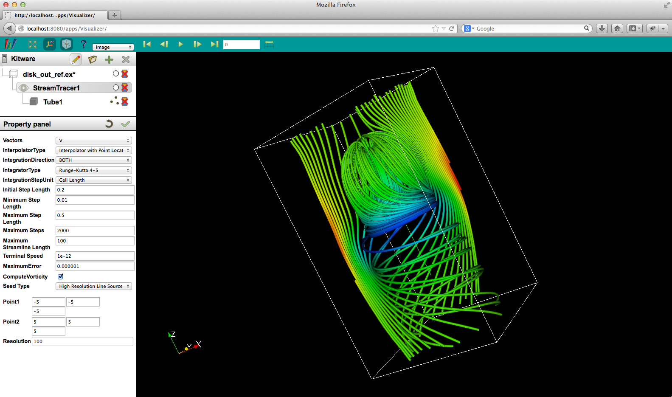
Improved ParaView Web
Notes:
ParaViewWeb is now part of ParaView. Comes with binary installs.
A generic purpose web visualization application
More of a framework than just an application
Provides a set of reusable web widgets for building new sets of apps
Much easier to apply than previous versions
Can launch service from command line or directly integrate with Apache
Demo

