Slide 1
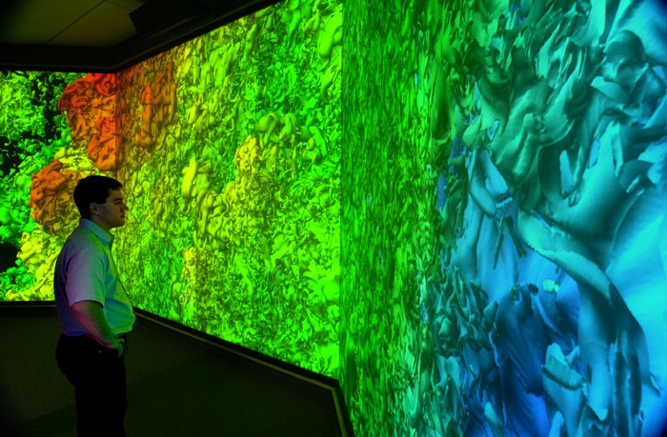
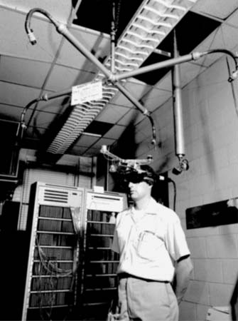
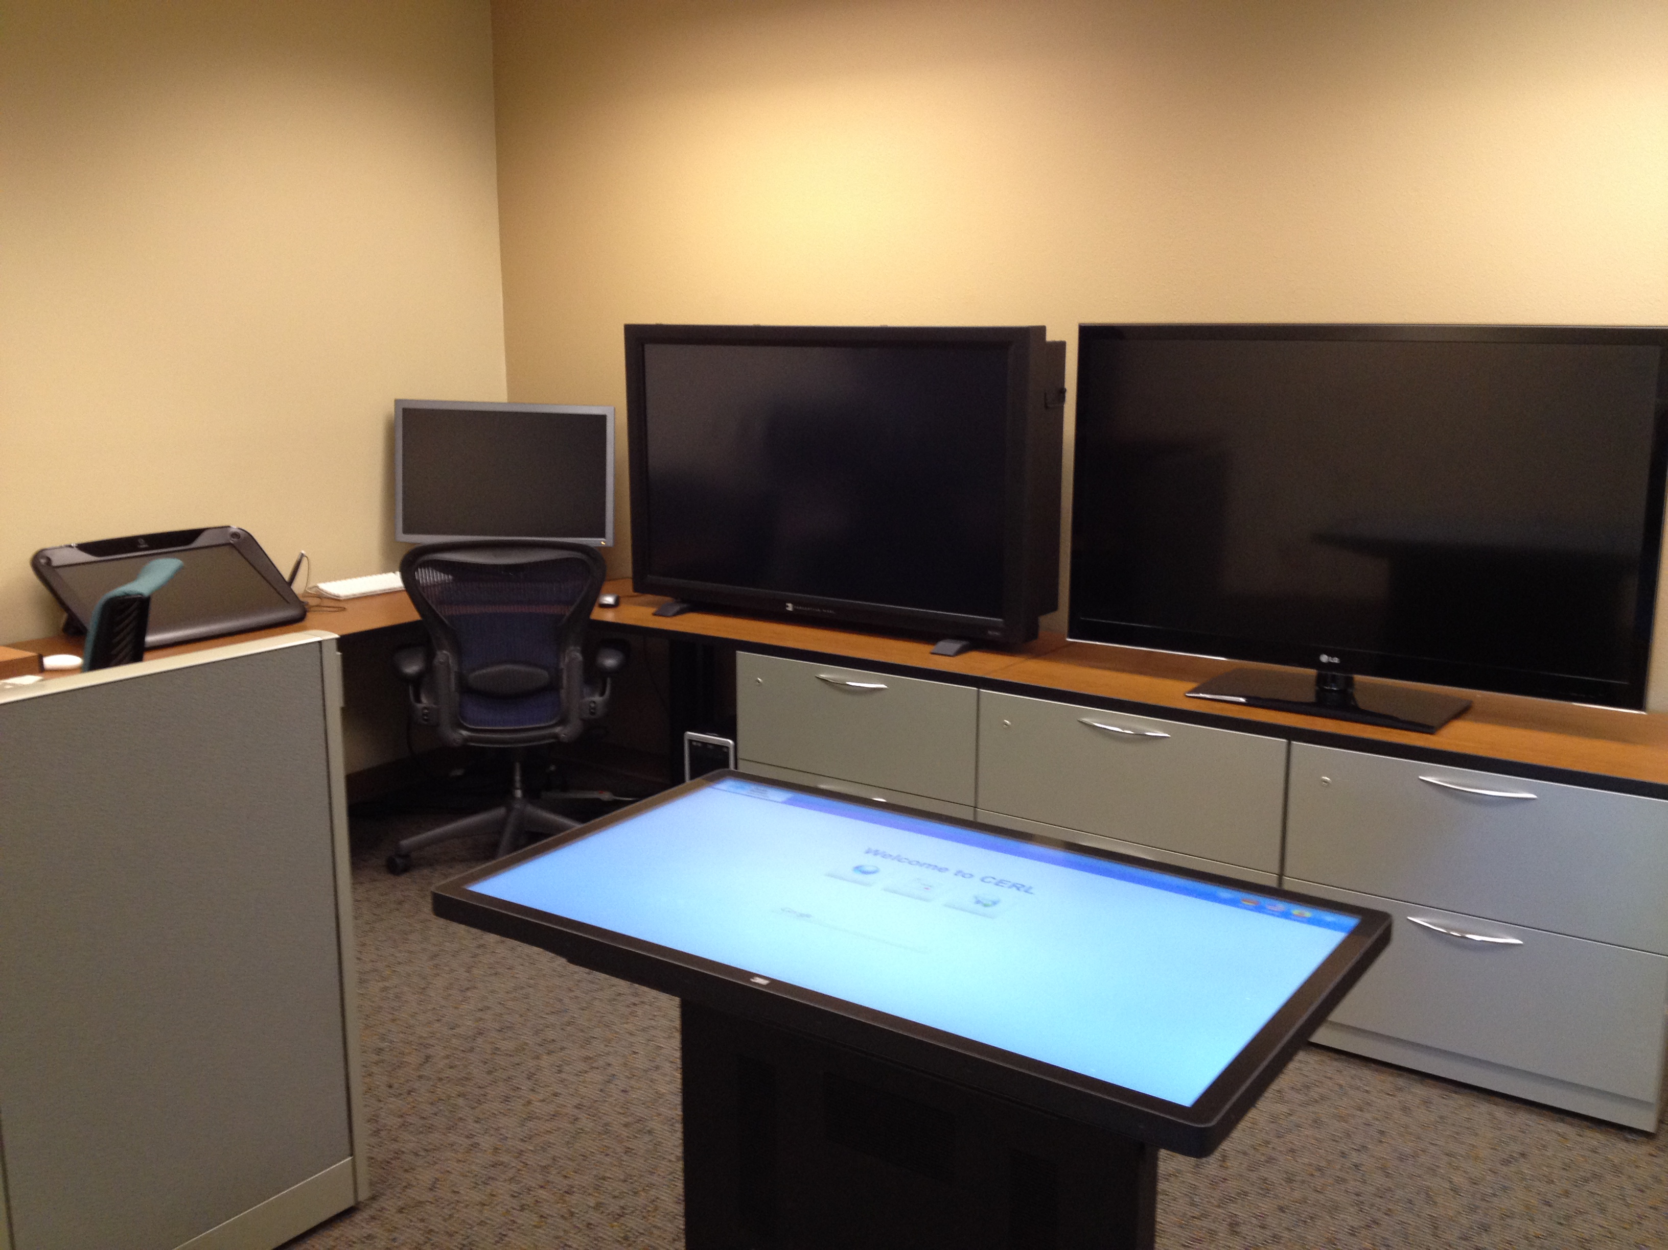
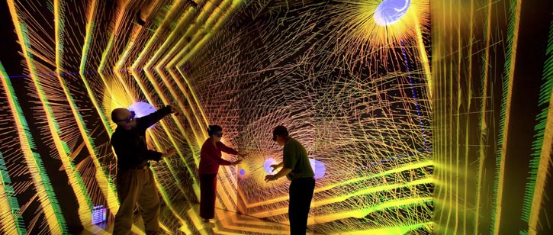
The Trials and Tribulations of a Visualization Laboratory
DOECGF Panel
April 24, 2014
Kenneth Moreland Sandia National Laboratories

Slide 2
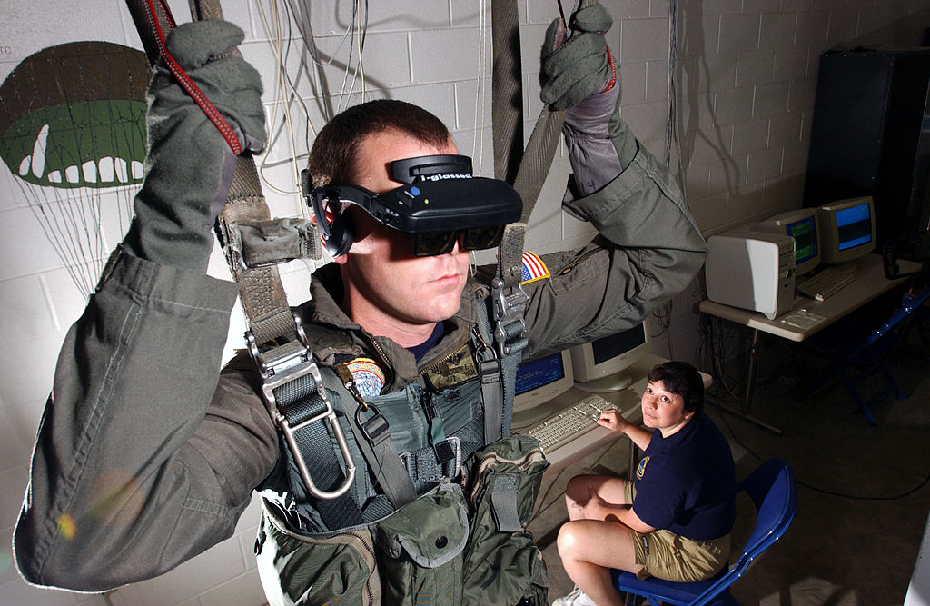
Pre-Topic: What is a Vis Lab?
Research Vis Lab: A space to develop or study new visualization equipment or techniques
Could contain hardware prototypes or equipment for cognitive studies
Never intended as a production facility
Does not contribute to sciences outside of visualization
Production Vis Lab: A facility for general usage containing specialized visualization equipment to be applied to other problems
For use by non-visualization customers
Never intended as a research facility
Does not contribute to vis papers
Notes:
Vis Lab is often a room with cool vis stuff. Not sure what to do with it.
Top image: First VR system, 1968, Ivan Sutherland.
Completely impractical. Primitive graphics and interface. So heavy it has to be suspended from ceiling.
Never to be used for production but critical in advancement of VR technology used today
Bottom image: Modern U.S. Navy parachute simulator (from Wikipedia)
Provides critical stimulus to help train warfighters for dangerous situations
You’re not using this to make any progress in VR or visualization technology
Trying to be both things at once is a recipe for disaster
Funding sources need to understand the function and limitations of the vis lab

Slide 3
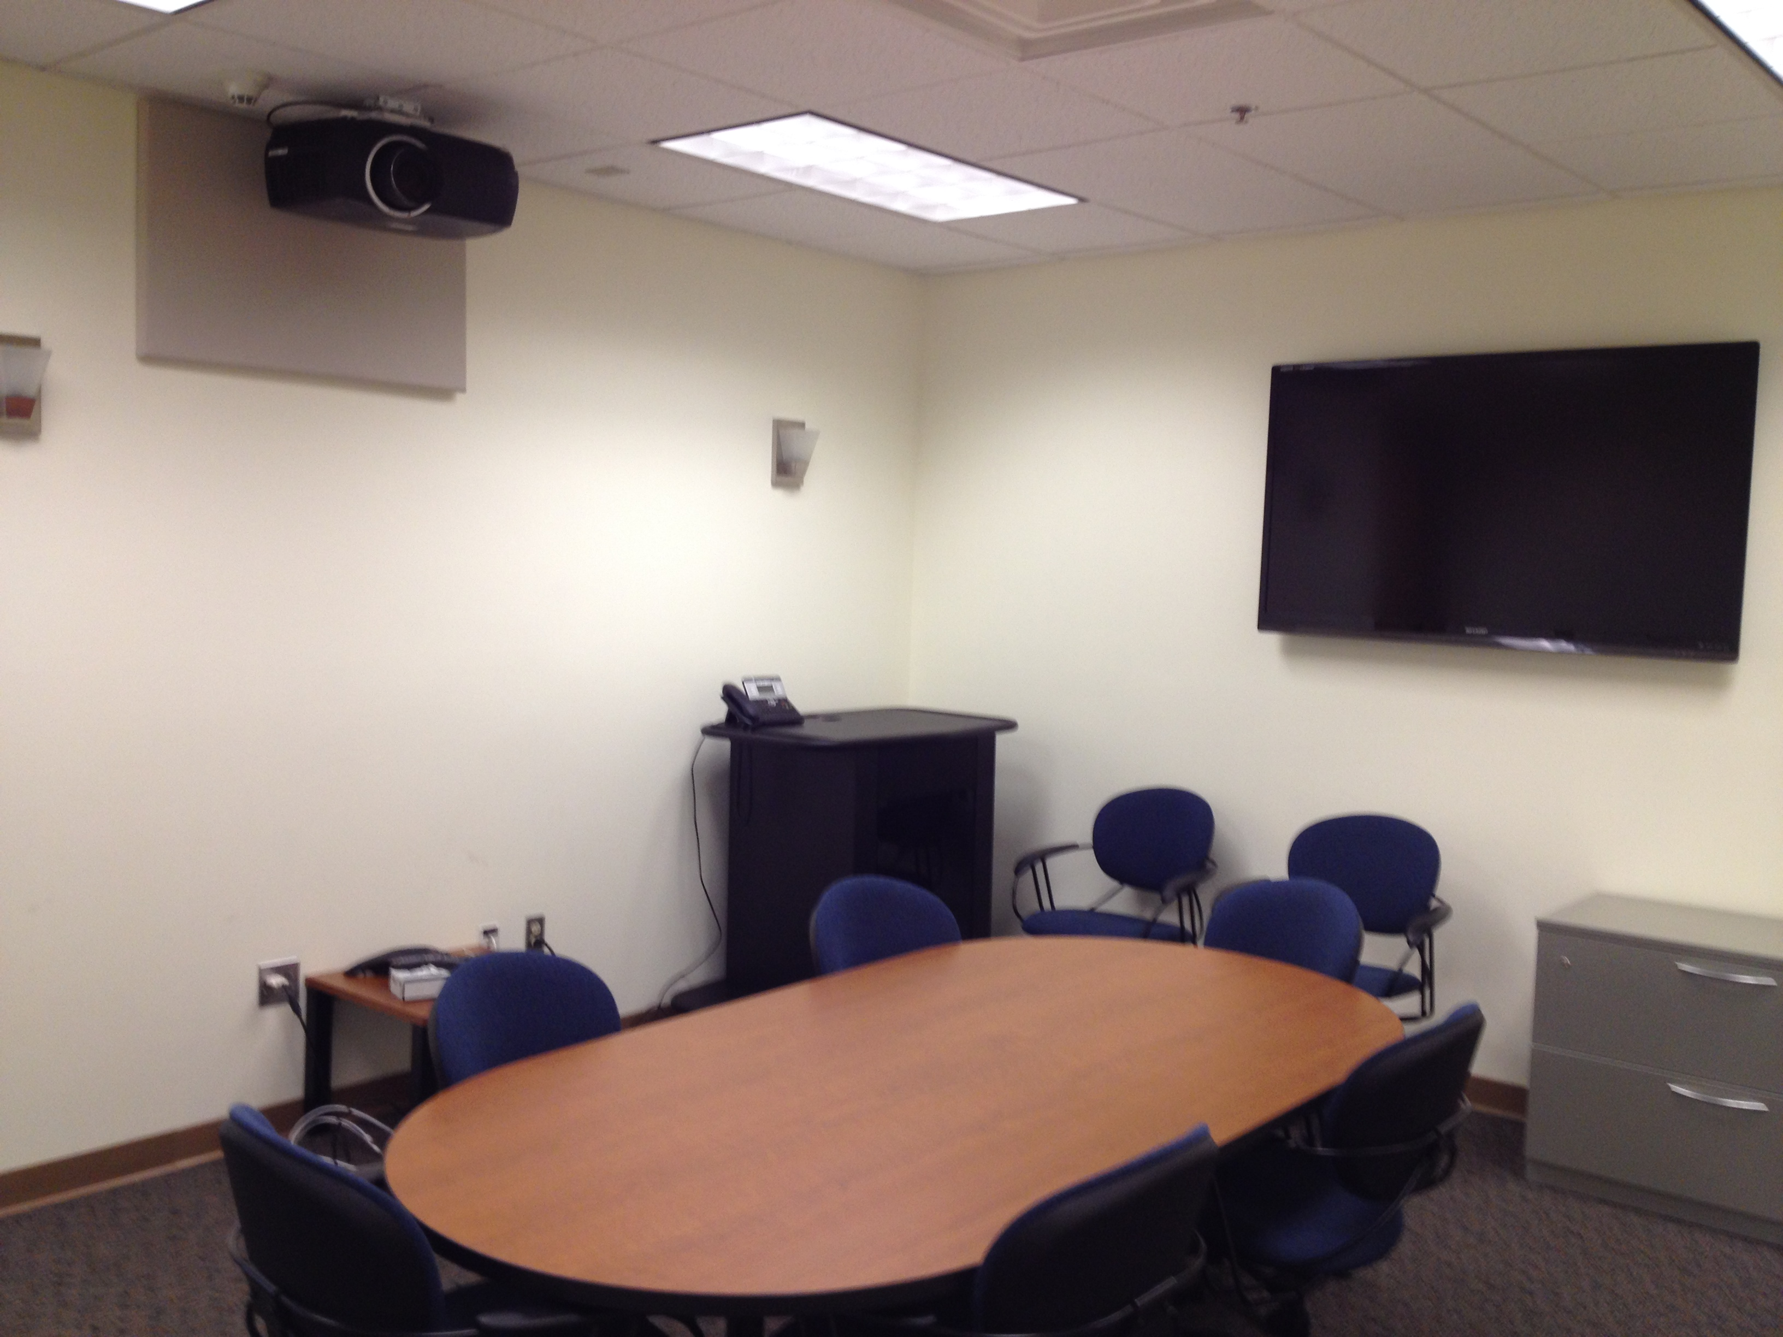
Vis Labs at Sandia/CERL
zSpace 3D
Tablet
Perspective Pixel
Touch Screen
3D HDTV
Panel
Ideum
Touch Table
Production Vis Lab
Research Vis Lab
“Steve”
the Projector
HDTV Panel
DVI/HDMI
Connectors

Slide 4
Topic: Communication Vs. Analysis
Research Vis Lab
Primarily Analysis
That is what a research lab is for
Otherwise you have wasted your money (or at least are loosing opportunity cost)
Secondarily Communication
Because congresspersons and school children like shiny things
Production Vis Lab
Primarily Support
The primary usage is not for advancing visualization
Secondarily (residually?) Communication
If you’ve done your job, domain experts will appreciate visualization

Slide 5
Topic: Autonomy Vs. Support
Research Vis Lab: Collaboration
Might establish a collaborative research project to apply emerging visualization technology to science domain
Not the same thing as support
Production Vis Lab: Depends on the function
Requires a dedicated operator.
Part of the operational design of facility.
Has no support. Autonomous.
Simple, standard connectors mean no need.

Slide 6
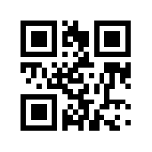
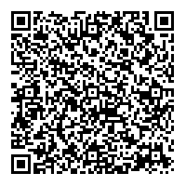
Topic: Resolution and Immersion Two HUGE and Pervasive Fallacies
More Pixels = More Bandwidth
The visual system does not interpret things like QR codes
Going to visual acuity
Looks nice
Does not provide more information
Bad metric for information displays
How to represent biggascale in an image/display
Wrong question. You want to understand your data, not shovel stuff on a viewer
Immersion ➔ Understanding
Being immersed in data does not necessarily mean you will understand it
It might not even help
Immersive displays can loose omnipotent controls

Slide 7
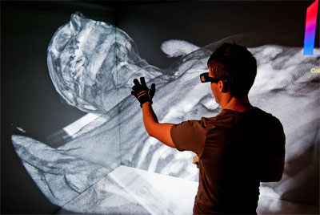
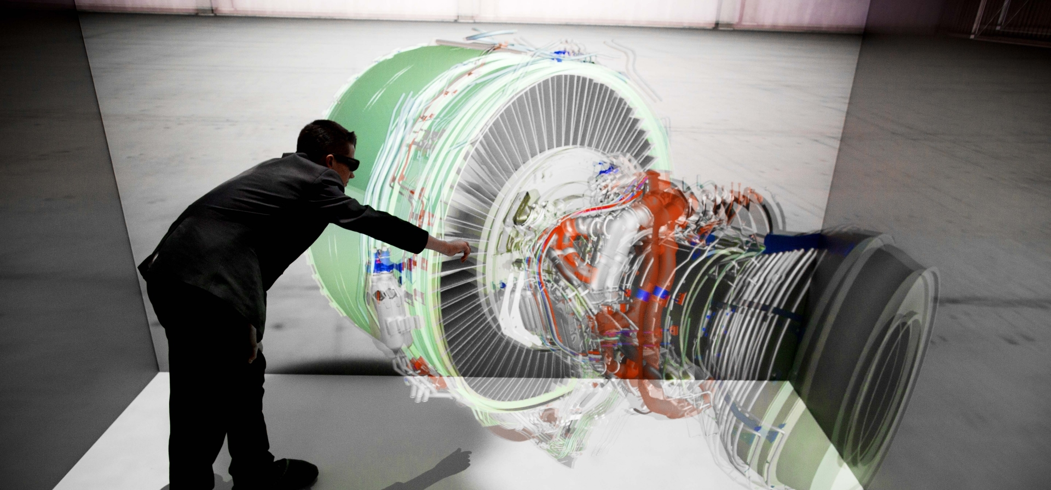
Does Immersion Help Here?
No
Maybe
Yes

