Slide 1
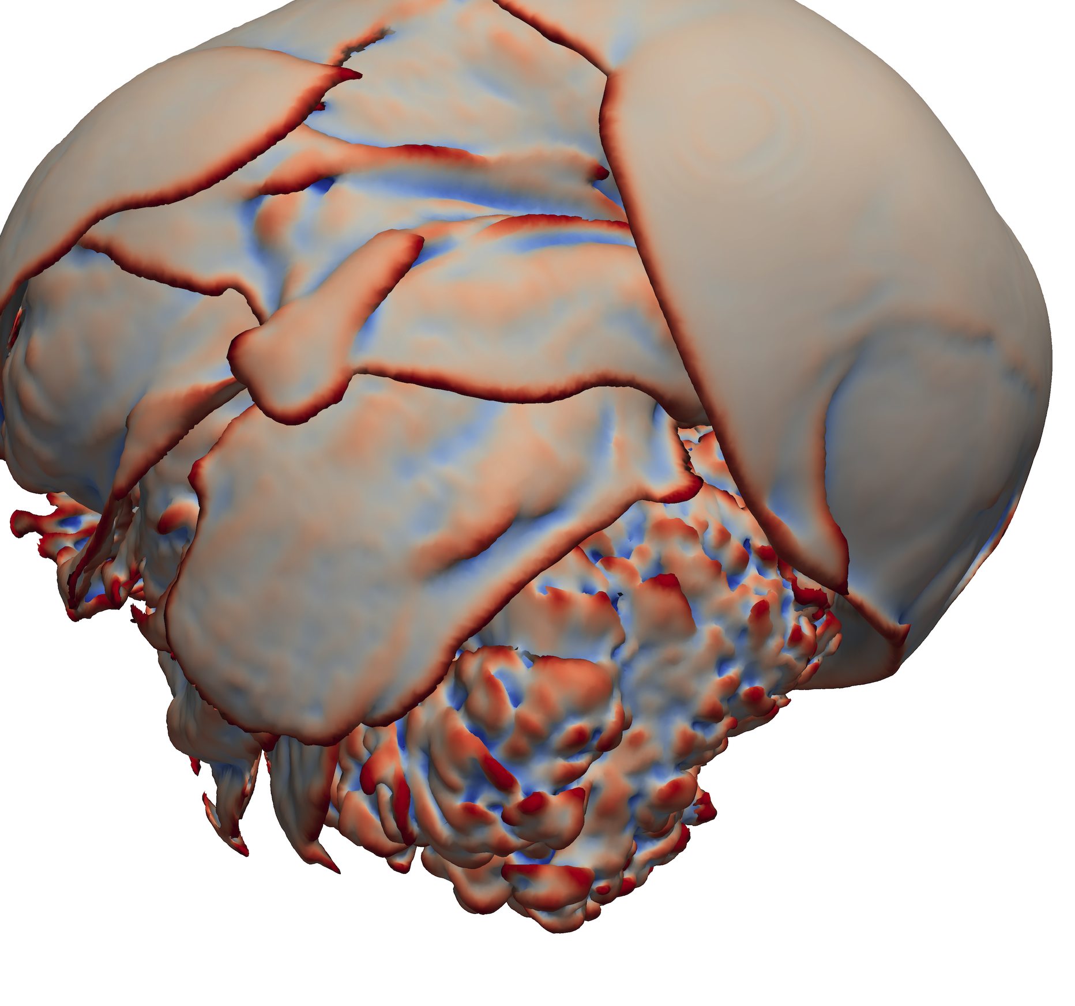
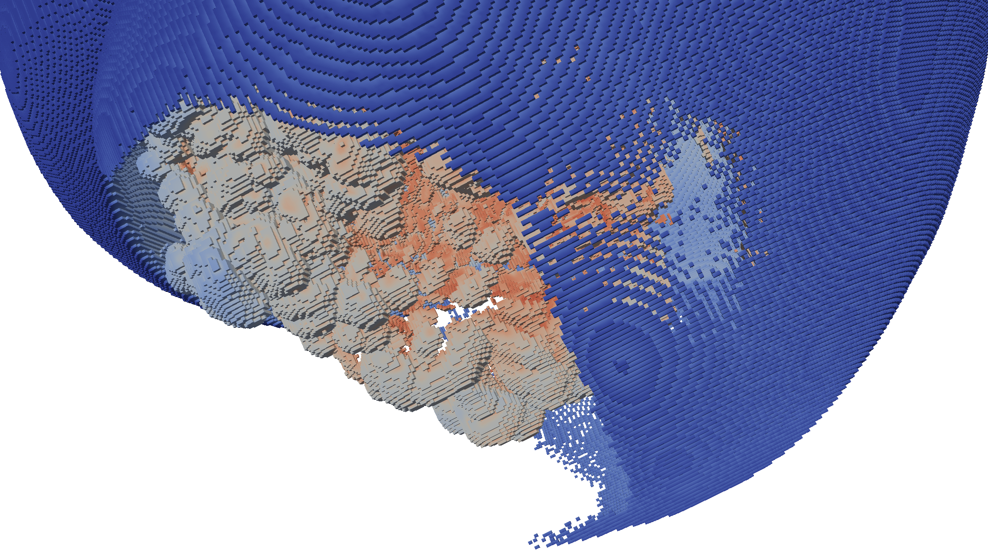
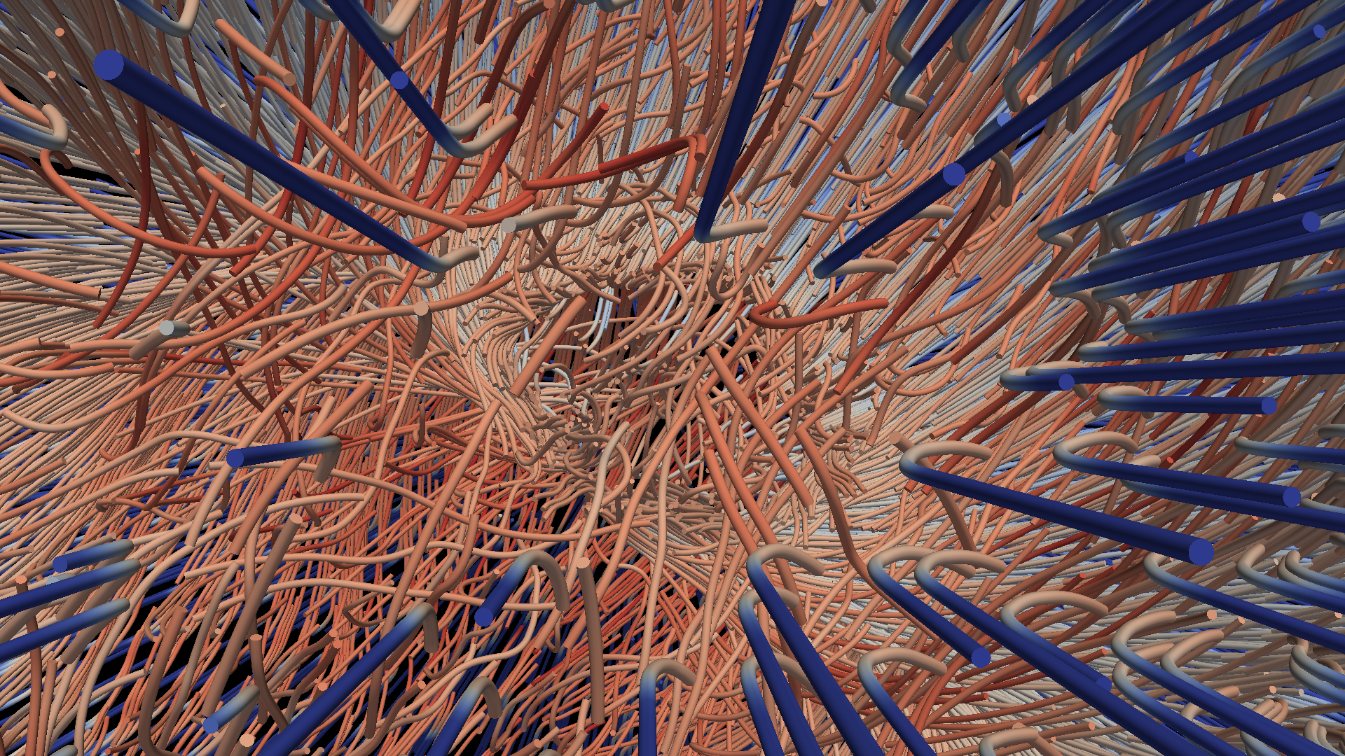
Fun with Dax
DOECGF 2014
April 22, 2014
Kenneth Moreland Sandia National Laboratories

Slide 2
Extreme Scale is
Threads, Threads, Threads!
To succeed at extreme scale, you need to consider the finest possible level of concurrency
  Expect each thread to process exactly one element
  Disallow communication among threads
 | Jaguar – XT5 | Titan – XK7 | Exascale*
Cores | 224,256 | 299,008 and 18,688 gpu | 1 billion
Concurrency | 224,256 way | 70 – 500 million way | 10 – 100 billion way
Memory | 300 Terabytes | 700 Terabytes | 128 Petabytes
*Source: Scientific Discovery at the Exascale, Ahern, Shoshani, Ma, et al.

Slide 3
Project Goals
Reduce the challenges of writing highly concurrent algorithms.
“Everybody who learns concurrency thinks they understand it, ends up finding mysterious races they thought weren’t possible, and discovers that they didn’t actually understand it yet after all.” Herb Sutter
Notes:
Dax goals all work together to help reduce the amount of concurrency developers need to handle. Reduce worrying about

Slide 4
Framework

Slide 5
Dax Framework
Control Environment
Execution Environment
dax::cont
dax::exec
Notes:
The Dax framework is divided into two distinct environments each with their own API.
The control environment a serial environment that is used to establish data and set up parallel jobs.
This is the interface used to connect Dax to applications and other code.
The API for the control environment is located in the namespace dax::cont.
The execution environment is the parallel environment where the actual data processing is done.
Internally, the control environment spawns parallel jobs in the execution environment.
The API for the execution environment is located in the namespace dax::exec.
These two environments mirror the typical hardware configuration of general purpose CPU and accelerator coprocessor.
But also work fine when both are integrated.

Slide 6
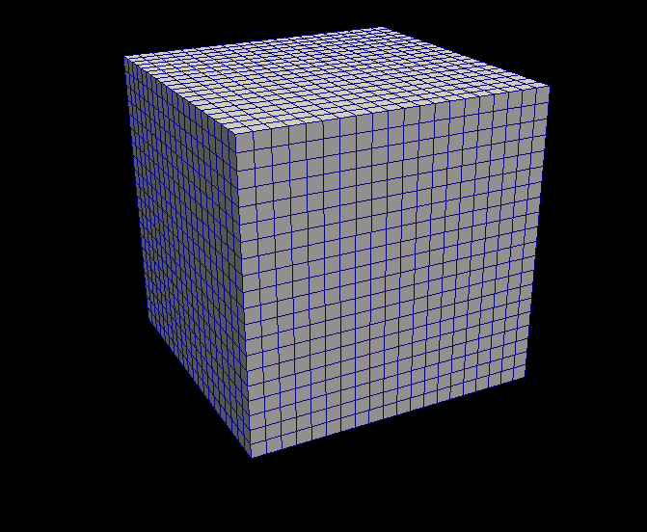
Dax Framework
Control Environment
Grid Topology
Array Handle
Invoke
Execution Environment
dax::cont
dax::exec
Notes:
When processing data in Dax, you first establish the data topology through the control environment.
This is done through very basic grid topology structures and adaptable array handles.

Slide 7
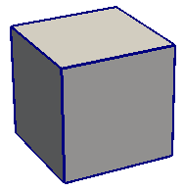
Dax Framework
Control Environment
Grid Topology
Array Handle
Invoke
Execution Environment
Cell Operations
Field Operations
Basic Math
Make Cells
Worklet
dax::cont
dax::exec
Notes:
Then from the control environment you can invoke an algorithm on your data.
Internally, this will decompose the data into constitute pieces, transfer data as necessary, and invoke a parallel algorithm.
Algorithms in the execution environment are built using worklets.
Worklets are serial functors that operate on one constituent element.
The execution API provides the basic operations for cells, interpolations, derivatives, and other math.
Worklets come in different types with different abilities.

Slide 8
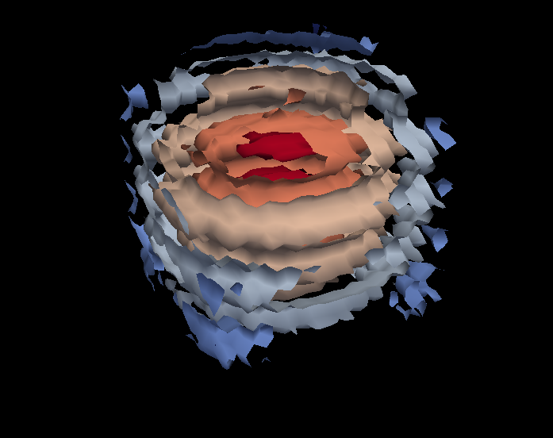
Dax Framework
Control Environment
Grid Topology
Array Handle
Invoke
Execution Environment
Cell Operations
Field Operations
Basic Math
Make Cells
Worklet
dax::cont
dax::exec
Notes:
And eventually the results are passed back to the control environment.

Slide 9
Dax Framework
Control Environment
Grid Topology
Array Handle
Invoke
Execution Environment
Cell Operations
Field Operations
Basic Math
Make Cells
Device Adapter
Allocate
Transfer
Schedule
Sort
…
Worklet
dax::cont
dax::exec
Notes:
These two environments, particularly the execution environment, are meant to work on a variety of architectures.
To manage this portability, we have a unit called a device adapter that sits between these two environments.
The device adapter provides the basic memory management, scheduling, and algorithms needed to run on a parallel device.

Slide 10
Device Adapter Contents
Tag (struct DeviceAdapterFoo { };)
Execution Array Manager
Schedule
Scan
Sort
Other Support algorithms
  Stream compact, copy, parallel find, unique
Control Environment
Execution Environment
Transfer
Schedule
worklet
worklet
worklet
worklet
worklet
worklet
worklet
worklet
worklet
Compute
8
3
5
5
3
6
0
7
4
0
8
11
16
21
24
30
30
37
41
41
8
3
5
5
3
6
0
7
4
0
Compute
0
0
3
3
4
5
5
6
7
8

Slide 11
Array Handle
Array Handle
x₀
y₀
z₀
x₁
y₁
z₁
x₂
y₂
z₂

Slide 12
Array Handle Container
Array Handle
Array of Structs Container
x₀
y₀
z₀
x₁
y₁
z₁
x₂
y₂
z₂
x₀
y₀
z₀
x₁
y₁
z₁
x₂
y₂
z₂

Slide 13
Array Handle Container
Array Handle
Array of Structs Container
x₀
y₀
z₀
x₁
y₁
z₁
x₂
y₂
z₂
x₀
y₀
z₀
x₁
y₁
z₁
x₂
y₂
z₂
Array Handle
x₀
x₁
x₂
Struct of Arrays Container
y₀
y₁
y₂
x₀
y₀
z₀
x₁
y₁
z₁
x₂
y₂
z₂
z₀
z₁
z₂

Slide 14
Array Handle Container
Array Handle
Array of Structs Container
x₀
y₀
z₀
x₁
y₁
z₁
x₂
y₂
z₂
x₀
y₀
z₀
x₁
y₁
z₁
x₂
y₂
z₂
Array Handle
x₀
x₁
x₂
Struct of Arrays Container
y₀
y₁
y₂
x₀
y₀
z₀
x₁
y₁
z₁
x₂
y₂
z₂
z₀
z₁
z₂
Array Handle
vtkCellArray Container
v₀
v₁
v₂
v₃
v₄
v₅
v₆
v₇
v₈
3
v₀
v₁
v₂
3
v₃
v₄
v₅
3
v₆
v₇
v₈

Slide 15
Array Handle Resource Management
Control Environment
Array Handle
Contains

Slide 16
Array Handle Resource Management
Control Environment
Execution Environment
Transfer
Array Handle
Contains
Implements
Uses
Device Adapter

Slide 17
Programming Fun

Slide 18
Example Code
Mandelbulb Fractal

Slide 19



Mandelbulb “nth power” of 3D Vector
where

Slide 20
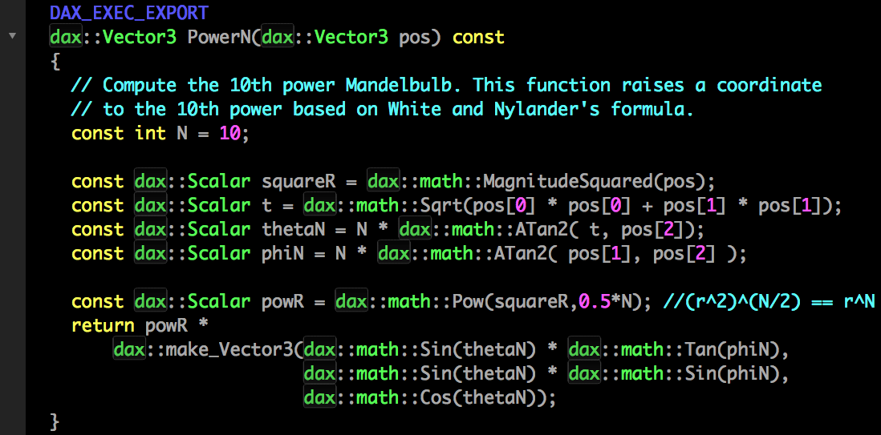

Slide 21

Mandelbulb Iteration
Fractal created by iterating on power operation, offsetting by input coordinate.
Our implementation counts how many iterations to “escape.”

Slide 22
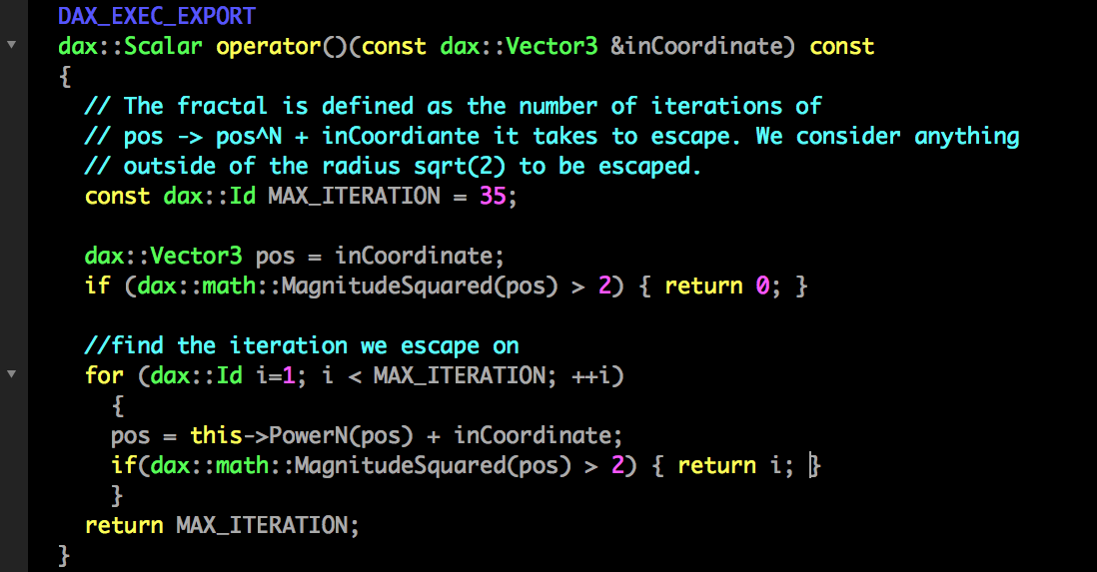

Slide 23
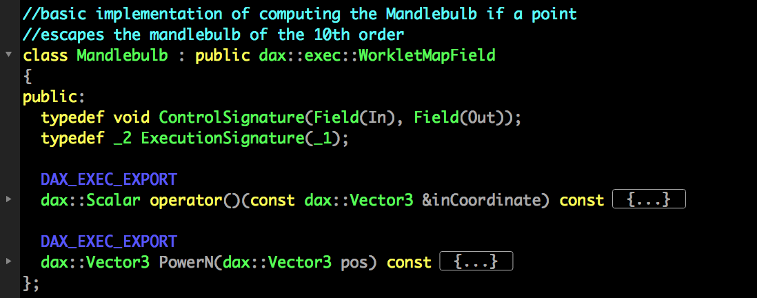

Slide 24
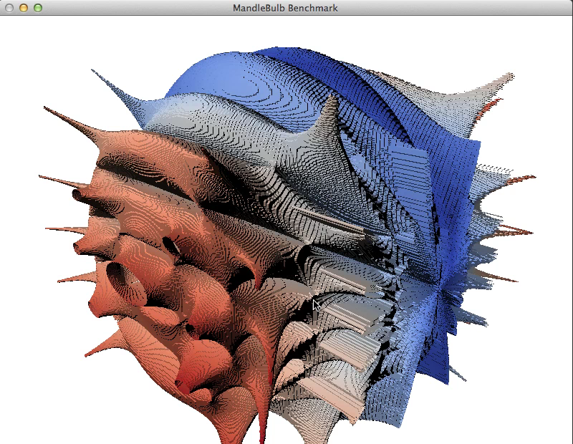
Notes:
When run on a Quadro 4000, computes over 100 million points in just under 3 seconds
We’ve added contouring and OpenGL interop to show interesting shape
Can also compile and run same code for multiple cores
Using 2 2.4 GHz 6-Core Intel Xeon processors, can compute the same data in just under 9 seconds
Dax allows portability between these two systems
If nothing else, provides a realistic comparison of your code across different architectures

Slide 25
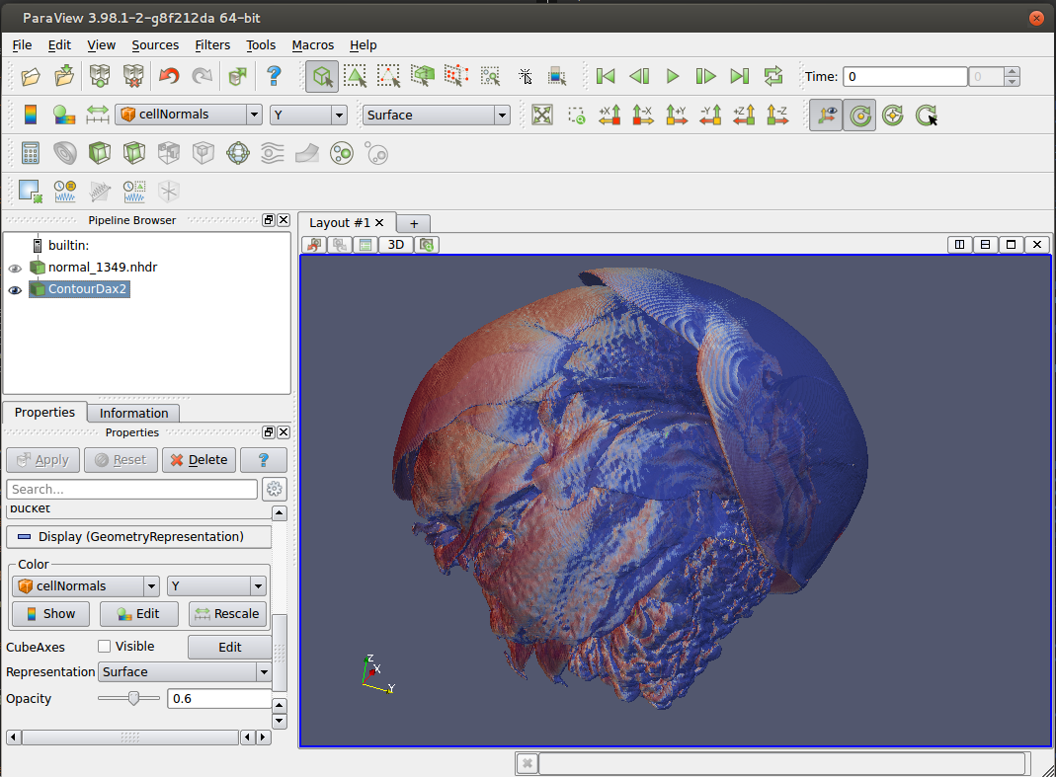
Next Steps
Integrate into existing Vis tools
VTK-m
  Dax + EAVL + PISTON = Awesome

Slide 26
Acknowledgements
This work was supported by the DOE Office of Science, Advanced Scientific Computing Research, under award number 10-014707, program manager Lucy Nowell.
Additional support by the Director, Office of Advanced Scientific Computing Research, Office of Science, of the U.S. Department of Energy under Contract No. 12-015215, through the Scientific Discovery through Advanced Computing (SciDAC) Institute of Scalable Data Management, Analysis and Visualization.
Sandia National Laboratories is a multi-program laboratory managed and operated by Sandia Corporation, a wholly owned subsidiary of Lockheed Martin Corporation, for the U.S. Department of Energy’s National Nuclear Security Administration under contract DE-AC04-94AL85000.

Slide 27

Try it Yourself!
http://daxtoolkit.org

