Slide 2
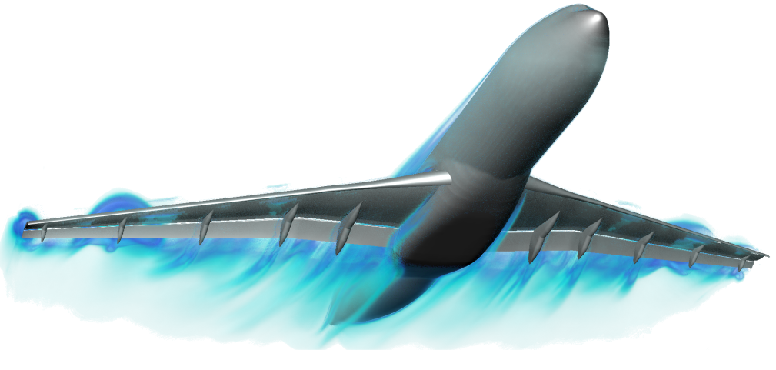
Fieldview-VisIt: building on strengths
Brad Whitlock
Intelligent Light

Slide 3
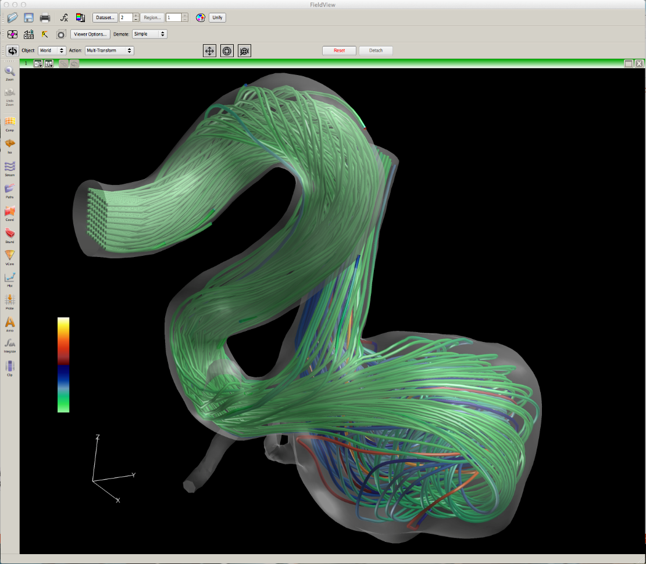
Overview
Intelligent Light Overview
VisIt
FieldView
Strengths
SBIR Phase 2
Integration Overview
  Infrastructure enhancements
  Database plug-in enhancements
  Plot enhancements
Cross Pollination
Other Activities
FieldView showing geometry and streamlines imported from VisIt via XDB

Slide 4

















Intelligent Light
Established in 1984
  Nearly three decades in the software & services business
  FieldView launched in 1990
  Global Customer Base
  Truly Solver Independent
  Multiple CFD practitioners on staff
We bridge CFD & IT for customers
IT
CFD Solvers

Slide 5
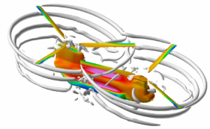
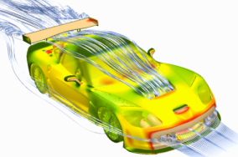
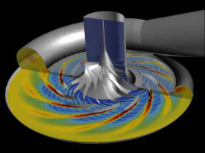
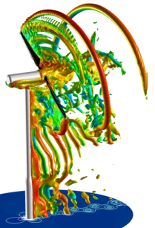
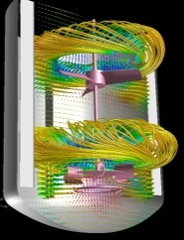
Serving the CFD Community
FieldView Software Products
  Comprehensive scope, from laptops to HPC
    Visualization, numerical analysis
    Data management & Automation
CFD Consulting Services Team
  Training (on-site or at Intelligent Light)
  Script development, FieldView customization
  Workflow Automation & Optimization
Applied Research Group (ARG)
  R&D in advanced post-processing & CFD methods
  Feeds technology into FieldView
Our Mission: To help our customers using CFD to do more with less and make better decisions

Slide 6
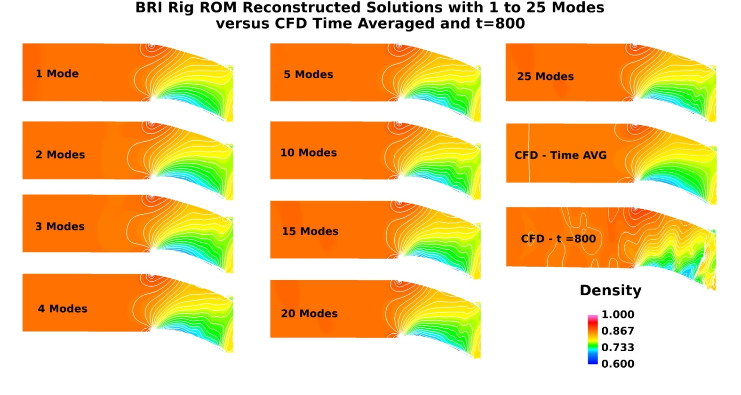
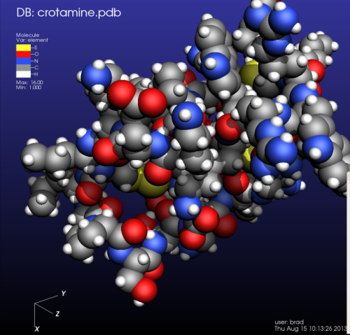
Applied Research Group
Strategic R&D for CFD, post-processing & visualization
Led by Dr. Earl P.N. Duque
Air Force Research Lab – EPISODE
  Large Scale Extracts
  POD
  Reduced Order Models
  New UI – Self Organizing Maps
Department of Energy – FieldView-VisIt
  Open Source Post-Processing Software
  Commercialized for High End Users

Slide 7
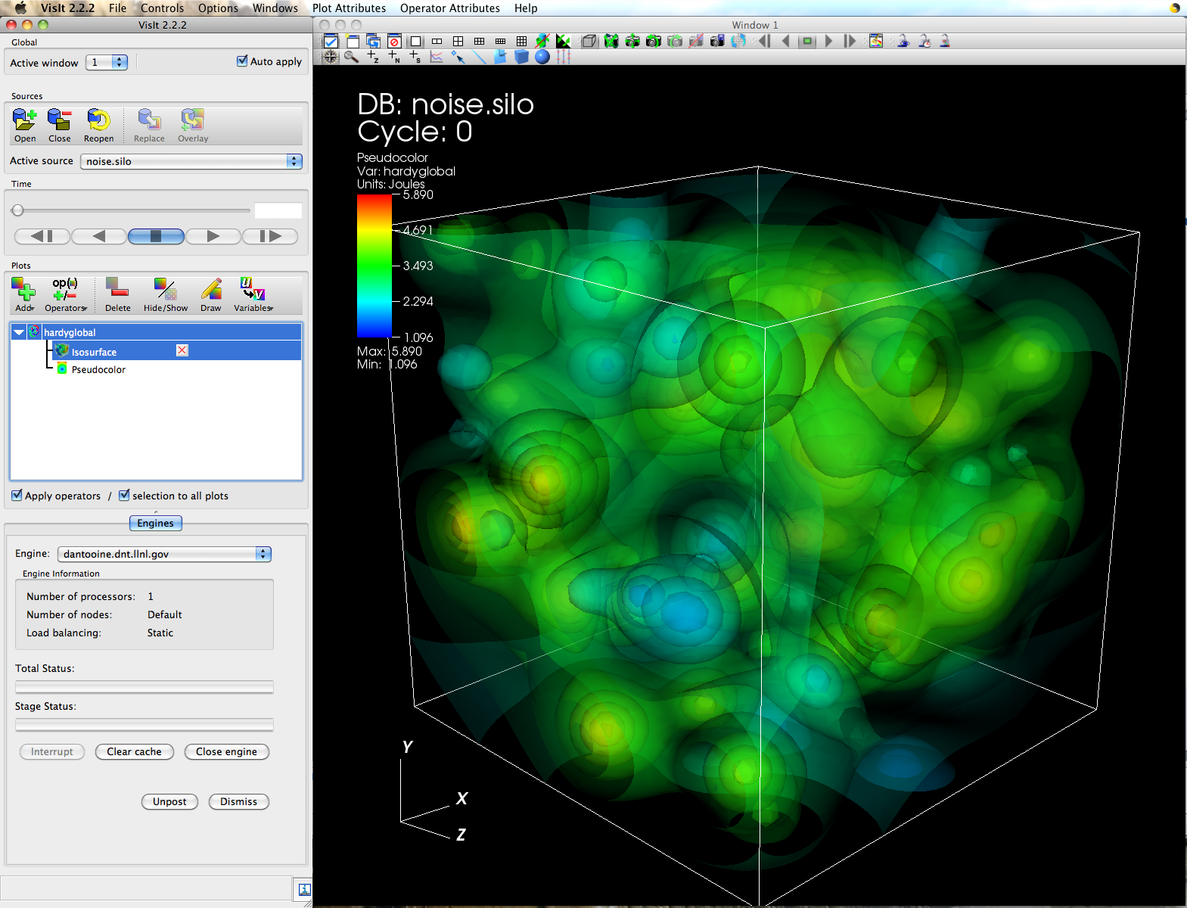
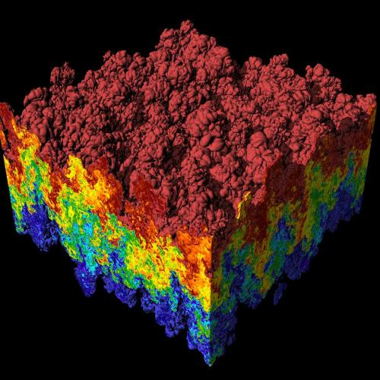
VisIt
Open source, production, end-user tool supporting scientific and engineering applications.
Provides an infrastructure for parallel data analysis and visualization that scales from desktops to massive HPC clusters.
Density Isovolume of a
3K^3 (27 Bz) dataset
Notes:
Note: Here is a 500 word summary of VisIt
http://visitusers.org/index.php?title=500words

Slide 8
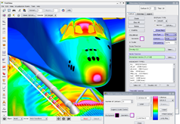
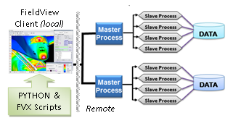
FieldView
FieldView been on the market for CFD post-processing since 1991
Graphic User Interface design created by close collaboration with Industry engineers and analysts
Over 3000 licenses of FieldView in use today throughout the world
Industries ranging from aerospace and automotive to nuclear engineering, turbomachinery, wind energy and food processing.
Scales well to 256 nodes per dataset, 30 Bn cell unsteady as high water mark

Slide 9
FieldView-VisIt SBIR Phase 2
Advance FieldView by integrating VisIt technology
  Incorporate into future FieldView release
Enable existing customers who prefer FieldView GUI to leverage VisIt’s scalability
  Backward compatible support for scripts, etc
Support VisIt Community
  Contribute enhancements back to open source VisIt
  Provide commercial VisIt support
Popularize in situ data analysis and visualization

Slide 10

Strengths
Each tool and organization has its respective strengths that we are bringing together.
VisIt Strengths
Scalability
Extensibility
In situ
Open source
Deployment target for research
Commitment to user support
Combined Strengths
Data handling
Ease of use
High Performance & Scalable
In situ
Extensibility
Deployed research gets used
Large customer base
Promoted commercially
Excellent customer support
Contributions to Open Source
FieldView Strengths
Data handling
Ease of use
High Performance
Large customer base
Promoted commercially
Excellent customer support

Slide 11
Integration Overview
High Performance to 256 cores
FieldView Server
FV Data Readers
VisIt Engine
New plug-ins
In-situ with solver code
FieldView Easy-to-use GUI
High-speed graphics
Fully backward compatible
FVX, XDB support
VisIt Engine
New plug-ins
Open Source
Scalable rendering
License-free operation
Wide list of functions
Supported by Intelligent Light
Added VisIt functions
Scalable rendering
VisIt Viewer

Slide 12
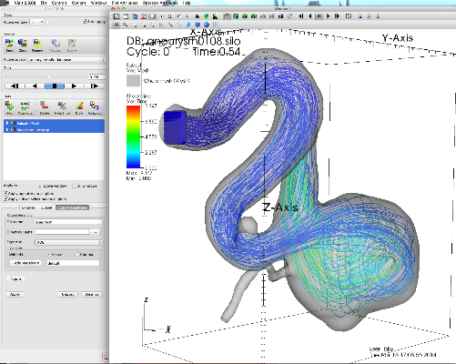
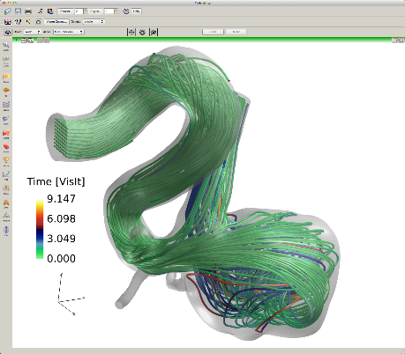
FieldView-VisIt Integration
Improved VisIt Infrastructure
Created new/enhanced database plug-ins for VisIt
Created new VisIt plots
  New filters for FieldView-style data extraction
  Custom rendering
Use VisIt to obtain data for FieldView
  Bridge library exposes FieldView-like API to get data from VTK datasets in VisIt’s plots
VisIt
FieldView
XDB
FieldView extract database (XDB) files allow open source VisIt to export data to Fieldview
Funded by IL and DOE Grant SC0007548

Slide 13
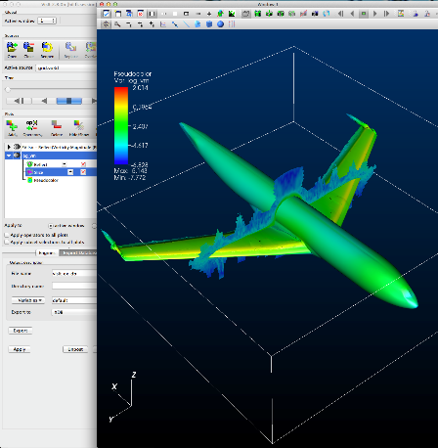
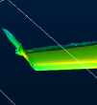
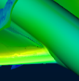
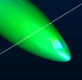

VisIt Export Enhancements
Monolithic export refactored into customizable methods that affect pipeline contract
Combine geometry modes to simplify plug-in creation
  Combine/move data to rank 0
  Automatic conversion to polydata, triangles
  Automatic normal generation
Retrieve license string from plug-ins
Support for FieldView extract database (XDB) format added
  Enables VisIt to save persistent extracts for use in FieldView
Simulation
Libsim
VisIt Runtime
Rank 0
Rank 1
…
Rank n
VisIt
export
XDB
XDB files extracted using VisIt
Hilift data shown
FieldView
Funded by IL and DOE Grant SC0007548
Notes:
VisIt’s export mechanism was a monolithic block of code in the avtDatabaseWriter::Write method. This has been split up into many helper methods that allow derived classes to control more of the export process. Derived types can influence which variables are exported, how materials are handled, and ultimately set various properties in the contract. If the contract has changed then the pipeline gets re-executed. This is an improvement over the former code that too often resulted in pipeline re-executions.
Down in writer plugins, there are various ways that we need to handle data. Some formats can deal with writing their data to a separate file. Other formats need to contain all data in a single file or single object within that file. The export mechanism has been extended so it asks the derived type the proper geometry combination mode based on the type of plot being exported. Writers can get VisIt to combine all data on rank 0, combine like data (label match) on rank 0 into n objects, or do no combining and let each rank get its own chunk of data (the old way). Geometry combination in the writer can simplify many plug-ins that were doing their own geometry combining since they can now use the base class methods.
The database plugin API was extended so it supports reading a license/copyright string from the plugins and passing it back to the clients. The current example of where this is used is in the Export window, which can show the plugin license on export.
XDB plugin support was added to the VisIt svn repo. XDB is a plugin that stores VisIt’s VTK data into FieldView’s XDB format so that FieldView can read and process the extracted data. XDB exports will be used in VisIt at scale and in situ to extract data for FieldView customers. This is the first example of a plugin that is primarily a binary. We had to develop cmake logic to determine compatibility, select the plugin, copy its support libraries in a way suitable to regular VisIt development builds, and ensure that plugins were installed properly when doing “make install” or “make package”.

Slide 14

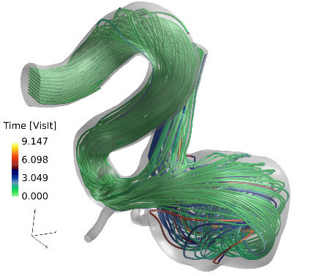
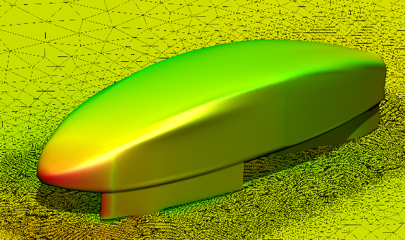
New/Enhanced Database Plug-ins
Database Plug-in | Description
OVERFLOW | New proprietary OVERFLOW reader Supercedes VisIt OVERFLOW reader Supports derived variables using OVERFLOW formulations Structured, multi-block, overset grid
XDB | New plug-in containing FieldView extract database (XDB) format writer Binary deployment in open source VisIt Enables VisIt/Libsim to directly output XDB files for analysis in FieldView
FV-UNS | New proprietary data reader Volumetric data + boundaries Developed for future FieldView-VisIt binary deployment proof of concept for boundary data
Funded by IL and DOE Grant SC0007548

Slide 15
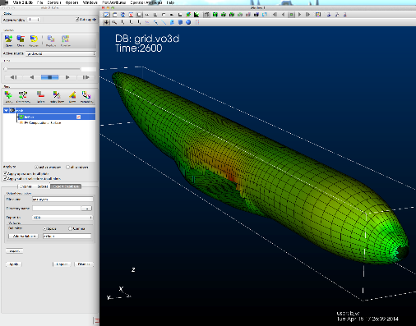
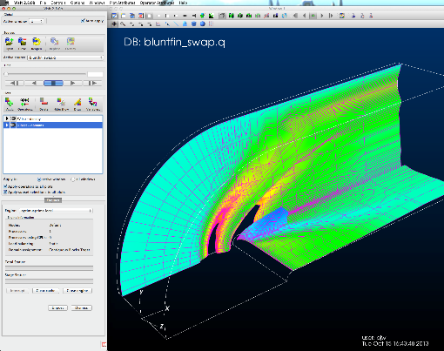
FieldView plots in VisIt
Proprietary new plots accomplish data extraction for the FVV integration
Based on VisIt’s AVT pipeline and use both existing AVT filters and custom filters
Compatible with VisIt’s operators and other features
Provide a place to customize / optimize for future
Plot Name | Description
fvCompSurface | IJK-slice of structured data with various visual representations Includes vector data Supports threshold by scalar
fvIso | Slice using isosurface function or slice plane Supports same rendering modes as fvCompSurface
fvStreamline | RK4 streamline integration using a list of seed points Extract variables along the streamline
Funded by IL and DOE Grant SC0007548

Slide 16
Cross-Pollination
As we have started integrating there has been exchange of ideas resulting in new (or planned) features in each code
Ideas/code
Ideas/code
FieldView ideas for VisIt
Animated plots
Auxiliary metadata files
Additional metadata for populating plot GUI
XDB Extracts
Boundary surfaces
VisIt ideas for FieldView
Simplified client/server API
Scalable rendering
Volume rendering
In situ
Funded by IL and DOE Grant SC0007548
Notes:
Some of these infrastructure enhancements may yet be contributed to the open source VisIt

Slide 17
Other VisIt Activity at IL
Produced ‘industrial strength’ OVERFLOW-2 reader for VisIt
Expanded VisIt outreach to other parts of NASA & Tokyo Univ. IIS and JAXA in Japan
1st dedicated VisIt booth at SC13
Supported Tutorial at SC13
BJW participating on VisIt wiki and email support
Started small scale industry (non-DOE) support for VisIt development
Committed to VisIt SC14 Tutorial and exhibit booth
Notes:
We’re not just coding…

Slide 18
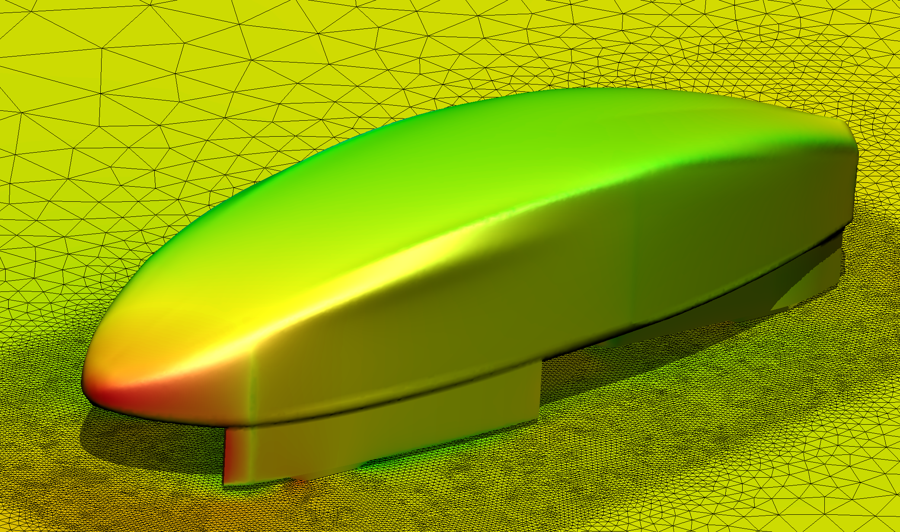
Conclusion
IL is committed to VisIt
  IL added some critical enhancements to VisIt
  IL will continue FieldView-VisIt integration efforts
    Add industrial strength CFD readers
  IL plans to expand commercial support for VisIt
    Consulting work
    Provide paid support and training
  IL will continue to support the VisIt project with our efforts and outreach
www.ilight.com

