Slide 1
Distributed Object Storage Rebuild Analysis via Simulation with GOBS
Justin M Wozniak, Seung Woo Son, and Robert Ross
Argonne National Laboratory
Presented at:
Workshop on Fault-Tolerance for HPC at Extreme Scale (FTXS 2010)
Chicago, IL – June 28, 2010

Slide 2
Outline
Context
High-performance storage use cases
Parallel filesystems
Object storage motivation
Problem statement
Disk size/fault rate dynamic
System model
GOBS Simulator
Data placement for survivability
Simulation and analysis of rebuild performance (GOBS)
Preliminary results
Hot spots
Eager rebuilds

Slide 3
Context

Slide 4
Uses of high-performance storage (1)
Checkpoint
Write out all user memory to non-volatile storage
Basic survival strategy to avoid lost work
Optimal checkpoint interval
First-order approximation to optimal checkpoint write interval
t_{o} : checkpoint interval
t_{w} : time to write checkpoint
t_{f} : mean time to failure
Future trends
Bigger memory → longer writes
More components → more faults
Could reach a critical point

Slide 5
Uses of high-performance storage (2)
Useful application data
MPI-IO
Parallel interface for file I/O operations
Allows I/O experts to implement optimizations
High-level libraries
Provide a variable-oriented view on data
PnetCDF, HDF5, ADIOS
Can use MPI-IO
POSIX I/O
Still prevalent in large-scale applications
Must maintain user expectations, portability, but make use of high-performance machines

Slide 6
Parallel filesystems
Eliminate single bottlenecks in I/O
-- APPLICATION --
CLIENT
CLIENT
CLIENT
CLIENT
-- NETWORK --
FS
FS
FS
FS
DISK
DISK
DISK
DISK
PVFS – Clemson, ANL Open source, community maintained GPFS – IBM Licensed by IBM | Lustre – Oracle/Sun Open source but supported PanFS – Panasas Software/hardware packages

Slide 7
Object storage
Separation of concerns
Employed by many modern systems – not “old news” either
CLIENT
CLIENT
-- NETWORK --
-- NETWORK --
FS
→
FS
BLOCKS
OBJECTS
-- NETWORK --
-- NETWORK --
BLOCKS
DISK
DISK

Slide 8
Distributed object placement
Object placement algorithm:
x_{i,j} : object i, replica j
s_{k} : server k
Replicas must be placed on different servers
Place whole objects
Essentially distribute a hash table over multiple sites

Slide 9
Related work
RUSH
(Honicky and Miller, 2003) – described distribution of remaining replicas after loss of one replica server
(Weil et. al., 2006) – evaluated efficiency of reorganization
Kinesis
(MacCormick et. al., 2009) – evaluated object load balancing of object placement, user accesses and rebuild parallelism
PIO-SIM
(Bagrodia et. al., 1997) – analyze MPI-IO strategies such as collective operations, two-phase I/O, and cooperative caches
PFSS
(Speth, 2005) – simulated PVFS with RAID under various fault conditions

Slide 10
Problem statement

Slide 11
Exascale storage challenges
Number of disks
Speed: to satisfy checkpoint requirements, will need ~30,000 disks
Capacity: may use additional storage hierarchy for space
Required bandwidth
~12 TB/s
New ability to manage many clients
Redundancy
Must plan to lose up to 10% of disks per year
That’s 263 TB/day; 3.125 GB/s
(Power)

Slide 12
System architecture
FILE 354
-- NETWORK --
OBJECT 520
SERVER 232
SERVER 812
OBJECTS
OBJECT 332 S
OBJECTS
OBJECT 520 P
OBJECT 421 S
OBJECT 813 S
OBJECT 193 P
OBJECT 993 P
STORE
STORE
OBJECT 520 S
OBJECT 772 S
DISK
DISK
DISK
DISK
RAID
DISK
RAID
DISK
DISK
DISK
DISK
DISK
RAID
DISK
RAID
DISK
Storage infrastructure modeled by GOBS

Slide 13
System design parameters
Setup
B : address bit-length
files : number of files
file.* : file generation parameters, including file.width
nodes : number of servers (~700)
Disks
disk.size : bytes
disk.speed : bytes/second
User accesses
reads
writes
Faults
disk.mttf : seconds
mttc : seconds
mttr.reboot : seconds (~1hr)
mttr.disk : seconds (~24hr)
Redundancy
replica.source : (primary, etc.)
file.replicas : (~3)
{
}
RAID Reliability Formula
Chen et. al., 1994
Notes:
Auto-generation of parameters

Slide 14
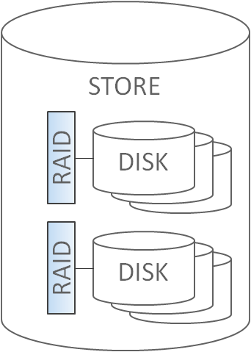
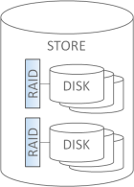
Fault response model
ESTABLISH PRIMARY
LOCATE
REPLICAS
SCHEDULE
COPY
OBJECT 332
OBJECT 124
-- SHORT --
OBJECT 265
OBJECT
034
OBJECT
265
OBJECT
124
OBJECT
332
OBJECT 034
OBJECT 192
-- WORK QUEUE--
COPY
COPY
X
Object copies scheduled by replica management routines
One copy per server in flight

Slide 15
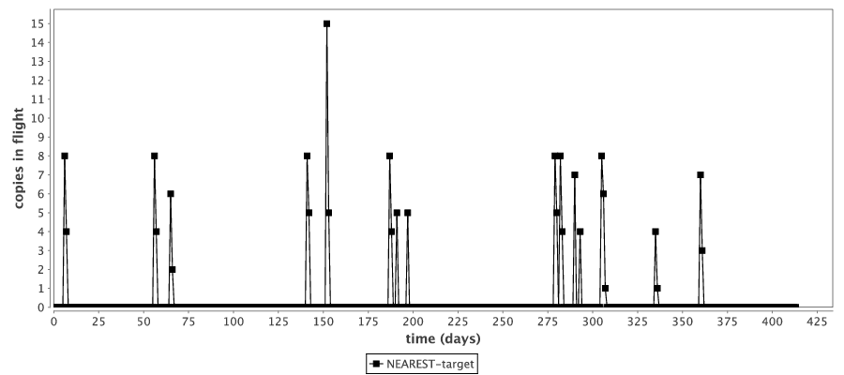
Disk failure rates
CMU study
Typically ~5%/year
Up to 13%
Google study
Below 5% in first year
Peaks near 10% in year 3
GOBS simulation of 32,000 disks in RAID 5 (4+1 ) Plot shows inter-node traffic due to RAID loss

Slide 16
Simple data placement is problematic
Combine local RAID with inter-node replication for availability
Local RAID is relatively faster for read-modify-write operations
Whole node loss – often temporary – managed with replicas
Replica chaining Simple, localized object placement On rebuild, creates a hot spot of activity | Large declustered RAIDs Fully distributed On rebuild, all nodes involved, all write to one new disk
SERVER
SERVER
NEW
SERVER
SERVER
SERVER
NEW
SERVER

Slide 17
GOBS Simulator

Slide 18
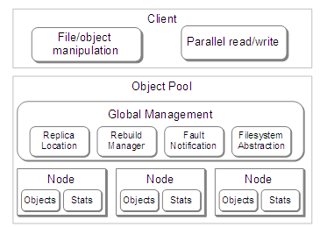
Simulation as initial approach
Simulated system
Workload simulation
Idealized control
Object servers

Slide 19
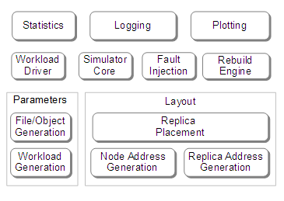
Software abstractions
General OBject Space (GOBS) simulator architecture
User interface
Core functionality
Replaceable components

Slide 20
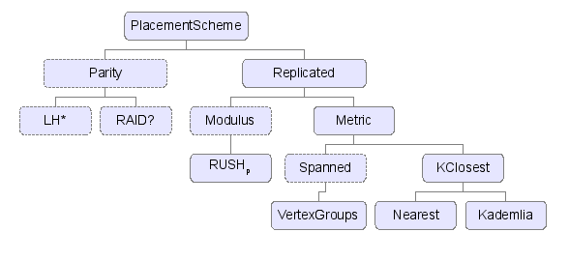
Simulator - extensibility
Extensible Java simulator
Heavy use of inheritance
Enable easy implementation of new schemes
Class hierarchy:

Slide 21
Preliminary results

Slide 22
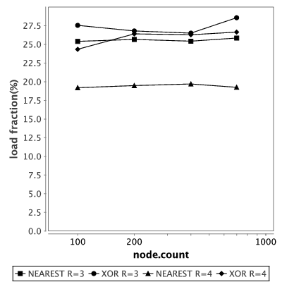
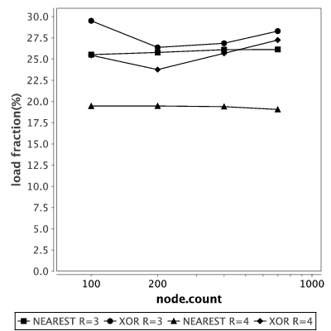
GOBS results – rebuild hot spots
600 servers; 30 TB disks; RAID 5 (4+1); disk transfer rate 400 MB/s;
1EB filesystem
Single fault induced – rebuild performed
Replica pulled from last in chain
Replica pulled from random node
Replica pulled from last in chain

Slide 23
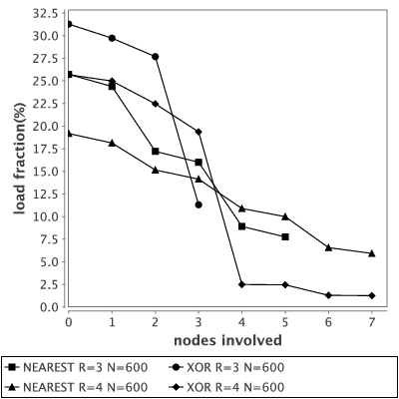
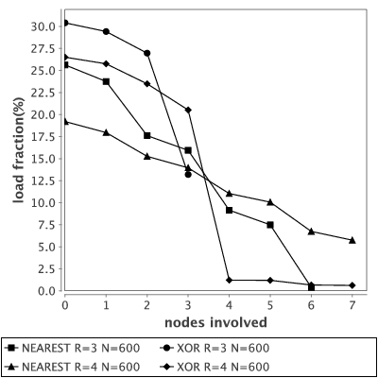
GOBS results – rebuild curves
Single fault induced – rebuild performed
Replica pulled from last in chain
Replica pulled from random node
Replica pulled from last in chain

Slide 24
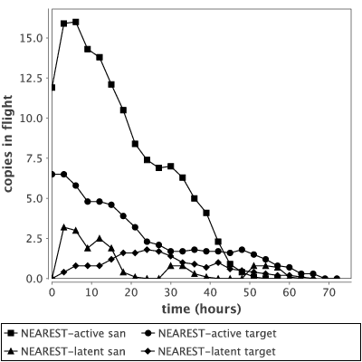
GOBS results – rebuild concurrency
Multiple faults induced – average traffic recorded
Replica pulled from primary
“target” – RAID (4+1)
“san” – RAID (8+2)
“active” – begin copies immediately
“latent” – wait until replacement is inserted

Slide 25
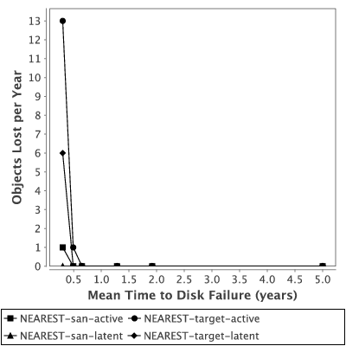
GOBS results – data loss
Vary disk MTTF and report objects lost per year
Neither scheme loses data unless MTTFs are extremely low
Indicates that aggressive schemes may be used that favor user accesses
(How does one quantify amount of data loss?)

Slide 26
GOBS: Summary
Data placement strategies matter when performing rebuilds
Rebuild time matters over long data lifetimes
Simulation can help evaluate placement strategies
Much more to do here…

Slide 27
Thanks
Grants: This research is supported in part by NSF grant OCI-721939, NIH grants DC08638 and DA024304-02, the Office of Advanced Scientific Computing Research, Office of Science, U.S. Dept. of Energy under Contracts DE-AC02-06CH11357 and DE-AC02-06CH11357. Work is also supported by DOE with agreement number DE-FC02-06ER25777.

Slide 28
Questions

